Slide 1

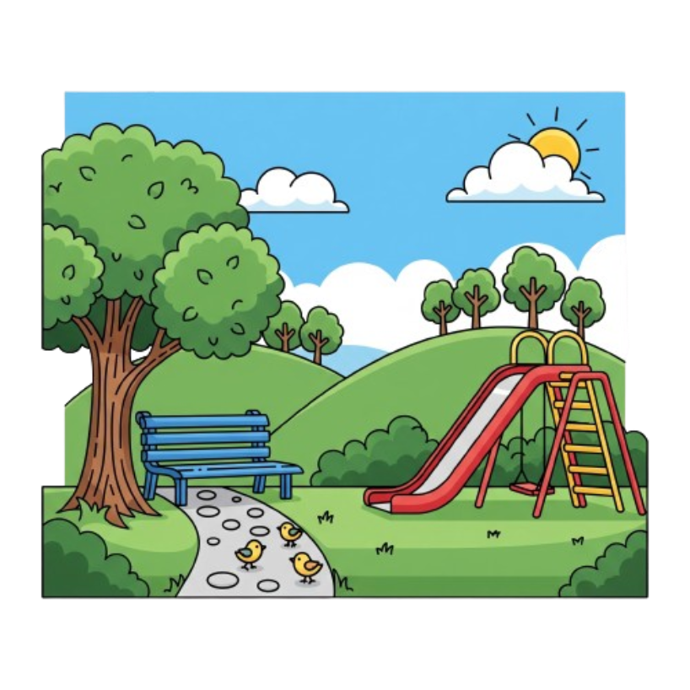
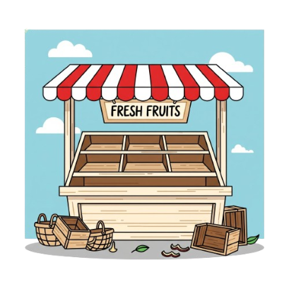
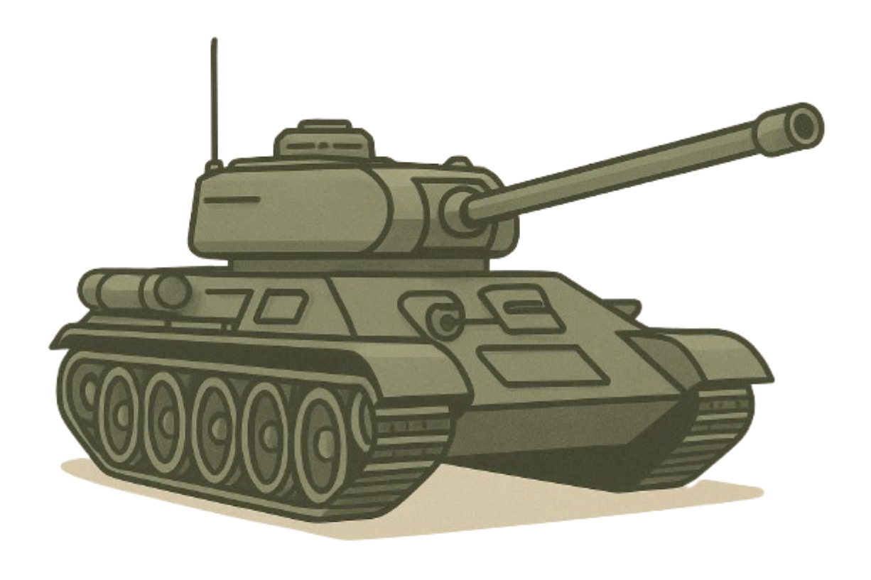
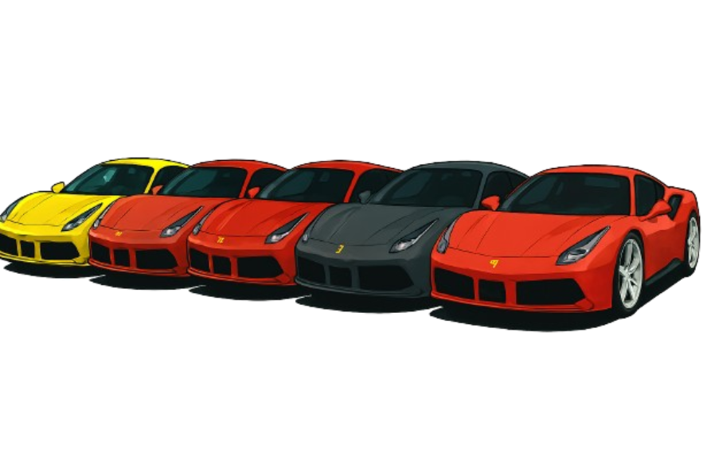
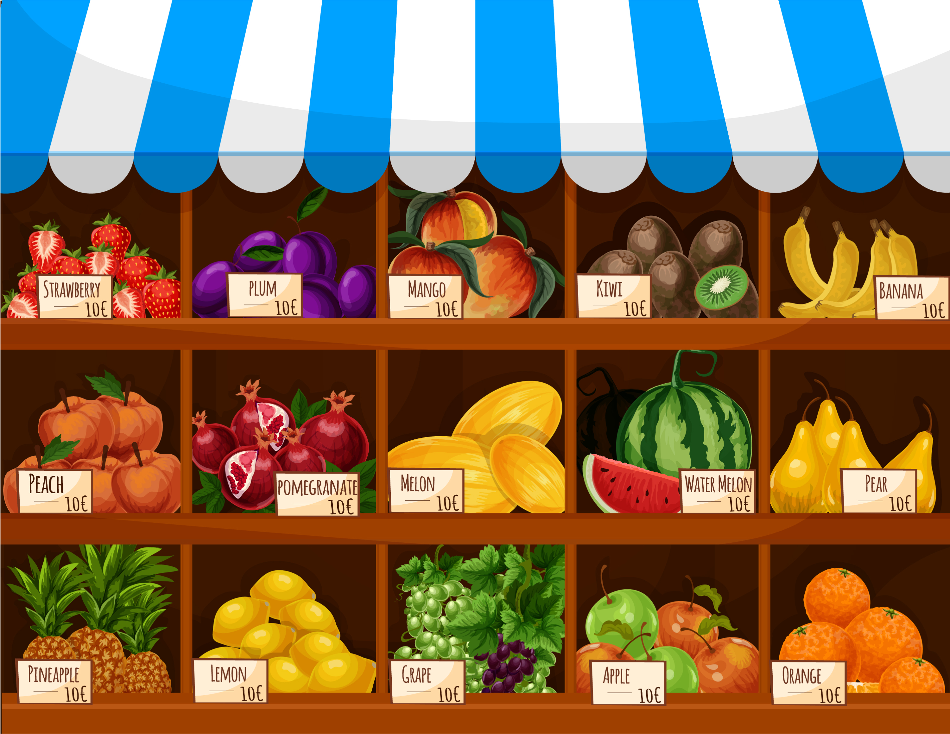
CED 1.1
Scarcity
Basic Economic
Concepts
Notes:
After completing this lesson, students should be able to:
Define scarcity as the condition that results from limited resources and unlimited wants.
Explain why scarcity exists for all individuals, businesses, and societies.
Identify characteristics of scarce and non-scarce items, including the presence or absence of opportunity cost and positive price.
Describe the four factors of production (land, labor, capital, and entrepreneurship) and explain how their scarcity leads to the scarcity of goods and services.
Illustrate trade-offs faced by individuals, businesses, and governments when allocating scarce resources.
Differentiate between scarcity and shortage, recognizing that scarcity is permanent while shortages are temporary market conditions.
Teacher Note:
This lesson establishes the foundation for the entire AP Economics course. Encourage students to connect these ideas to their everyday experiences - every choice they make (how they spend time or money) is an example of dealing with scarcity.

Slide 2
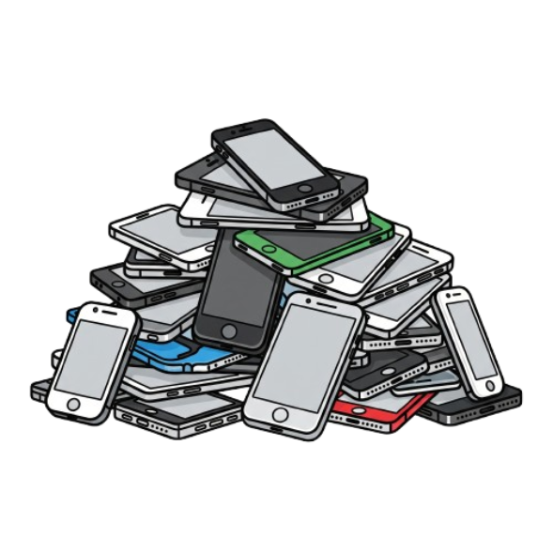
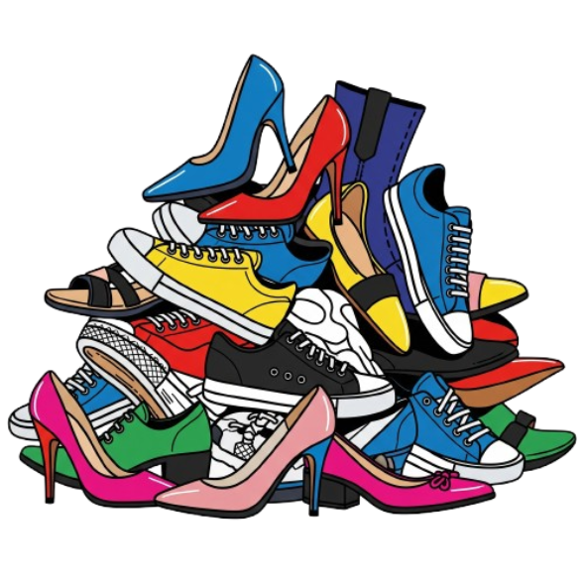
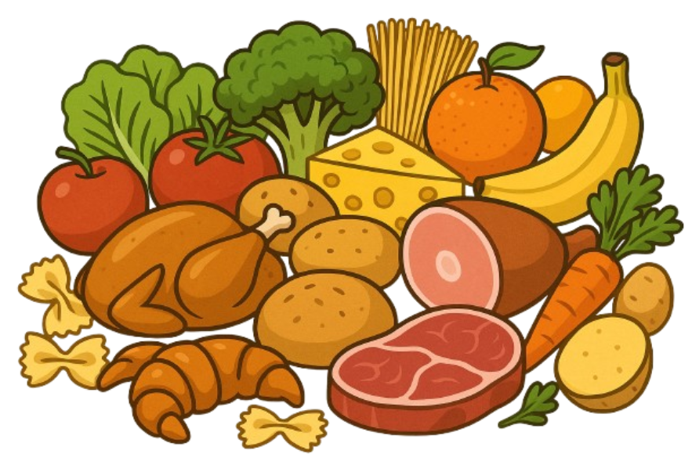
The Definition
Scarcity is the inability of limited resources to satisfy unlimited wants
If there is less than is wanted the item is scarce
Notes:
Main Objective:
Students should understand that scarcity is the foundational economic problem - there are limited resources and unlimited wants, and because of this mismatch, choices must be made.
Key Framing Idea:
“Scarcity doesn’t mean something is rare - it simply means there isn’t enough for everyone who wants it.”
You can be surrounded by resources and still experience scarcity.
Even an item that is very common can be scarce if more is wanted than is available.
How to Present the Slide:
Start by reading the definition aloud:
“Scarcity is the inability of limited resources to satisfy unlimited wants.”
Pause and emphasize:
Humans have infinite wants - more clothes, more food, more tech, more entertainment, better cars, better homes, more leisure time.
Point to the images at the bottom and connect them to scarcity:
Food: Even in grocery stores filled with food, there is still scarcity because not everyone can have as much food as they want.
Phones: Students might want the newest iPhone, but not everyone can afford one - scarcity.
Shoes: There may be thousands of shoes in a store, but more people want certain pairs than stores can provide at a given price.
Cars: High-end sports cars exist, but limited production and cost mean many people want them but can’t have them - scarcity.
Bring the focus back to the definition:
“If there is less than is wanted, the item is scarce.”
Engagement Prompts:
Ask:
“Think of something you would love to have more of - time, money, snacks, game consoles, vacation days, etc. Is there as much as you want?”
Then ask:
“So is that item scarce to you? Why?”
Follow-up:
“Even if a store has 500 PS5s, if 1,500 people want them - is that scarce? Yes - because not everyone can get one.”
Transition to Next Slide:
“Scarcity is very important in economics. Let find out why.”

Slide 3
The Definition
All societies and all people face scarcity
Scarcity is the fundamental
problem of economics
Notes:
Main Objective:
Students should understand that scarcity affects everyone and every society, regardless of wealth, technology, political system, or level of development.
Key Framing Idea:
“Scarcity is universal - no person, no business, and no country has enough of everything they want.”
How to Present the Slide:
Start by reading the top sentence aloud:
“All societies and all people face scarcity.”
Pause and emphasize:
Scarcity is not just a problem for poor countries or poor individuals.
Even wealthy nations experience scarcity - they still must decide how to allocate resources like land, labor, and physical capital.
Even billionaires face scarcity - they can’t buy more time, more attention, more land than exists, or every possible resource.
Make the big point clear:
Scarcity is the fundamental problem of economics.
Explain why:
Economics exists because scarcity forces choices.
If there were truly unlimited resources, economics would not be needed - everyone would get everything they wanted with no trade-offs.
Engagement Prompts:
Ask:
“Can you think of something that is scarce for everyone, rich or poor?”
Students will say: time, clean water, housing, attention, sleep, teachers, fossil fuels, etc.
Follow-up:
“Even if someone has a lot of money, can they buy more hours in a day? More land than exists? Infinite workers? No - that’s scarcity.”
Transition to Next Slide:
“Now that we understand scarcity affects everyone, the real question becomes: how do we know if something is scarce? Let’s look at the conditions that tell us whether an item is scarce.”

Slide 4


Is it scarce?
Items that are scarce:
Less of it than people want
It has a positive price
Opportunity cost involved in obtaining it
Goods and Services are Scarce
Notes:
Main Objective:
Students should learn the three conditions that tell us whether a good, service, or resource is scarce, and understand that both goods and services can be scarce.
How to Present the Slide:
Begin by reading the title:
“Is it scarce? Items that are scarce…”
Explain the first condition:
There is less of it than people want.
Clarify:
Scarcity isn’t about whether something is hard to find - it’s about whether the quantity people would like is greater than quantity available, at price of zero.
Even if there is a lot of something (food, cell phones, cars), if more is wanted than is freely available, it is scarce.
Scarcity doesn’t mean “rare”-it means limited compared to wants.
Introduce the second condition:
It has a positive price.
Explain:
If you must pay something to get it - money, time, effort - that suggests scarcity.
If something were not scarce at all, the price would be zero, and everyone could take as much as they want.
Prices are signals that resources are limited.
Introduce the third condition:
There is opportunity cost involved in obtaining it.
Remind students:
Opportunity cost means giving up the next best alternative.
Any time you spend money, time, or effort to obtain something, you’ve given something up - that proves scarcity.
Even services are scarce because workers’ time and skills are limited.
Connect to Goods and Services:
Point out the images:
Goods (like food and phones) are scarce because they take resources to produce and we can’t have unlimited amounts.
Services (like haircuts) are scarce because human labor and time are limited.
Say explicitly:
“Scarcity applies to more than objects - it applies to people’s skills, labor, time, and knowledge. Both goods AND services are scarce.”
This broadens students' understanding beyond physical items.
Engagement Prompts:
Ask students:
“What is something you bought recently? Did you have to give something up to get it - money, time, or energy?”
Follow-up:
“So if you had to give something up, that means it was scarce.”
Then ask:
“Do you think a haircut is scarce even though haircuts happen every day? Why?”
Students should note:
Time is limited.
Only so many haircuts can be performed per hour.
Workers’ skills are limited.
Transition to Next Slide:
“Now that we know how to identify scarcity, the real question becomes: are there items that are NOT scarce? Let’s look at the conditions for something that is truly not scarce.”

Slide 5



Is it scarce?
Items that are NOT scarce:
More of it than people want
Negative price
Can be obtained without a cost
Knowledge is not scarce - Non-rival
Notes:
Main Objective:
Students should understand that not everything is scarce, and be able to identify conditions under which an item is not scarce.
How to Present the Slide:
Begin by reading the title:
“Is it scarce? Items that are NOT scarce.”
Explain the first condition:
There is more of it than people want.
Clarify:
More is available than people want an there is no cost - it is not scarce.
Example: Air - we breathe as much as we want at a zero price.
Even though air is essential, it is not scarce because there is more of it than anyone demands.
Introduce the second condition:
Negative price.
Explain simply:
Sometimes you pay you to take it away.
Example: Trash - homeowners or businesses pay disposal services because trash has a negative value.
If something has a negative price, that means nobody wants it, even if it’s offered for free - therefore, it is not scarce.
Introduce the third condition:
It can be obtained without a cost.
Clarify:
If no opportunity cost is involved - no time, money, or effort - it is not scarce.
If you can have as much as you want without giving up anything, then it is not scarce.
Introduce the important exception:
Knowledge is not scarce - it is non-rival.
Explain:
Knowledge is different from physical goods - if you learn something, it doesn’t reduce the amount someone else can learn.
One person using an idea or a formula does not prevent another person from using it, which makes it non-rival.
Knowledge may take effort to create or communicate, but once it exists, it can be shared infinitely at a near-zero cost.
Engagement Prompts:
Ask students:
“Can you think of something that has no monetary cost (or a negative price) AND you can have as much as you want, without giving anything up?”
Then:
“Why is oxygen free but bottled oxygen is scarce?”
Guide them to see:
Air is freely available → not scarce.
Bottled oxygen takes resources and labor to produce → scarce.
Follow-up question:
“Can trash ever become scarce? Would that change how we think about its price?”
This encourages deeper thinking about market conditions.
Transition to Next Slide:
“Now that we see not everything is scarce, the next question becomes: why are goods and services scarce? The answer lies in the resources needed to produce them - and resources themselves are limited.”

Slide 6
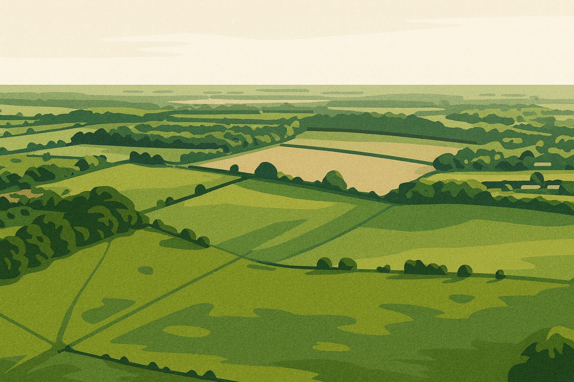



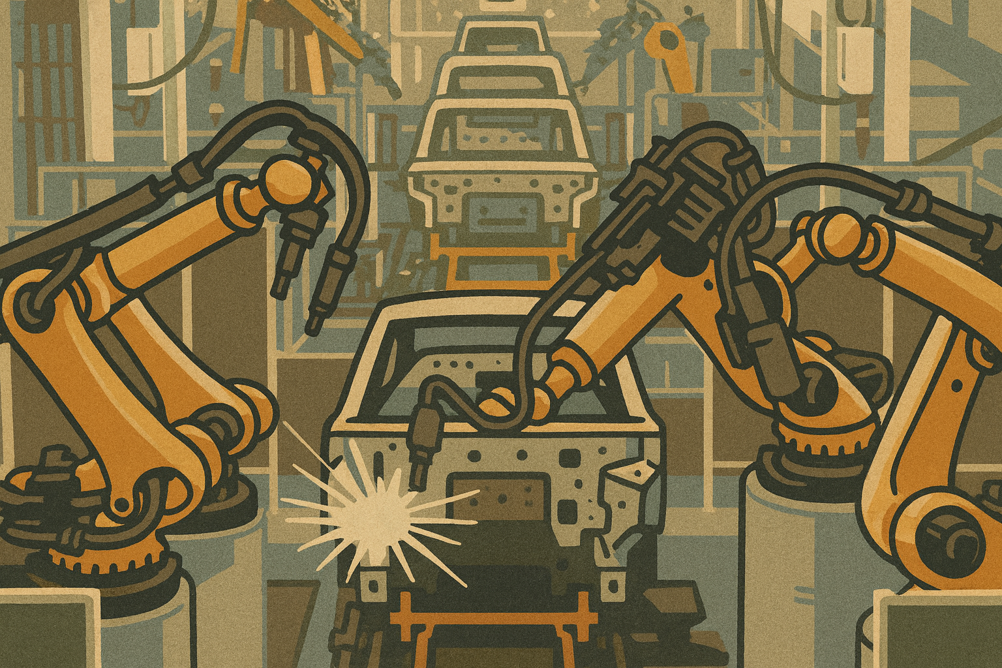



Resources
Goods and Services are scarce because resources (factors of production)are scarce
Land:
Resources from nature
Labor:
Mental or physical work from people
Capital:
Goods used to produce goods and services
Entrepreneurship:
Business owner who produces a product
Notes:
Main Objective:
Students should understand that goods and services are scarce because the resources used to produce them are scarce, and be able to name and describe the four factors of production.
Key Framing Idea:
“All goods and services are scarce because the resources required to make them are scarce. Since we can’t create unlimited land, labor, capital, or entrepreneurship, we can’t produce unlimited goods and services.
How to Present the Slide:
Start by reading the top line:
“Goods and services are scarce because resources - also called factors of production - are scarce.”
Clarify the key idea:
Every product we buy, every service we receive, requires inputs.
Those inputs are limited, which makes the final goods and services limited as well.
Explain Land:
“Land refers to all natural resources we get from nature.”
Examples:
Forests, farmland, oil, minerals, water, wind, sunlight.
Land isn't just ‘dirt’ - it's anything provided by the natural world.
Explain Labor:
“Labor is the physical or mental work performed by people.”
Examples:
Construction workers, doctors, teachers, software developers.
Labor is scarce because people’s time and ability are limited.
Explain Capital:
“Capital is goods used to produce other goods and services.”
Examples:
Machinery, factories, tools, trucks, computers.
Capital is not the same as money (though in Macro we will learn about “financial capital,” which is money).
Money buys capital - but money itself is not a productive resource.
Explain Entrepreneurship:
“Entrepreneurship is the business owner who combines land, labor, and capital to create a product while seeking a profit.”
Clarify:
Entrepreneurs take risk, make decisions, and organize production.
Without entrepreneurship, the other resources would not be used efficiently.
Reinforce:
“Every good or service - from apples to airplanes - requires all four factors.”
So if any one of these resources is scarce, production becomes scarce.
Engagement Prompts:
Ask:
“What is one resource that limits how much of a product a business can make?”
Then:
“Can you think of a good that becomes scarce if labor is scarce? What about if land is scarce?”
Examples students might mention:
Limited farmland → limited crops.
Labor shortage → fewer available services.
Lack of machinery → slow production.
Follow-up:
“If an entrepreneur quits or closes a business, what happens to goods and services?”
Helps students see dependency across all four factors.
Transition to Next Slide:
“Since resources are scarce, people, businesses, and societies can’t produce or consume everything they want. That leads us to the next key idea: we have to make trade-offs - choosing one thing means giving up something else.”

Slide 7


Trade-offs
Allocating scarce resources involves trade-offs
For Individuals
More
Video Games
Less
Yard Work
Notes:
Main Objective:
Students should understand that scarcity forces individuals to make trade-offs, meaning choosing more of one thing requires giving up something else.
Key Framing Idea:
“When an individual, business, or government chooses to use its scarce resources in one way, it automatically gives up the opportunity to use those same resources in another valuable way.”
How to Present the Slide:
Start by reading the title:
“Allocating scarce resources involves trade-offs.”
Clarify what “allocating” means:
People must decide how to use their limited time, money, and effort.
Introduce the example shown:
“Here’s a trade-off that individuals face every day.”
Explain the images:
More video games - using time for entertainment.
Less yard work or chores - but this means something else doesn’t get done.
Make it relatable:
Ask students how many have ever ignored chores to do something more fun.
Reinforce that this is exactly what economics studies - choices under scarcity.
Highlight the key idea:
“Every choice has a trade-off - choosing one option means giving up another.”
Connect to earlier concepts:
Scarcity limits time, energy, money.
Because of this limitation, we can’t do everything, so decisions involve sacrifice.
Engagement Prompts:
Ask:
“What is something you chose to do last weekend instead of something else?”
“What did you give up to do that?”
Then ask:
“If you spend more time gaming, what happens to your homework, sleep, chores, fitness?”
Follow-up:
“Economics isn’t just about money - it’s about how we decide what to do with scarce resources like our time.”
Transition to Next Slide:
“We’re not the only ones who face trade-offs - businesses also have to choose how they use scarce resources. Let’s look at examples from the business world.”

Slide 8
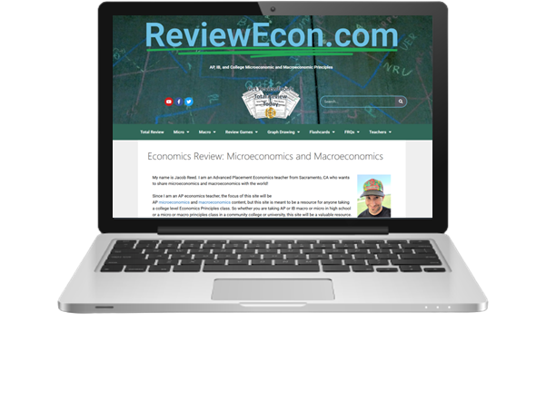
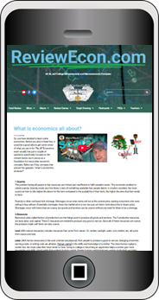
Trade-offs
Allocating scarce resources involves trade-offs
For Businesses
More
Laptops
Fewer
Cellphones
Notes:
Main Objective:
Students should understand that scarcity forces individuals to make trade-offs, meaning choosing more of one thing requires giving up something else.
How to Present the Slide:
Start by reading the main idea:
“Allocating scarce resources involves trade-offs.”
Explain that businesses face trade-offs just like individuals do, but the scale and purpose are different:
Instead of choosing between fun activities and chores, businesses must choose what to produce with their scarce resources.
Introduce the business example on the slide:
“A business that makes technology products might decide to produce more laptops.”
Then explain the trade-off:
If they choose to produce more laptops, that means they have fewer resources left to produce cellphones.
Time, labor, machinery, and materials are scarce, so producing more of one item means producing less of another.
Clarify the economic reasoning:
“Businesses want to use their scarce resources where they can make the most profit or best serve their customers.”
Connect to earlier concepts:
Scarcity exists because labor, materials, and machinery are limited, and businesses cannot produce unlimited amounts of every good.
This is why companies specialize or focus on certain products and not others.
Engagement Prompts:
Ask students:
“If you owned a factory, would you focus on laptops, phones, or something else? Why?”
“What would you have to give up to make more of one product?”
Follow-up:
“How do companies decide what to produce more of? (Students may suggest profit, popularity, or customer demand.)”
Then reinforce:
“Because resources are limited, every business decision has a trade-off - just like personal decisions.”
Transition to Next Slide:
“Individuals and businesses face trade-offs, but so do governments. When governments use tax dollars, they also have to choose which programs to fund - which means giving up something else. Let’s look at government trade-offs next.”

Slide 9
Trade-offs
Allocating scarce resources involves trade-offs
For Governments
More
Guns
Less
Butter
Notes:
Main Objective:
Students should understand that scarcity forces governments to make trade-offs, meaning choosing more of one thing requires giving up something else.
How to Present the Slide:
Start by rereading the main idea:
“Allocating scarce resources involves trade-offs.”
Explain that governments face trade-offs just like individuals and businesses, but the consequences affect entire societies:
“Governments must decide how to spend tax dollars - and because resources are limited, spending more in one area means spending less in another.”
Introduce the classic economic example shown on the slide:
“This example is known as the ‘guns vs. butter’ model.”
Explain the analogy clearly:
“Guns” represent government spending on the military, national defense, or weapons.
“Butter” represents spending on civilian goods and services, like parks, education, healthcare, or public safety.
Then deepen the reasoning:
“If a government chooses to build more tanks or increase military spending, it has fewer resources left to spend on playgrounds, schools, or social programs.”
Connect this to scarcity:
“Governments have limited tax revenue, labor, and materials. They can’t meet every possible want for the military and for civilians. Scarcity forces them to make a trade-off.”
“Economists often use the guns vs. butter model when explaining big political decisions, especially during wartime - when governments shift resources toward national defense and reduce spending on civilian goods.”
Engagement Prompts:
Ask students:
“If a country feels very unsafe or under threat, what might it spend more money on - guns or butter?”
“What trade-offs would that cause for citizens?”
“If a society wants more parks, playgrounds, hospitals, and schools, where might funding come from?”
Follow-up:
“Can a government produce unlimited tanks, unlimited schools, unlimited roads, and unlimited healthcare? Why not?”
Let students naturally connect back to scarcity:
“Because resources are scarce, governments must prioritize.”
Transition to Next Slide:
“Now that we understand that scarcity causes trade-offs for individuals, businesses, and governments, we need to make an important distinction: scarcity is not the same thing as a shortage. Our next slide explains the difference.”

Slide 10
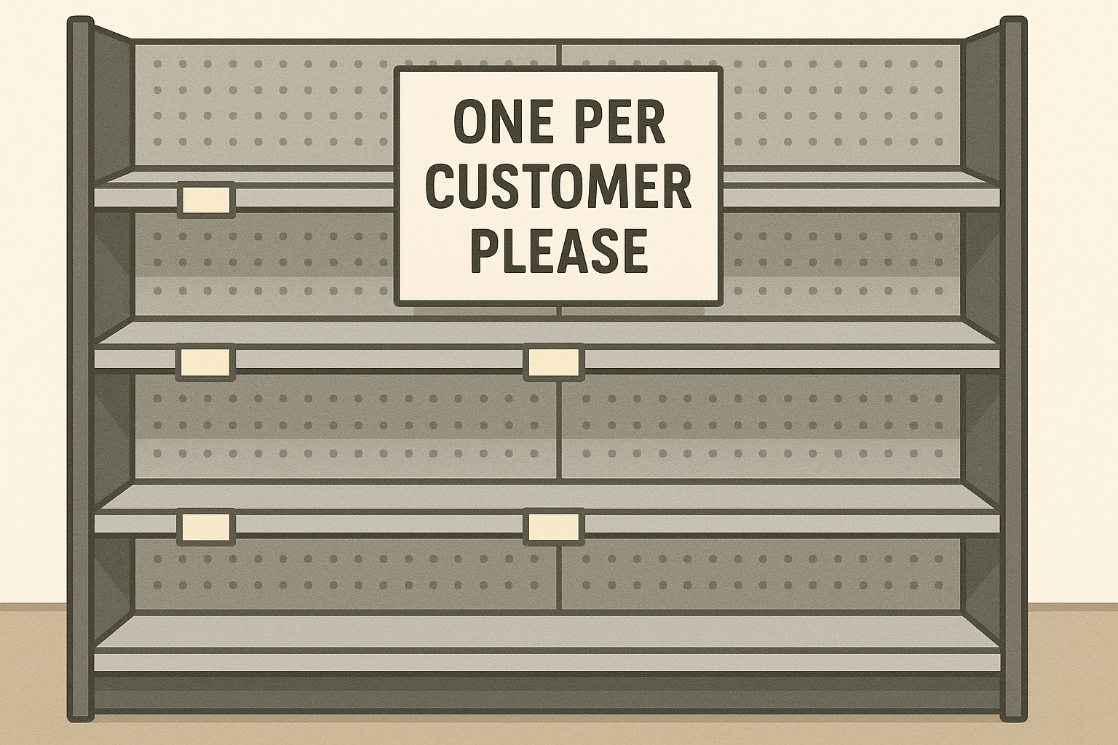
Scarcity vs Shortage
Shortage is not the same as Scarce
Scarcity:
-Less available than people desire
-Pervasive and permanent
Shortage:
-Quantity supplied is less than quantity demanded at the current price
-Temporary market condition
With a shortage,
prices increase or we run out
Notes:
Main Objective:
Students should understand that scarcity and shortage are not the same concept, and that scarcity exists permanently while shortages are temporary market conditions.
Key Framing Idea:
“Scarcity is about unlimited wants and limited resources - it never goes away.”
Shortages happen when quantity supplied at the current price is not enough to meet demand.
Prices rise or shelves empty during a shortage, but the underlying scarcity of resources still remains.
How to Present the Slide:
Start by reading the large title:
“Scarcity vs. Shortage - Shortage is not the same as scarce.”
Clarify scarcity first using the wording on the slide:
Scarcity: Less available than people desire.
Explain:
“Scarcity exists all the time because resources are always limited relative to our wants. That’s true for food, clothes, phones, and almost everything produced.”
Tell students scarcity is pervasive and permanent and connects directly to limited resources:
“Even if a store is fully stocked, goods are scarce in the economic sense because producing them always requires land, labor, and capital - all of which are limited and scarce.”
Shift to the second definition on the slide:
Shortage: Quantity supplied is less than quantity demanded at the current price.
Explain shortages as temporary market conditions:
“A shortage happens when the price is too low for how many people want to buy the product - or when producers didn’t make enough.”
Use the images of empty shelves as an example:
“If there’s a shortage of apples at a store, shelves empty or stores ration the product. That’s because more people want the apples at the current price than the store has available.”
Clarify how markets respond to shortages:
“With a shortage, prices tend to increase. Higher prices reduce demand and encourage producers to supply more - eventually ending the shortage.”
Reinforce the core difference:
“Scarcity never ends - shortages do end as prices rise or production increases.”
Engagement Prompts:
Ask:
“What products have you seen shortages of in real life? Toilet paper during COVID? Popular holiday toys? Concert tickets?”
Follow-up:
“Why do shortages often cause prices to rise or stores to limit how much each person can buy?”
Then ask:
“Can a product be scarce even when shelves are full?”
Students should answer: YES, because resources are scarce even if the store currently has inventory.

