Slide 1

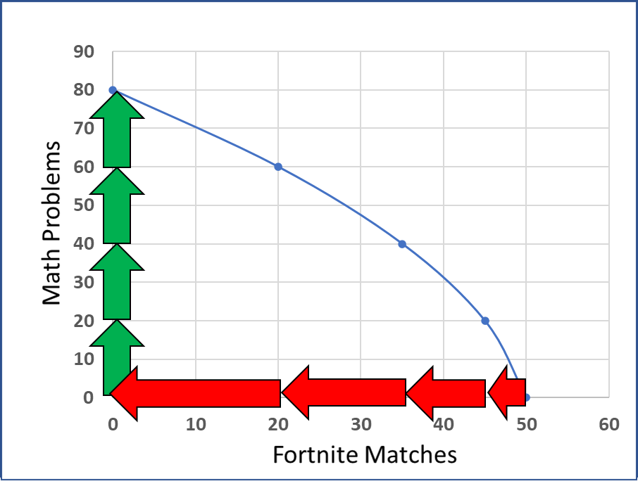
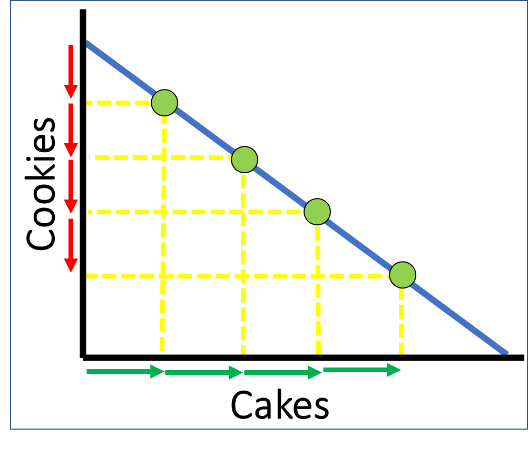

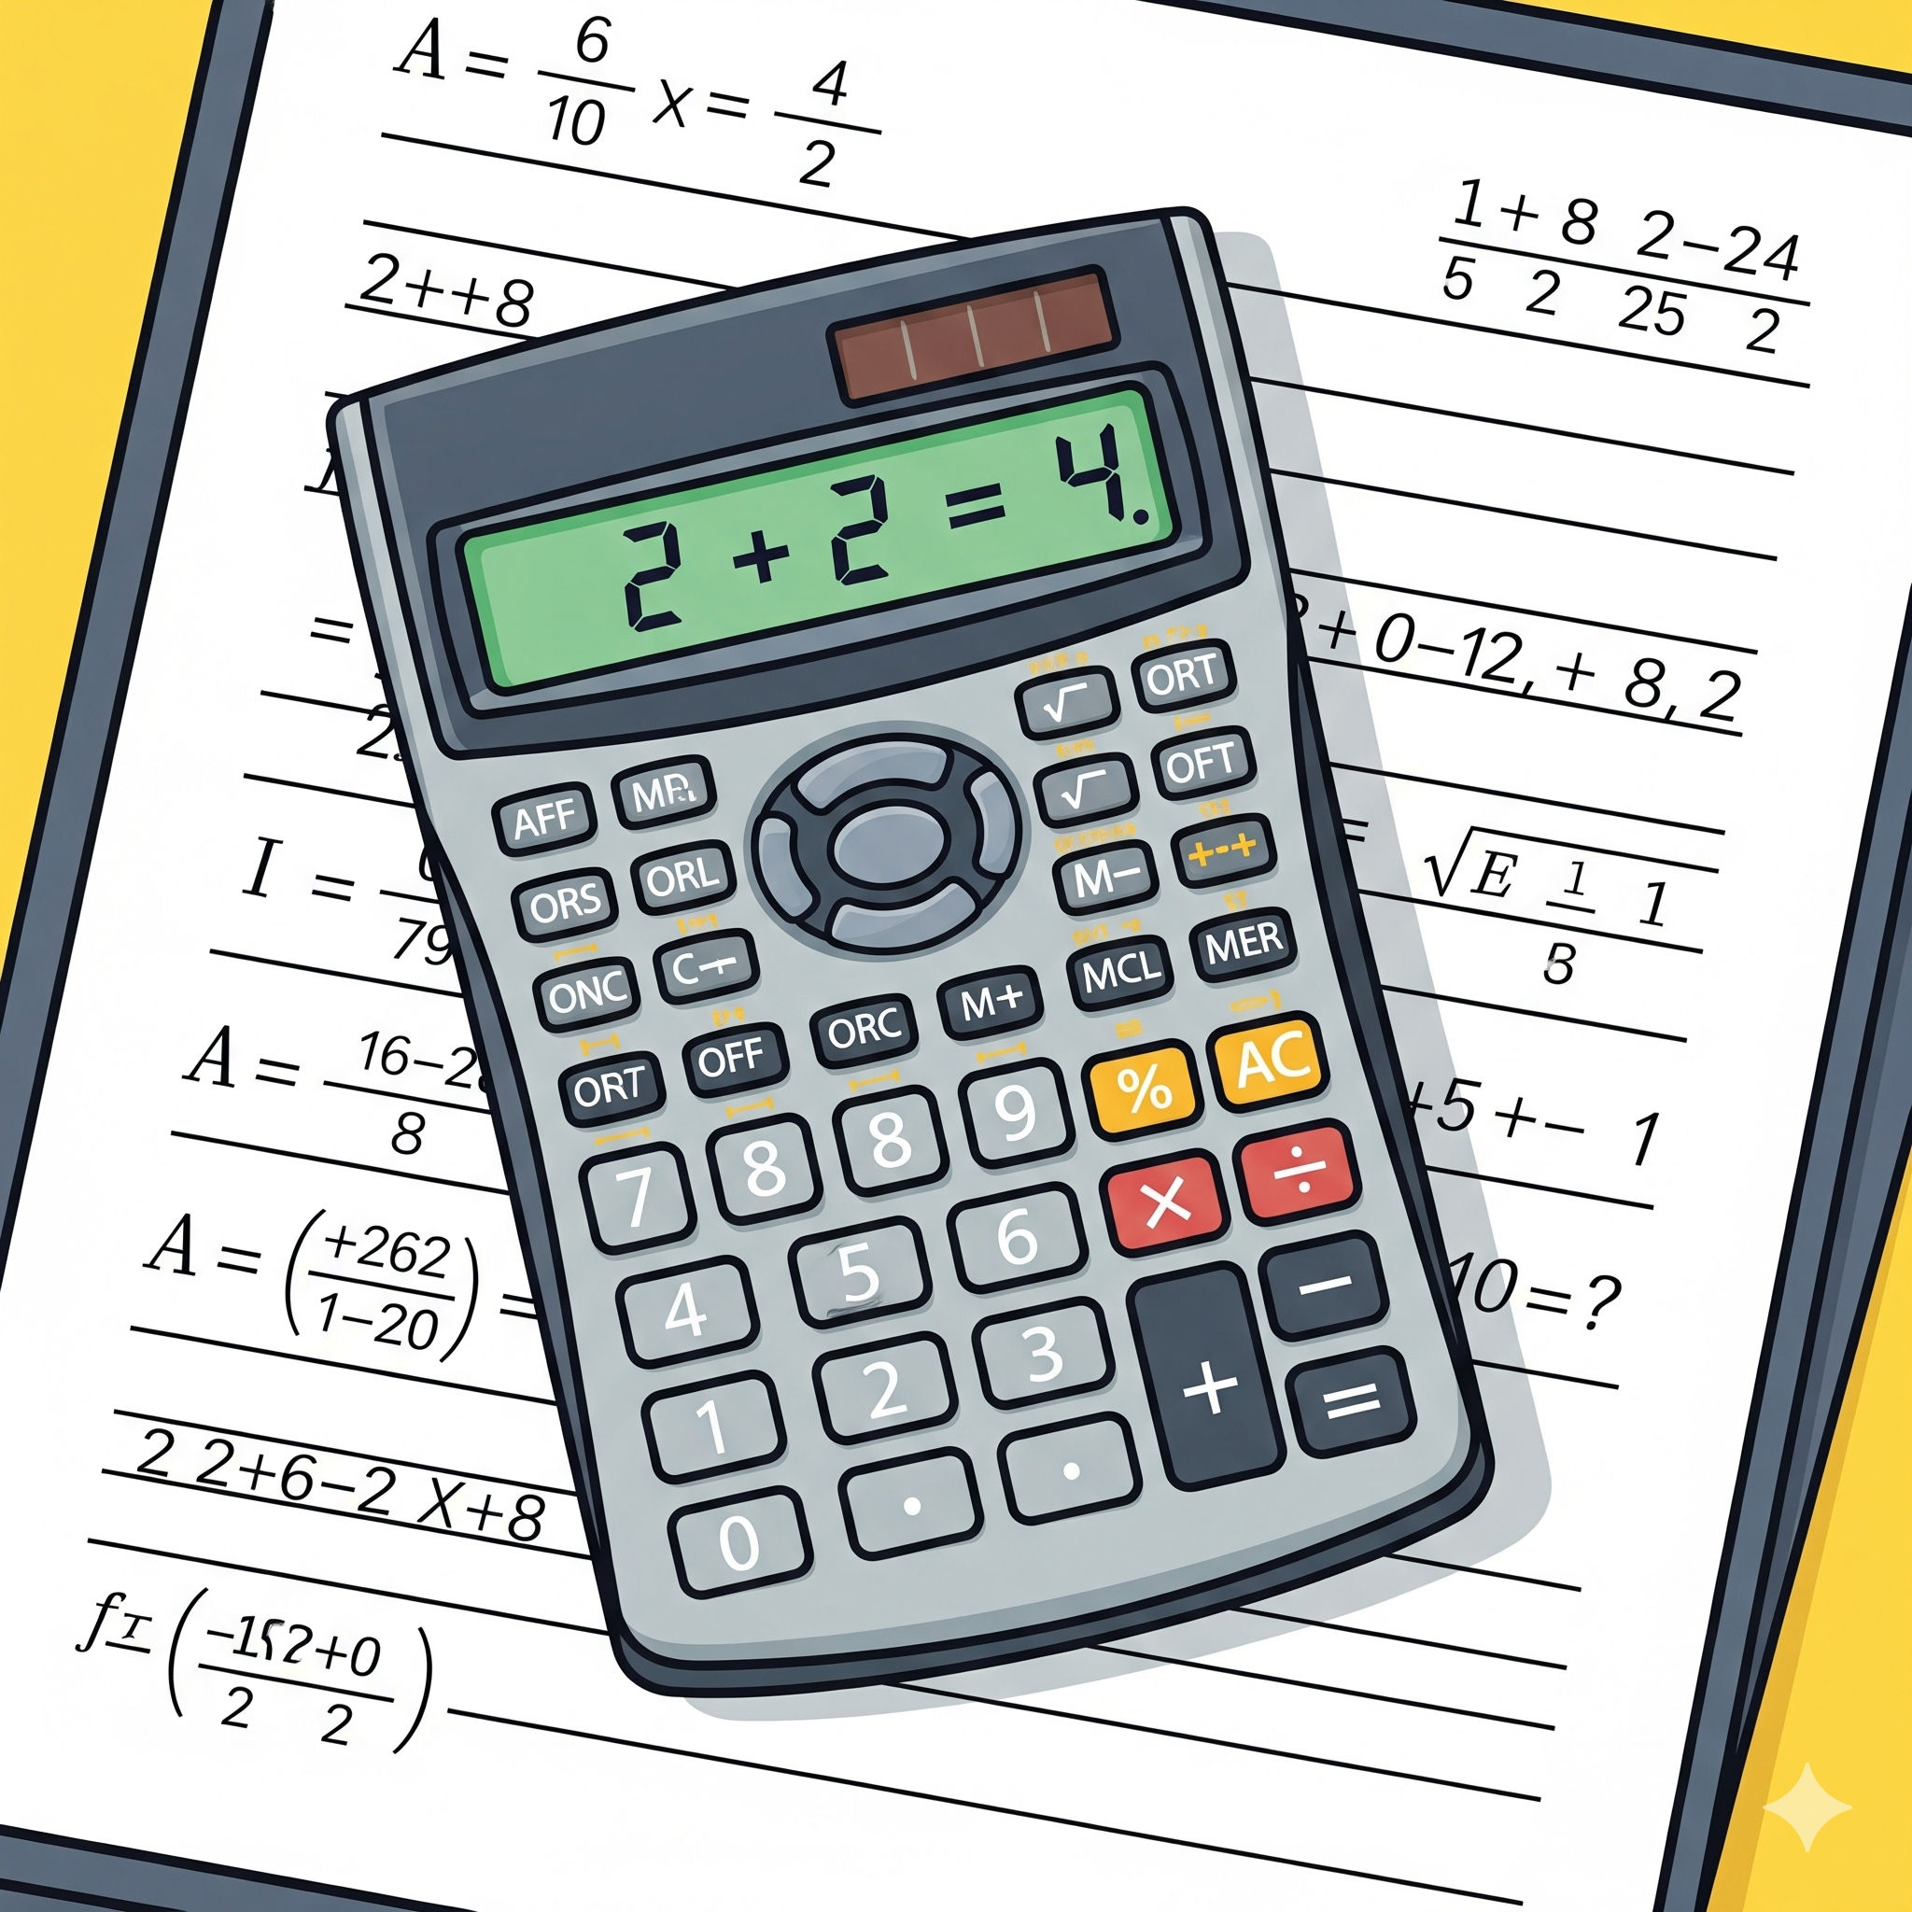
CED 1.3
Production Possibilities
Basic Economic
Concepts
Notes:
After completing this lesson, students should be able to:
Define the Production Possibilities Curve (PPC) as a model that illustrates tradeoffs resulting from scarcity.
Explain how the PPC shows the concepts of opportunity cost, efficiency, and economic growth.
Distinguish between efficient, inefficient, and unattainable points on a PPC.
Differentiate between constant opportunity costs (linear PPC) and increasing opportunity costs (concave PPC).
Analyze how movements along the curve represent changes in production choices between two goods.
Describe how shifts of the curve reflect changes in the quantity or quality of resources or in technology.
Apply the PPC model to individual, business, and national examples (e.g., math vs. Fortnite, laptops vs. cellphones, consumer vs. capital goods).
Interpret how changes on or within the PPC relate to economic growth, recession, and recovery in macroeconomics.
Teacher Note:
This lesson builds directly on the concept of scarcity by introducing students to the first major economic model they will use throughout the course. Emphasize that the PPC is a visual representation of tradeoffs - showing that every choice involves giving up something else. Encourage students to connect the PPC to real-world examples of decision-making, such as balancing time, business investment, or national economic policy.

Slide 2
What is it?
The production possibilities curve is a graph that shows all combinations of two goods or categories of goods that can be produced with fixed resources.
Notes:
Main Objective:
Students should understand that the PPC is a graphical tool used to show the combinations of two goods or categories of goods that can be produced using all available resources efficiently.
Key Concepts to Emphasize:
The PPC represents scarcity (limited resources).
It represents choice (different combinations of goods).
It represents trade-offs (increasing one good means producing less of another).
The resources are assumed to be fixed and fully employed - meaning the economy is using all its available inputs efficiently.
How to Explain the Text:
Read the definition slowly and highlight key phrases:
“All combinations of two goods or categories of goods” → helps students see that PPCs are flexible; the two “goods” could be anything from consumer vs. capital goods to Fortnite time vs. homework time.
“Produced with fixed resources” → resources don’t change in quantity or quality during the model; this keeps the graph simple.
Connection to Prior Knowledge:
Link back to scarcity and trade-offs from the previous presentation.
Explain that the PPC is a visual model showing the same problem - limited resources force choices.
Engagement Prompt:
Ask students: “If we can’t have everything, what might we have to give up to get more of something else?”
Prepare them for the next slide’s example (math homework vs. Fortnite rounds) by noting that individuals, not just societies, face production trade-offs.
Transition to Next Slide:
“Now that we know what the PPC represents, let’s look at an example that’s closer to your everyday life - how a student might ‘produce’ schoolwork and leisure time.”

Slide 3
What is it?
Imagine you have just two things to do with your labor after school
Math Problems
Rounds of Fortnite
Notes:
Main Objective:
Students should begin to see how the PPC reflects choices that result from scarcity - in this case, scarce time and energy after school.
Key Framing Idea:
“You can’t do everything at once - time is limited, and choosing one thing means giving up something else.”
The PPC models that decision-making process.
This simple example sets the stage for understanding the trade-offs that shape every PPC.
How to Present the Slide:
Start by reading the text:
“Imagine you have just two things to do with your labor after school.”
Emphasize that in economics, “labor” doesn’t only mean factory work - it’s any productive use of effort or time.
Introduce the two options:
Math Problems (left image): represents productive academic work.
Rounds of Fortnite (right image): represents leisure - still a use of time but not contributing to homework output.
Both require the same scarce resource: the student’s time and attention.
Connect to Scarcity:
Time after school is limited - say, two hours.
The student must decide how to divide that time between math and Fortnite.
Doing more of one means doing less of the other - this is the foundation of a trade-off.
Engagement Prompts:
Ask: “If you had two free hours after school, how might you divide your time?”
Then ask: “Could you do both perfectly - all the math problems and all the Fortnite rounds?” (Students will usually laugh and say no - perfect segue to scarcity.)
Follow-up: “So if you spend more time gaming, what happens to your math progress? That’s the trade-off we’re going to graph next.”
Transition to Next Slide:
“Now that we’ve described the trade-off in words, let’s put some numbers to it and see what it looks like on a graph - our very first Production Possibilities Curve.”

Slide 4
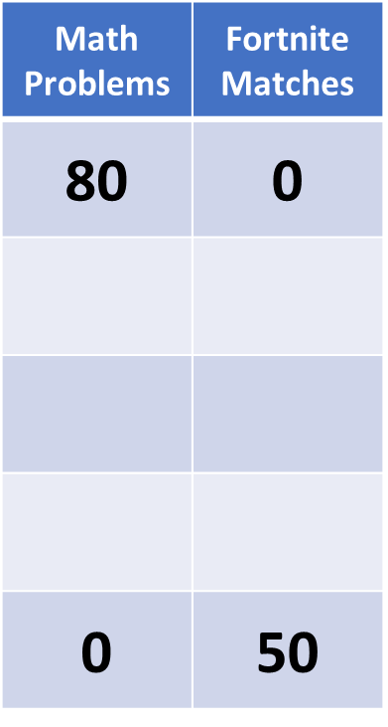
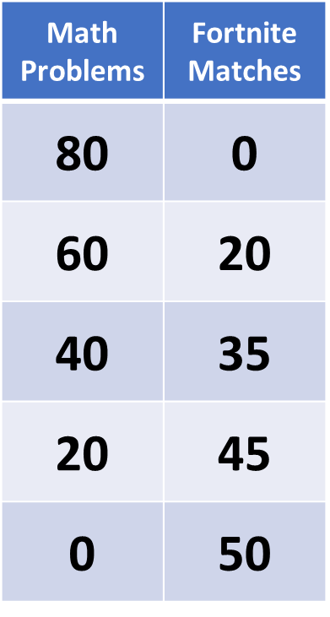
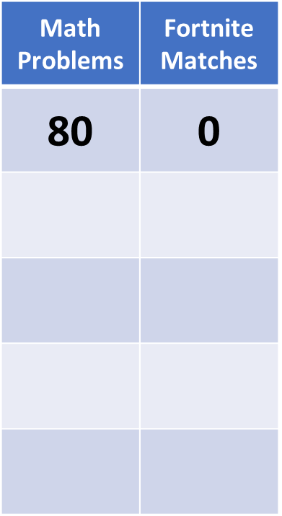
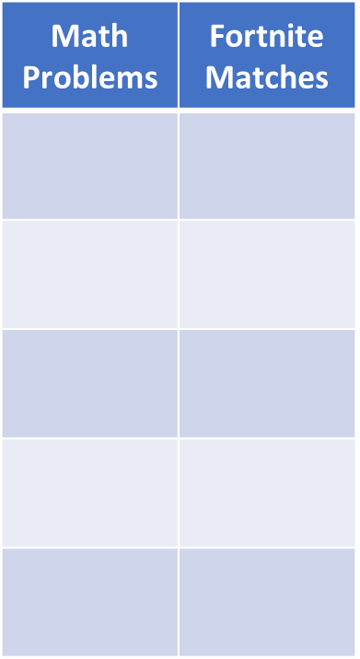
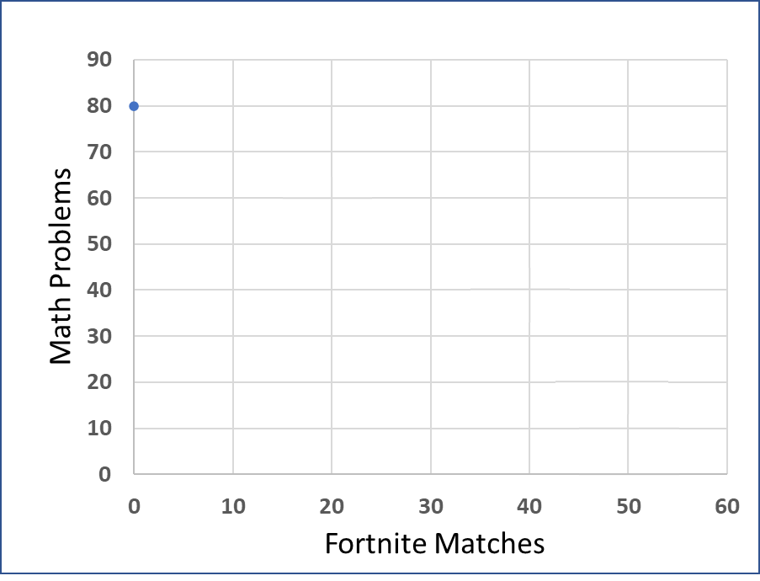
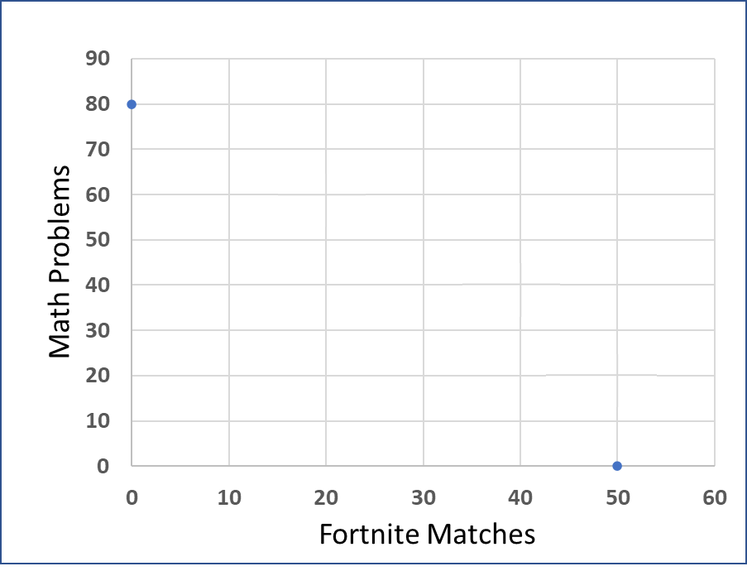
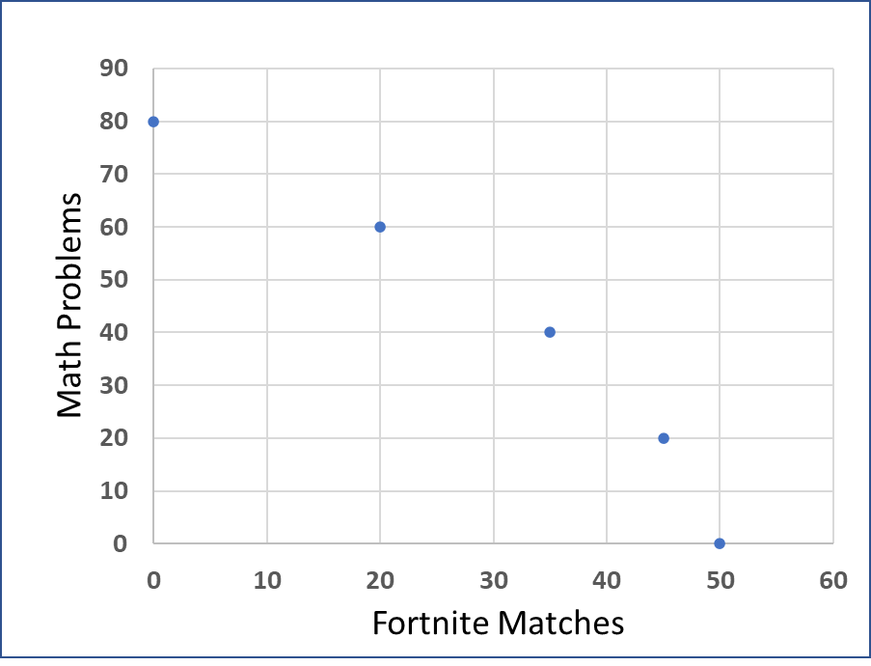
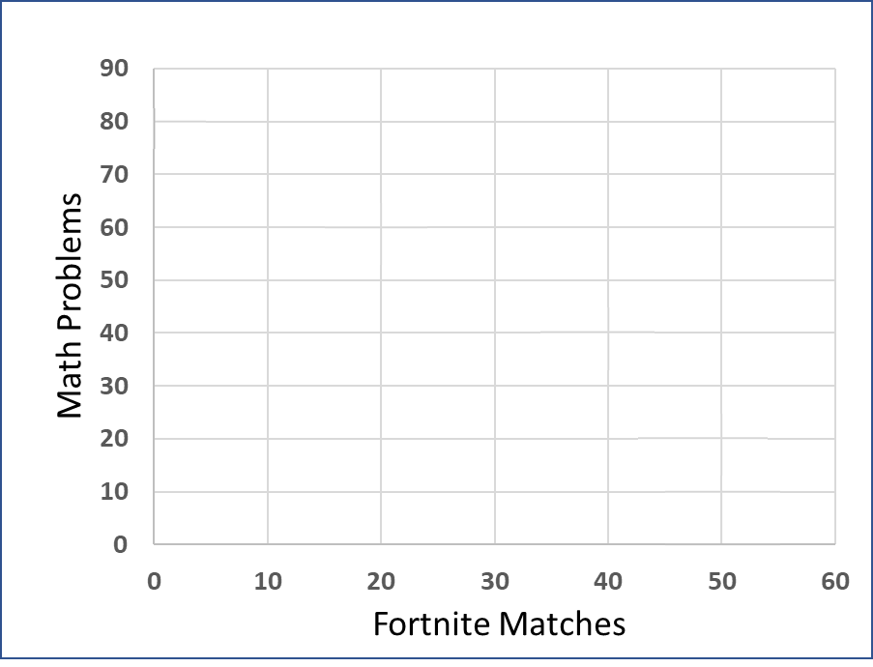
What is it?
Notes:
Main Objective:
Students should understand that each row in the table and each point on the graph represents a possible allocation of scarce resources.
The student can choose any one of these combinations, but not all at once.
These options illustrate the trade-offs available when resources (in this case, time after school) are fully used.
How to Walk Through the Slide:
Start with the Table (left side):
Read the first row: “If the student spends all their time on math problems, they complete 80 problems and play 0 Fortnite matches.”
Then the last row: “If they spend all their time playing Fortnite, they can play 50 matches but complete 0 math problems.”
These represent the two extremes - total focus on one good or the other.
Point out the middle rows - these show realistic trade-offs between the two.
Highlight the Pattern:
As the student plays more Fortnite, the number of math problems they can complete decreases.
Ask students: “Why does that happen?”
Guide them to recognize time as the scarce resource that must be divided between the two activities.
Connect to the Graph (right side):
Point out how each combination in the table is plotted as a dot on the graph.
“Each dot shows one possible use of the student’s time - one combination of math and Fortnite.”
Emphasize the axes:
X-axis: Fortnite Matches (leisure)
Y-axis: Math Problems (productive work)
This graph visualizes the same data as the table - it just helps us see the trade-offs more clearly.
Introduce Key Vocabulary:
Scarcity (limited time)
Choice (selecting between options)
Trade-offs (giving up one good to get more of another)
Engagement Prompts:
“If this student wanted to do 60 math problems, how many Fortnite rounds could they play?”
“What happens if they want to play 50 rounds and do 80 math problems?” (Helps them see that’s impossible given their limited time.)
“Does this table show inefficiency anywhere? Or are these all efficient uses of time?”
Transition to Next Slide:
“These dots show all the possible combinations our student can produce with their time - now let’s connect them to form the Production Possibilities Curve, which shows efficiency, trade-offs, and limits all at once.”

Slide 5
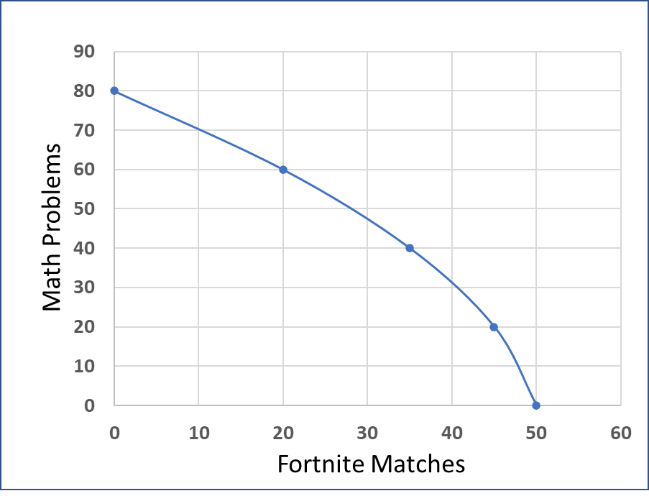
What is it?
Notes:
Main Objective:
Students should understand that the PPC illustrates scarcity, choice, and efficiency all in one model.
The curve itself shows maximum possible output combinations.
Points on the curve represent efficient use of resources.
Points inside the curve represent inefficiency (unused resources).
Points outside the curve are unattainable given current resources and technology.
How to Present the Slide:
Start by Reviewing the Table and Points:
Briefly remind students that each dot comes from the combinations in the table.
“We already saw these points plotted-now we’re connecting them to see what’s possible when resources are fully used.”
Introduce the Curve:
Explain that connecting the points forms the Production Possibilities Curve.
Emphasize that this curve shows the boundary between what is possible and impossible given the student’s limited time.
“Every point on this line represents a different choice about how to spend time - every one of them uses all the available time efficiently.”
Reinforce Core Economic Ideas:
Scarcity: Time is limited, so the curve exists.
Choice: The student must pick a point on the curve - they can’t have all of both goods.
Trade-offs: Moving along the curve means gaining one good but losing some of the other.
Engagement Prompt:
“Which combination might this student actually choose, and why?” → Encourage reasoning about personal preferences and priorities.
Transition to Next Slide:
“Now that we have our full PPC, let’s take a closer look at what happens when we move along this curve - the trade-offs and opportunity costs that result from shifting between math problems and Fortnite matches.”

Slide 6
Trade Offs
Math Problems | Fortnite Matches
80 | 0
60 | 20
40 | 35
20 | 45
0 | 50
More math means less Fortnite
Notes:
Main Objective:
Students should recognize that the PPC is not just a picture - it represents decisions.
Every move along the curve shows a trade-off between two competing uses of scarce time or resources.
Key Concept:
When resources are fully employed, producing (or doing) more of one thing means doing less of another.
In this example, time is the scarce resource.
If the student wants to complete more math problems, they must reduce the time spent playing Fortnite.
How to Present the Slide:
Start with the Table (Left):
Point out the change between two rows.
Example:
Moving from 40 math problems and 35 Fortnite matches → to 60 math problems and 20 Fortnite matches.
Ask students what the student had to give up to get those extra math problems (Answer: 15 Fortnite matches).
This lost activity represents the trade-off.
Use the Graph (Right):
Draw attention to the yellow arrow.
Explain that the arrow shows movement up and left along the PPC.
“Moving up the curve means spending more time studying - completing more math problems - but because time is limited, there’s less time left for Fortnite.”
Emphasize that every point on the curve uses all available time efficiently.
Phrase to Emphasize:
“More math means less Fortnite.”
Simple, memorable, and perfectly captures the essence of a trade-off.
Transition to Next Slide:
“Now, let’s look at the reverse - what happens if the student decides to play more Fortnite? What do they have to give up?”

Slide 7
Trade Offs
Math Problems | Fortnite Matches
80 | 0
60 | 20
40 | 35
20 | 45
0 | 50
More Fortnite means less math
Notes:
Main Objective:
Students should understand that moving down and to the right along the PPC represents producing (or doing) more of one good and less of the other - demonstrating opportunity cost in the other direction.
How to Present the Slide:
Review the Table (Left):
Start with a combination like 60 math problems and 20 Fortnite matches.
Compare it to the next row down: 40 math problems and 35 Fortnite matches.
Ask: “If the student plays more Fortnite, what happens to the number of math problems completed?”
→ Answer: It drops from 60 to 40.
This shows a clear trade-off - more Fortnite = less math.
Discuss the Graph (Right):
Point out the yellow arrow moving down and right.
Explain that this direction means shifting time and effort away from math and toward gaming.
Reinforce that the student is still on the PPC - still using all their time - but in a different way.
Engagement Prompts:
“If you were this student and decided to play 15 more rounds of Fortnite, how many math problems would you have to give up?”
“Would your choice depend on how much you enjoy Fortnite versus how much your grade depends on math homework?”
(This adds a human element to the economic model - showing that opportunity costs vary by preferences and priorities.)
Transition to Next Slide:
“Now that we can see both directions of trade-offs, let’s put some numbers to these choices and calculate the opportunity cost of doing more math.”

Slide 8
Opportunity Costs
Opportunity Cost is the cost of a choice
Math Problems | Fortnite Matches
80 | 0
60 | 20
40 | 35
20 | 45
0 | 50
Opportunity Cost of 20
20 – 0 = 20
Benefit of 20
80 - 60 = 20
Opportunity Cost of 5
50 – 45 = 5
Benefit of 20
20 - 0 = 20
Notes:
Main Objective:
Students should see that the opportunity cost of doing more math is the Fortnite matches given up.
The table illustrates both the benefit gained (math problems) and the opportunity cost (lost Fortnite rounds).
Key Concept:
Opportunity cost = what you give up or what you sacrifice to gain something else.
In this example, the student gains more completed math problems but gives up time that could’ve been spent playing Fortnite.
The PPC visually shows this as movement up and left along the curve.
How to Present the Slide:
Start with the Definition:
Point out the line at the top: “Opportunity cost is the cost of a choice.”
Ask: “What does it mean that every choice has a cost?”
Emphasize: Even if the student isn’t paying money, there’s still a cost - time, enjoyment, or another activity.
Discuss the First Example (Top of the Table):
Compare the top two rows:
Moving from (60 math, 20 Fortnite) to (80 math, 0 Fortnite).
The student gains 20 math problems but gives up 20 Fortnite matches.
Highlight the arrows:
Green = benefit (more math).
Red = opportunity cost (fewer Fortnite matches).
Ask: “Is that trade-off worth it? Depends on how much the student values more math versus more gaming.”
Explain the Second Example (Bottom of the Table):
Compare (0 math, 50 Fortnite) to (20 math, 45 Fortnite).
The student gains 20 math problems but only gives up 5 Fortnite matches.
Point out: “At this part of the curve, math problems are cheaper in terms of opportunity cost.”
Connect this to the law of increasing opportunity costs - as more of one good is produced, you give up increasingly larger amounts of the other.
Engagement Prompts:
“When might the student decide it’s no longer worth giving up Fortnite for math?”
“Can you think of a real-life example where you had to give up something fun to get something productive done?”
Phrase to Emphasize:
“Opportunity cost is what you give up to get what you want.”
Keep repeating this as the anchor phrase for the next slide.
Transition to Next Slide:
“Now let’s flip this around - what if the student chooses to play more Fortnite instead? We’ll calculate the opportunity cost of fun in terms of math problems lost.”

Slide 9
Opportunity Costs
Opportunity Cost is the cost of a choice
Math Problems | Fortnite Matches
80 | 0
60 | 20
40 | 35
20 | 45
0 | 50
Opportunity
Cost of 20
80 – 60 = 20
Benefit of 20
20 – 0 = 20
Opportunity Cost of 20
20 – 0 = 20
Benefit of 5
50 – 45 = 5
Notes:
Main Objective:
Students should understand that opportunity cost doesn’t depend on whether a person is working or playing - it’s always about what’s given up when making a choice.
Key Concept:
Opportunity cost = the value of the next best alternative forgone.
Here, the student chooses to spend more time gaming.
The opportunity cost is the lost math practice.
How to Present the Slide:
Start by Restating the Definition:
Revisit the header: “Opportunity cost is the cost of a choice.”
Say: “Now we’re flipping the situation. Instead of choosing to do more math, our student decides to play more Fortnite.”
Focus on the Top Example (80 → 60 Math):
Compare the first two rows of the table.
Math drops from 80 → 60 (a loss of 20).
Fortnite rises from 0 → 20 (a gain of 20).
Point to the arrows:
Red (left side): Opportunity cost = 20 math problems lost.
Green (right side): Benefit = 20 Fortnite matches gained.
Emphasize: “To gain 20 Fortnite matches, the student sacrifices 20 math problems.”
Show the Second Example (20 → 0 Math):
Compare the last two rows.
Math drops from 20 → 0 (opportunity cost = 20).
Fortnite rises from 45 → 50 (benefit = 5).
Point out that now the opportunity cost (20) is much higher than the benefit (5).
Say: “As the student spends more and more time on Fortnite, each extra match costs more and more math problems.”
Transition to Next Slide:
“Now, let’s take those same opportunity costs and plot them right onto our PPC graph to see visually how the cost of a choice looks on the curve.”

Slide 10
Opportunity Costs
On the Graph
Benefit
35 - 20 = 15 Fortnite Matches
Opportunity Cost
60-40 = 20 Math Problems
A
B
Notes:
Main Objective:
Students should see that moving down and to the right on the PPC (from point A to point B) means gaining Fortnite matches but giving up math problems - that trade-off represents opportunity cost.
Key Concept:
The PPC visually represents the limits of production with fixed resources.
A movement along the curve shows a reallocation of those resources (in this case, the student’s time).
How to Present the Slide:
Point to A (60 math, 20 Fortnite) and B (40 math, 35 Fortnite).
Say: “At point A, our student spends most of their time doing math. At point B, they shift some of that time to Fortnite.”
Explain the Movement:
Draw students’ attention to the yellow arrow connecting A → B.
Describe this as a choice - more Fortnite, less math.
Reinforce that we’re still on the curve, meaning all time is used efficiently.
Walk Through the Numbers:
Math decreases from 60 to 40 → Opportunity Cost = 20 math problems lost.
Fortnite increases from 20 to 35 → Benefit = 15 matches gained.
Write or emphasize the equations shown:
Opportunity Cost = 60 – 40 = 20
Benefit = 35 – 20 = 15
Ask: “Is every Fortnite match equally costly? Or does the cost change as we move further down the curve?”
Make the Economic Connection:
“This downward slope shows the trade-off - as one activity increases, the other decreases.”
“The PPC lets us visualize scarcity and opportunity cost together - we can’t have unlimited math and unlimited Fortnite.”
Engagement Prompts:
“Would it be worth giving up 20 math problems to play 15 more Fortnite matches?”
“What could make that trade-off worth it or not worth it?” (e.g., homework deadline, test tomorrow, or needing a break).
Phrase to Emphasize:
“Every movement along the curve has an opportunity cost - a give-up and a get.”
Transition to Next Slide:
“Notice that the curve isn’t a straight line - it’s bowed outward. That shape tells us something important: opportunity costs increase as we keep shifting resources from math to Fortnite.”

Slide 11
Opportunity Costs
Concave shape means increasing opportunity costs
Notes:
Main Objective:
Students should grasp that the concave shape of the PPC is not random - it reflects the Law of Increasing Opportunity Costs.
As we shift resources (time, energy, or materials) toward one activity, the trade-offs become steeper because not all resources are equally efficient at both tasks.
Key Concept:
The PPC’s typical concave shape means opportunity costs increase as we produce more of one good.
This happens because resources (or time) are not perfectly adaptable - the more we specialize, the less efficient production becomes for the newly emphasized good.
How to Present the Slide:
Draw Attention to the Curve:
Point out how the PPC bends outward.
Ask: “Why isn’t this a straight line?”
Walk Through the Fortnite Example:
Explain that at first, the student gives up just a few rounds of Fortnite to get some easy math problems done.
These problems are simple - maybe just writing in the right answer.
Low opportunity cost: few Fortnite rounds lost.
Next, as the student wants to complete more math problems, they move to problems that take longer - like showing work or solving more steps.
Medium opportunity cost: they give up more Fortnite per problem solved.
Finally, if they try to do every math problem, they reach the hardest ones - the word problems. These take lots of time and energy.
High opportunity cost: they give up many Fortnite rounds to complete each extra problem.
Emphasize: “That’s why the curve is bowed out - it takes more and more Fortnite to get additional math done.”
Connect to Broader Economic Principle:
“This same logic applies to workers and resources in the economy. As we shift production from one good to another, we start using resources that are less efficient for that new purpose.”
“That’s why most PPCs - whether for individuals, businesses, or entire countries - are concave.”
Engagement Prompts:
“What other situations in your life might show increasing opportunity cost? (e.g., practicing a sport, studying, working extra hours)”
“Would the curve ever be a straight line? What would that mean?” (Perfectly adaptable resources.)
Transition to Next Slide:
“Now that we’ve seen why the curve is concave using our Fortnite and math example, let’s apply the same concept to a real business - one that must decide between producing laptops and cell phones.”

Slide 12


Opportunity Costs
Business
Example
Cellphones
Laptops
Notes:
Main Objective:
Students should connect the PPC concept to a real-world production decision - in this case, a company that manufactures cellphones and laptops.
Key Concept:
Businesses face scarcity because they have limited labor, machinery, materials, and time.
They must decide how much of each good to produce using the resources they have.
Producing more of one product (like laptops) means giving up production of another (cellphones).
The PPC shows all possible combinations of those goods when resources are used efficiently.
How to Present the Slide:
Introduce the Scenario:
“Imagine you’re the owner of an electronics company that makes both laptops and cellphones.”
“Your factory has limited workers, machines, and materials - so you can’t make unlimited quantities of both.”
Point to the Curve:
The vertical axis shows cellphones; the horizontal axis shows laptops.
Each point on the curve represents a different combination your business could produce.
“If you produce more laptops, you’ll need to use some of the labor and parts that could have gone into making cellphones.”
“That’s the trade-off - the opportunity cost of each laptop is the number of cellphones not produced.”
Connect to Previous Slide:
“Just like the student gave up Fortnite rounds to do more math problems, this company gives up cellphones to make more laptops.”
“Both examples are about how limited resources force us to make choices.”
Engagement Prompts:
“If you were this company, how would you decide how many laptops vs. cellphones to make?”
“What might change your production choice? (For example: higher laptop demand, shortage of materials, new technology, etc.)”
Transition to Next Slide:
“Now that we’ve seen how a business faces trade-offs, let’s zoom out to the entire economy. Economists use the same kind of curve to show how societies must choose between producing consumer goods and capital goods.”

Slide 13


Opportunity Costs
Economy
Example
Consumer Goods
Capital Goods
Notes:
Main Objective:
Students should recognize that an entire economy faces scarcity and trade-offs, just like individuals and firms.
The PPC shows how limited resources (land, labor, capital, and entrepreneurship) must be divided between consumer goods and capital goods.
Key Concept:
Consumer Goods: Items produced for immediate satisfaction (e.g., food, clothing, electronics).
Capital Goods: Tools, machines, and buildings used to make other goods in the future (e.g., factories, trucks, tools).
Producing more capital goods now means producing fewer consumer goods today - but it can lead to greater production possibilities in the future.
How to Present the Slide:
Introduce the Axes:
“On this curve, the vertical axis shows consumer goods - things people buy and use right now.”
“The horizontal axis shows capital goods - things businesses use to make future production possible.”
Explain the Trade-off:
“If the economy wants to produce more capital goods (like tools and machines), it must shift resources away from producing consumer goods.”
“In the short run, people have fewer things to enjoy - fewer clothes, phones, or cars.”
“But over time, those capital goods allow the economy to make more of everything.”
Connect to Growth:
“An economy that invests heavily in capital goods today will likely see its PPC shift outward faster in the future.”
“That’s the trade-off between current consumption and future growth.”
Relate to Previous Slides:
“Just like the student had to choose between Fortnite and math, and the business had to choose between laptops and phones - society as a whole must choose between producing for today and producing for tomorrow.”
Engagement Prompts:
“Which choice do you think most countries would prefer - more consumer goods now or more capital goods for the future?”
“What kind of country might prioritize capital goods? What kind might focus on consumer goods?”
Transition to Next Slide:
“Now that we’ve seen how the PPC applies to the entire economy, let’s look at a fictitious economy that produces just two goods - robots and corn. We’ll use this model to explore efficiency, growth, and opportunity cost throughout the rest of this unit.”

Slide 14


Opportunity Costs
Economy
Example
Robots
Corn
Notes:
Main Objective:
Students should understand that even in a simplified two-good world, scarcity forces choices.
Producing more of one good (robots) requires giving up some production of the other (corn).
Key Concept:
The PPC shows all efficient combinations of two goods an economy can produce with fixed resources and technology.
Movement along the curve shows a trade-off - as more robots are produced, fewer resources are available for corn.
The slope of the curve represents the opportunity cost of one good in terms of the other.
How to Present the Slide:
Introduce the Model Economy:
“Now we’re looking at a very simple economy - one that produces only robots and corn.”
“Robots represent capital goods that help future production, and corn represents consumer goods that people use and enjoy right now.”
Describe the Trade-off:
“If this economy wants to produce more robots, it must take resources away from farming - maybe diverting workers or machines from agriculture into manufacturing.”
“So, the opportunity cost of producing more robots is measured in bushels of corn not grown.”
Connect to Previous Slides:
“This is just like the student choosing between Fortnite and math, or the business choosing between laptops and cellphones - but now it’s the entire economy choosing between producing for the future and producing for today.”
Engagement Prompts:
“If you were the government of this robot-and-corn economy, how would you decide where on this curve to produce?”
“Would a developing nation likely focus more on corn or on robots? Why?”
Transition to Next Slide:
“Now that we’ve established our simple robot-and-corn economy, let’s removed the numbers and make this a theoretical graph. Graphs without numbers are what we will use most I this class. Then, we will explore why the curve is concave - showing that as we produce more robots, the opportunity cost of each additional robot increases.”

Slide 15
Opportunity Costs
With no numbers or Points
When you draw a PPC, it will be without any numbers
We can still see the benefit and opportunity cost of changing production
Robots
Corn
Notes:
Main Objective:
Students should recognize that economists often use theoretical models - they don’t need specific numbers to interpret trade-offs.
Even without data labels, the PPC still communicates scarcity, efficiency, and opportunity cost.
Key Concept:
PPC graphs are models, not measurements.
We can still see how increasing production of one good (corn) reduces production of another (robots).
The curve’s shape illustrate opportunity cost, even if the quantities are unknown.
Dashed lines and arrows can represent the direction of trade-offs - the concept remains the same.
How to Present the Slide:
Start with Familiar Context:
“Up to this point, our PPCs had real numbers - 80 robots, 50 corn, etc.”
“But in AP Economics, graphs are almost always drawn without any numbers.”
“That’s because the goal isn’t to calculate exact quantities - it’s to show relationships between the goods.”
Explain What Students Should Still Notice:
“Even with no numbers, we can still tell that producing more corn means producing fewer robots.”
“The yellow dashed lines show the benefit of more corn and the opportunity cost of fewer robots.”
“So the core lesson - opportunity cost - doesn’t depend on having data.”
Reinforce Key AP Skill:
“When you draw your own PPCs on the AP exam, they should look just like this - a clean, curved line with clearly labeled axes, but no numbers.”
“The graders don’t care about your scale; they care that you understand the direction of trade-offs.”
Engagement Prompts:
“Why do you think economists (and the AP exam) leave off the numbers?”
“If I told you the economy moves rightward on this curve, what does that mean is happening?”
Phrase to Emphasize:
“Even without numbers, a PPC still tells the full story of scarcity and choice.”
Transition to Next Slide:
“Now that we’ve seen a standard concave PPC without numbers, let’s look at a special case - a linear PPC, where the trade-offs and opportunity costs stay the same all along the curve.”

Slide 16
Opportunity Costs
Linear PPC
Cookies
Constant opportunity Costs
Resources perfectly adaptable
Cakes
Notes:
Main Objective:
Students should understand that a linear PPC implies that each additional unit of one good always costs the same amount of the other good - there is no change in trade-off along the curve.
Key Concept:
The PPC is a straight line because opportunity costs are constant.
This happens when resources are equally good (or bad) at producing either good.
As more resources are moved from cookies to cakes (or vice versa), the trade-off remains the same.
Real-world economies rarely have perfectly adaptable resources, so this curve is theoretical but useful for comparison.
How to Present the Slide:
Start with a Visual Observation:
“You’ll notice this PPC is a straight line instead of a curve.”
“That straight shape tells us that the opportunity cost stays the same as we move along the curve.”
Connect to Resource Adaptability:
“When we see a linear PPC, resources are perfectly adaptable between different goods.”
“Imagine every baker in this bakery is equally good at making cookies and cakes.”
“No matter who switches from cookies to cakes, production changes at a constant rate - maybe 1 cake for every 2 cookies given up.”
Reinforce with Economic Logic:
“Because resources are equally efficient in both uses, there’s no ‘increasing’ or ‘decreasing’ cost - the slope doesn’t change.”
“That’s why the PPC is a straight line rather than bowed out.”
Contrast to Real Economies:
“In the real world, resources are rarely this flexible - farmers can’t instantly become robotics engineers!”
“That’s why most PPCs are concave - which we’ll see on the next slide.”
Engagement Prompts:
“What would it mean if this bakery had one person who’s great at cakes but terrible at cookies? Would the PPC still be a straight line?”
“Can you think of an example in the real world where resources might almost be equally adaptable?”
Phrase to Emphasize:
“A straight-line PPC means constant opportunity costs – because reserouces are perfectly adaptable
Transition to Next Slide:
“Now let’s see what happens when resources are not equally good at producing both goods - the PPC becomes concave, and we get increasing opportunity costs.”

Slide 17
Opportunity Costs
Concave PPC
Increasing Opportunity Costs
Resources are not perfectly adaptable
Robots
Corn
Notes:
Main Objective:
Students should grasp that as production shifts from one good to another, opportunity costs rise because resources are better suited for producing one good than the other.
Key Concept:
A concave PPC means opportunity costs increase as more of one good is produced.
This happens because some resources are more efficient at making robots, while others are better suited for growing corn.
As resources are reallocated, we must use less efficient ones for the new product, which makes each additional unit more costly in terms of what we give up.
How to Present the Slide:
Begin with the Visual:
“Notice how this PPC is curved - bowed outward from the origin.”
“That shape tells us that as we move along the curve, the trade-offs change.”
Explain the Reason for the Curve:
“Resources are not perfectly adaptable between different goods.”
“The best engineers and metals are great for making robots - but not much help in growing corn.”
“Likewise, the best farmland and farmers are great for corn but not for robot production.”
“So, as we shift resources from robots to corn, we must start using less and less efficient resources, which increases the opportunity cost.”
Contrast with the Linear PPC:
“Remember the straight-line PPC from the last slide? That one assumed all resources were equally good at producing both goods - which almost never happens in the real world.”
“This curved shape is what we actually see in real economies.”
Engagement Prompts:
“If an economy wants to double its robot production, what might happen to corn output?”
“Why do you think the first few robots are cheaper to make, but the next few become more ‘expensive’ in terms of corn lost?”
Phrase to Emphasize:
“As we produce more of one good, we must give up increasing amounts of the other - because not all resources are equally good at producing everything.”
Transition to Next Slide:
“Now that we understand the shape of the PPC and what it tells us about opportunity costs, let’s focus on specific points along the curve - starting with those that are productively efficient.”

Slide 18
Important Points
Any point of production on the curve is an efficient use of resources
Productive
Efficiency
Any of these points are a point of maximum possible production
Long-run equilibrium in Macroeconomics
Robots
Corn
Notes:
Main Objective:
Students should understand that being on the curve means an economy or producer is making the most of its available resources - nothing is wasted.
Key Concept:
Points on the curve = productively efficient.
Efficiency doesn’t depend on which good is being produced - even all-robots or all-corn are efficient if all resources are fully used.
How to Present the Slide:
Start with the Definition:
“Every point on this PPC represents full and efficient use of the economy’s resources.”
“That means there’s no unemployment or underutilized resources - everything is being used as productively as possible.”
Use the Graph:
Point to each black dot: “Each of these points - whether mostly robots, mostly corn, or a mix - represents productive efficiency.”
“Even if we make only robots or only corn, it’s still efficient - we’re just choosing a different allocation of the same resources.”
Connect to the Bigger Picture:
“In macroeconomics, we call this long-run equilibrium - the economy is at full employment and maximum potential output.”
“This is what economists mean when they say the economy is producing on its PPC.”
Engagement Prompts:
“If we’re on the PPC, can we make more of one good without making less of another?”
“Can an economy be productively efficient but still produce something people don’t actually want?” (→ leads to allocative efficiency later.)
Phrase to Emphasize:
“Every point on the PPC is efficient - we’re using all our resources to their fullest potential.”
Transition to Next Slide:
“Now that we know what productive efficiency looks like, let’s see what happens when an economy is not using all its resources - when it’s producing inside the curve.”

Slide 19
Important Points
Any point of production inside the curve is an inefficient use of resources
Inefficient
Robots
Some resources are sitting idle or not being used to their potential
A Recession in Macroeconomics
Corn
Notes:
Main Objective:
Students should see that inefficiency means the economy could produce more of one or both goods without giving anything up - but it isn’t, due to unemployment, idle factories, or misallocated resources.
Key Concept:
Points inside the curve = inefficient use of resources.
These inefficient points show an economy producing less than it could with current resources.
In macroeconomics, this corresponds to a recession - when output is below potential.
How to Present the Slide:
Start with the Visual:
“Notice that these points are all inside the PPC.”
“That means we’re not producing as much as we could with our available resources.”
Connect to Real-World Causes:
“This happens when some workers are unemployed, factories are idle, or resources aren’t being used efficiently.”
“Think of a recession - when the economy slows down, production drops below potential.”
Contrast to Productive Efficiency:
“On the previous slide, points on the PPC meant full and efficient use of resources.”
“Here, we’re operating below that - there’s wasted potential.”
Make the Graph Connection:
“If we fix inefficiencies - like reemploying workers or restarting factories - the economy can move outward toward the curve without needing more resources.”
Engagement Prompts:
“What are some examples of resources being underused during a recession?”
“What policies could help the economy move from inside the PPC back onto the curve?”
Phrase to Emphasize:
“Points inside the PPC show that we’re not using all our resources - the economy could do more without sacrificing anything.”
Transition to Next Slide:
“Now that we’ve seen efficiency and inefficiency, let’s look at the last type of point - one that’s beyond the curve - a level of production that’s currently unattainable with existing resources.”

Slide 20
Important Points
Scarcity prevents any point of production outside the PPC
Impossible
Robots
Resources are insufficient to produce at this level of output
Corn
Notes:
Main Objective:
Students should understand that unattainable points show what’s beyond the economy’s current capacity - the economy doesn’t have enough land, labor, capital, or technology to reach them yet.
Key Concept:
Points outside the curve = unattainable today due to scarcity.
This reflects the limits of production given the economy’s current factors.
In the long run, economic growth (more resources or better technology) can shift the PPC outward - making these points possible in the future.
How to Present the Slide:
Start with the Visual:
“These points beyond the curve are impossible to produce right now.”
“They represent combinations of robots and corn that the economy simply doesn’t have the resources to make.”
Connect to Scarcity:
“Scarcity is the reason we have a PPC in the first place - we don’t have unlimited resources.”
“If we had more workers, more land, or better technology, we might reach these points someday - but right now, they’re out of reach.”
Prepare for the Next Section:
“But economies don’t stay fixed forever. Over time, technology improves and resources grow - when that happens, the entire PPC can shift outward.”
Engagement Prompts:
“What kinds of real-world changes could move one of these impossible points onto the curve?”
“Can you think of a country that has made its previously unattainable production levels possible?”
Phrase to Emphasize:
“Points beyond the PPC are not possible today - they require more resources or better technology than we currently have.”
Transition to Next Slide:
“So far, we’ve seen what different points on the PPC mean. Next, we’ll see what happens when the PPC itself changes - when the economy grows or shrinks.”

Slide 21
Changes in the PPC
Decrease in the quality or quantity or resources
Robots
The possible production of robots and corn have both decreased
Corn
Notes:
Main Objective:
Students should understand that an inward shift of the PPC represents a decrease in potential output - the economy can now produce less of both goods than before.
Key Concept:
The PPC moves inward when the economy loses productive capacity.
This means fewer robots and less corn can be produced.
It’s the graphical representation of negative economic growth.
The cause could be a loss of resources, natural disaster, war, or decline in technology.
How to Present the Slide:
Start with the Visual:
“Notice the PPC has shifted inward - that means this economy’s total production potential has fallen.”
“It can no longer make as many robots or as much corn as before.”
Explain the Causes:
“This could happen if workers emigrate, if a natural disaster destroys farmland, or if factories close down.”
“It could also happen if the quality of labor or technology declines.”
Connect to Macroeconomics:
“This is what we see in recessions that cause long-term damage - or in economies that lose resources after war.”
“The key idea is that the economy’s capacity to produce has decreased - not just its current production.”
Clarify the Graph:
“We’re not talking about moving from a point on the curve to inside it - that’s inefficiency. This is the whole curve shifting inward, meaning the maximum possible production has dropped.”
Engagement Prompts:
“What kinds of real-world events could cause an inward shift of the PPC?”
“Would unemployment alone cause this inward shift, or would that just move us inside the curve?”
Phrase to Emphasize:
“An inward shift means the economy’s potential has shrunk - it can produce less of everything than before.”
Transition to Next Slide:
“Now let’s look at the opposite situation - when new technology or resources allow the economy to produce more of everything. That’s an outward shift of the PPC.”

Slide 22
Changes in the PPC
Increase in the quality or quantity or resources
Robots
This is Economic Growth
Corn
Notes:
Main Objective:
Students should recognize that an outward shift means the economy’s productive capacity has grown - it can now make more robots and corn than before.
Key Concept:
This shift shows economic growth.
It happens when there’s:
More resources (labor, land, capital).
Better quality resources (education, skills, innovation).
The economy’s potential expands - it can now produce combinations that were once unattainable.
How to Present the Slide:
Start with the Visual:
“Notice the PPC has shifted outward - the entire curve moved away from the origin.”
“That means this economy can now produce more of both goods.”
Connect to Real-World Examples:
“If a country invests in education or infrastructure, it can produce more with the same resources.”
“Think about how the introduction of automation allows firms to make more goods with fewer workers.”
Emphasize the Distinction:
“This is different from moving to a point on the curve - that’s just using existing resources better. This is the curve itself expanding - the economy has grown.”
Relate to Macroeconomics:
“This outward shift represents long-run economic growth, which increases living standards over time.”
Engagement Prompts:
“What are some examples of resource growth or technological innovation that expand an economy’s production possibilities?”
“Does this mean scarcity goes away?” (Answer: No - scarcity still exists, but the economy’s limits move outward.)
Phrase to Emphasize:
“An outward shift of the PPC means the economy can produce more - this is what we call economic growth.”
Transition to Next Slide:
“Sometimes growth doesn’t affect every good equally. For example, what if a new technology only helps make robots but doesn’t improve corn production? Let’s see what that kind of change looks like next.”

Slide 23
Changes in the PPC
Changes in technology
Robots
Opportunity cost of producing corn decreases
Corn
Notes:
Main Objective:
Students should understand that when technology improves in producing one good, the PPC pivots outward on that axis, meaning more of that good can be produced without sacrificing as much of the other.
Key Concept:
The PPC pivots (not shifts entirely outward).
The economy can now make more corn for any given number of robots.
The opportunity cost of corn decreases, because each additional unit of corn now requires giving up fewer robots.
However, this will increase the opportunity cost of robots (to be shown next).
How to Present the Slide:
Start with the Visual:
“Here we see that new technology improves corn production.”
“The PPC stretches outward along the corn axis, while the robots axis remains unchanged.”
Highlight the Arrows:
“The large red arrow represents the old opportunity cost of producing corn - how many robots we had to give up before the tech improvement.”
“The small red arrow represents the new, smaller opportunity cost after the technology improved.”
“So now, producing corn costs fewer robots - technology made corn production more efficient.”
Explain the Economic Meaning:
“This is called biased growth - growth that favors one sector of the economy.”
“If farmers adopt new machinery, fertilizers, or genetically modified crops, they can produce more corn without needing to reduce robot production as much.”
Link to Opportunity Cost Logic:
“Because corn is cheaper to produce in terms of robots given up, the opportunity cost of corn decreases.”
“But if we want to produce more robots now, we’ll have to give up more corn - so the opportunity cost of robots rises, which we’ll see on the next slide.”
Engagement Prompts:
“Can you think of real-world examples where technology helped one industry but not another?”
“How might this affect how an economy chooses to allocate resources?”
Phrase to Emphasize:
“When technology improves for one good, the PPC pivots - that good becomes cheaper to produce, and its opportunity cost falls.”
Transition to Next Slide:
“So, while the opportunity cost of corn has gone down, something else happens at the same time - the opportunity cost of producing robots actually goes up. Let’s look at that next.”

Slide 24
Changes in the PPC
Changes in technology
Robots
Opportunity cost of producing robots increases
Corn
Notes:
Main Objective:
Students should understand that a technological change affecting one side of the economy (corn) leads to a pivot in the PPC, which alters opportunity costs in opposite directions for the two goods.
Key Concept:
The PPC pivots outward along the corn axis, meaning corn production becomes easier (requires fewer resources).
However, that same change raises the opportunity cost of producing robots because resources are now relatively more efficient in producing corn.
Producing robots now requires giving up more corn than before.
How to Present the Slide:
Start with the Visual:
“Notice how the PPC again pivots outward for corn, but look at the horizontal arrows on the bottom - that’s the key change here.”
“The red arrows show the opportunity cost of robots measured in corn.”
“Before the tech change, producing robots meant giving up a smaller amount of corn - the short red arrow.”
“After the improvement in corn technology, we have to give up more corn to make robots - the longer red arrow.”
Explain the Logic:
“This happens because resources are now better suited for corn. To make robots, we have to take resources out of the more efficient corn sector.”
“That makes robots relatively more expensive in opportunity cost terms.”
Tie Back to the Previous Slide:
“So the same change that made corn cheaper to produce makes robots more costly to produce.”
“It’s all about tradeoffs - when efficiency increases in one sector, opportunity costs shift in the other.”
Macroeconomic Connection:
“In the real world, this kind of shift happens when an economy specializes or when one industry advances faster than others.”
“For example, if agricultural technology improves dramatically but manufacturing lags behind, the economy can produce more food but must give up more of it to expand industrial output.”
Engagement Prompts:
“Why does improving technology for one product make the other relatively more expensive to produce?”
“Can you think of real-world examples where this tradeoff might show up - maybe between agriculture and technology sectors?”
Phrase to Emphasize:
“When one good becomes easier to produce, the other becomes more costly in terms of opportunity cost.”
Transition to Next Slide:
“Now that we understand how opportunity costs change, let’s look at what happens when production actually moves from one point to another on the PPC - showing how economies adjust and reallocate resources.”

Slide 25
Changes in the PPC
B
D
Moving from C to D would indicate the economy returning to full employment
Moving from B to C would indicate the economy is entering a recession
A
Moving from A to B would slow economic growth
Consumer Goods
C
Capital Goods
Notes:
Main Objective:
Students should understand how an economy’s position and movement on the PPC represent real-world conditions - such as full employment, economic growth, or recession - and how the tradeoff between consumer goods and capital goods reflects short-term versus long-term priorities.
Key Concept:
Consumer Goods: Items produced for immediate consumption that satisfy current wants (e.g., food, clothing, smartphones).
Capital Goods: Tools, machines, and infrastructure used to produce other goods in the future, driving economic growth.
Tradeoff: Producing more consumer goods boosts current living standards but limits future growth, while producing more capital goods sacrifices current consumption for future productivity.
Movements between points (A, B, C, D) on or inside the PPC illustrate macroeconomic changes such as changes in choice, recession, and recovery.
How to Present the Slide:
Introduce the Axes:
“Now the PPC shows two broad categories of goods an economy can produce - consumer goods and capital goods.”
“Consumer goods improve life now. Capital goods help us produce more in the future.”
Explain Each Movement on the Graph:
A → B:
“Moving from A to B means shifting resources from capital goods to consumer goods. This increases present consumption but reduces investment for future growth - so long-run economic growth slows down.”
B → C:
“Moving from B to C means the economy is entering a recession. Output falls, unemployment rises, and resources sit idle.”
C → D:
“Moving from C to D means the economy is recovering - moving from inside the curve (inefficient, recession) back to the curve (efficient, full employment). Resources that were idle are now being used again.”
Connect to Real-World Examples:
“During a boom, countries might choose more capital goods to promote future growth.”
“During a recession, production falls inside the curve, like what we saw in 2020 when factories and offices closed.”
Highlight the Big Picture:
“Every choice along the PPC has an opportunity cost. Do we want more consumption now, or more growth later?”
“Economics is about balancing these tradeoffs over time.”
Engagement Prompts:
“If you were a policymaker, would you prioritize producing more consumer goods or capital goods? Why?”
“Can you think of a time when the U.S. economy was inside its PPC? What caused it?”
“What happens to the PPC in the long run if an economy focuses too much on consumer goods?”
Phrase to Emphasize:
“Where we produce on the PPC shows not just what we can make - it shows the health of the entire economy.”
Transition to End of Lecture:
“Now that we fully understand the Production Possibilities Curve, we can see why it is a favorite among economists. It shows us scarcity, tradeoffs, opportunity cost, efficiency, inefficiency, and growth. This concludes today’s lecture.”

