Slide 1




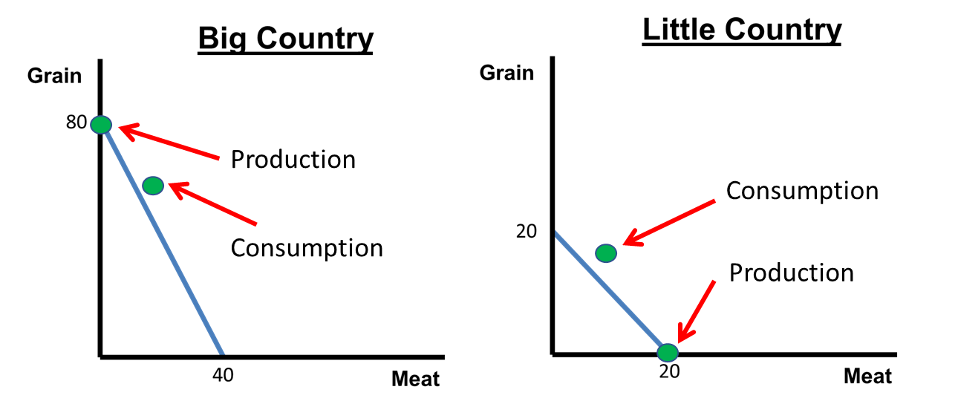

CED 1.4
Comparative Advantage
Basic Economic
Concepts
Notes:
After completing this lesson, students should be able to:
Define absolute advantage as the ability to produce more output or use fewer inputs than another producer.
Define comparative advantage as the ability to produce at a lower opportunity cost.
Calculate opportunity cost for both output problems using the Other-Over formula and input problems using the It-Over formula.
Determine which producer has the comparative advantage in each good and explain how it guides specialization and trade.
Identify mutually beneficial terms of trade that fall between opportunity costs, and explain how terms outside this range hurt one side of the trade and help the other.
Illustrate how specialization and trade allow countries (or individuals) to consume beyond their production possibilities.
Distinguish between output-based and input-based comparative advantage problems and apply reasoning to each type.
Interpret comparative advantage concepts using real-world and personal examples (e.g., countries trading goods, students dividing chores, or businesses outsourcing labor).
Teacher Note:
This lesson builds directly on students’ understanding of scarcity and opportunity cost by introducing the foundation of all trade theory - comparative advantage. Emphasize that absolute advantage explains who is more productive, while comparative advantage explains who should produce what to maximize total output.
Encourage students to connect these ideas to everyday life: when they divide household tasks, choose between work and leisure, or specialize in school projects, they are acting on comparative advantage principles.

Slide 2
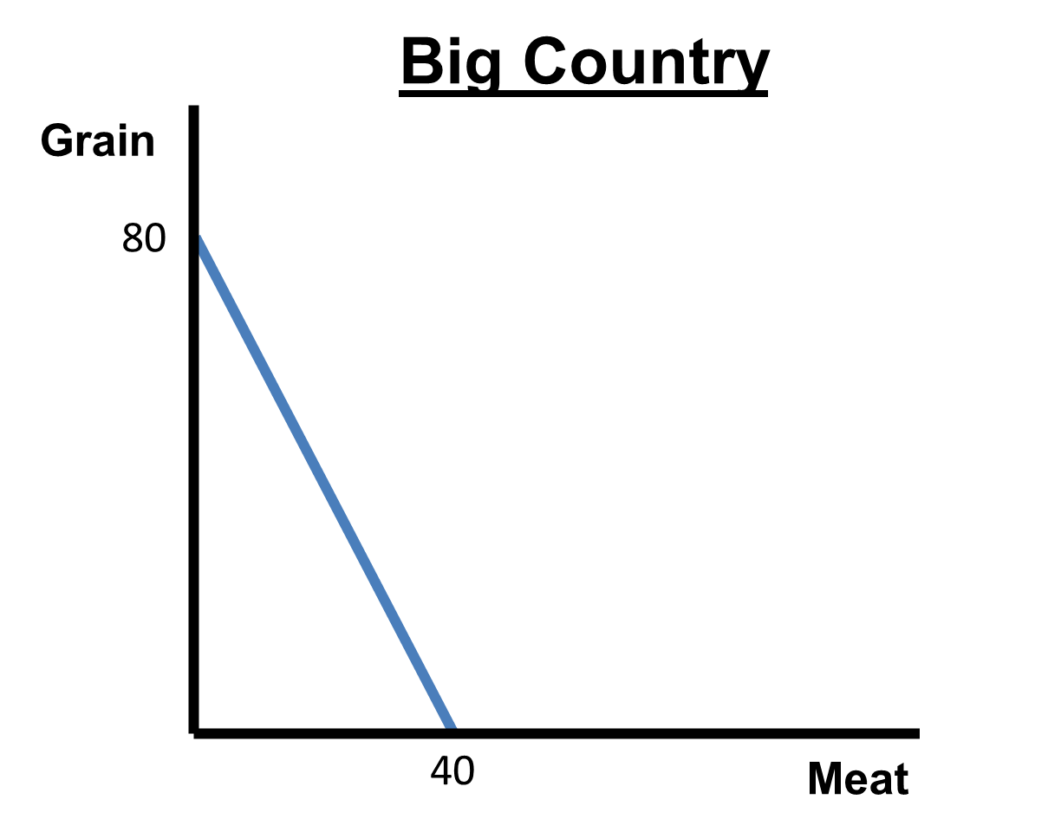
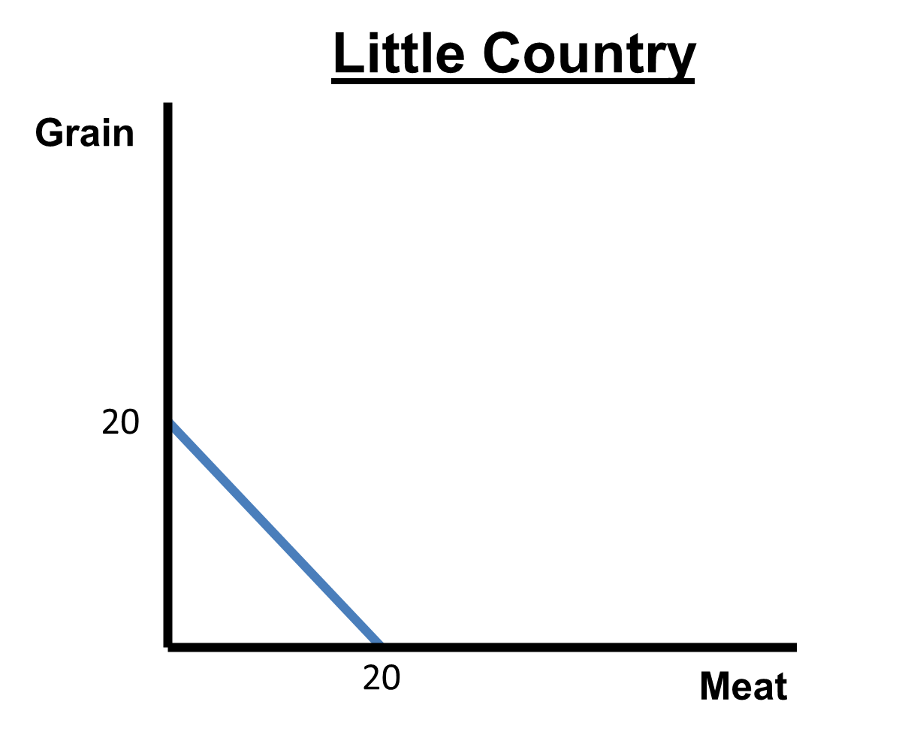
Absolute Advantage
 | Big Country | Little Country
Grain | 80 tons | 20 tons
Meat | 40 tons | 20 tons
Notes:
Main Objective:
Students should recognize that absolute advantage refers to which country can produce more output with the same resources or the same output with fewer resources.
Key Concept:
Both Big Country and Little Country can produce grain and meat.
The Production Possibilities Curves (PPCs) show the maximum amount of each good they can produce given their available resources.
How to Present the Slide:
Begin by pointing out the two PPCs:
“Here we have two countries - Big Country and Little Country - both producing grain and meat.”
“Each country’s PPC shows its maximum possible production combinations given its resources.”
Ask students to observe differences:
“Which country can produce more grain?”
“Which can produce more meat?”
Next slide: “Now that we see what these countries can produce, let’s look at the definition of comparative advantage.”

Slide 3
Absolute Advantage
Ability to produce more with fixed resources
or
The same amount using fewer resources
It’s who’s better!
Notes:
Main Objective:
Students should understand that absolute advantage means being able to produce more output with the same resources or the same output with fewer resources. It’s about overall productivity, not efficiency or specialization.
Key Concept:
Absolute advantage measures who is more productive.
If one country, person, or business can make more of a good using the same amount of inputs, they have the absolute advantage.
Alternatively, if they can make the same output while using fewer inputs, that also means they have the absolute advantage.
Think of it as “who’s better at making it”, not “who should make it.”
This distinction sets up the transition to comparative advantage, which is about who gives up less (i.e., who has the lower opportunity cost).
How to Present the Slide:
Read the first line aloud: “Ability to produce more with fixed resources.”
Give a real-world example: “If Taylor can bake 10 cookies in an hour and Alex can bake 6, Taylor has the absolute advantage in cookies.”
Emphasize the second part: “Or produce the same amount using fewer resources.”
“If both bake 10 cookies, but Taylor uses half the flour, Taylor still has the absolute advantage.”
Drive home the red text: “It’s who’s better!”
Have students repeat it aloud for emphasis - it’s a good mnemonic anchor before introducing opportunity cost next.
Engagement Prompts:
“If the U.S. can produce more airplanes and more cars than Japan, does that mean Japan shouldn’t trade with us?”
“Does having the absolute advantage in everything mean a country should make everything itself?”
“Who has the absolute advantage in your group projects - who finishes the fastest or best?”
Phrase to Emphasize:
“Absolute advantage tells us who’s better - but not who benefits most from trade.”
Next slide: “Now that we know the definition of absolute advantage, let’s identify who has the comparative advantage in the production of grain.”

Slide 4
Absolute Advantage
Which country has the absolute advantage in grain?
 | Big Country | Little Country
Grain | 80 tons | 20 tons
Meat | 40 tons | 20 tons
Big Country
80>20
Notes:
Main Objective:
Students should determine which country has the absolute advantage in grain by comparing maximum outputs. They should conclude that Big Country can produce more grain (80 tons) than Little Country (20 tons).
Key Concept:
The table and graphs show maximum production levels for each country.
Big Country can produce up to 80 tons of grain, while Little Country can produce only 20 tons.
Since 80 > 20, Big Country has the absolute advantage in grain.
This is because it can make more of that good with the same fixed resources.
Remember, absolute advantage is simply “who’s better at making it.”
How to Present the Slide:
Start by reminding students of the previous definition:
“Absolute advantage means producing more with the same resources.”
Ask:
“Which country produces more grain?”
Allow students a moment to respond.
Highlight the data:
“Big Country can produce 80 tons of grain, and Little Country only 20. So Big Country clearly has the absolute advantage in grain.”
Engagement Prompts:
“If one country can make more grain, does that automatically mean it should specialize in grain?”
“What might make a smaller country still competitive even without the absolute advantage?”
“Can you think of real-world examples - maybe comparing the U.S. and a smaller nation - where one can produce more overall?”
Phrase to Emphasize:
“Absolute advantage is about who can make more - not who should make what.”
Next Slide: “Now let’s identify who has the absolute advantage in the production of meat.”

Slide 5
Absolute Advantage
Which country has the absolute advantage in meat?
 | Big Country | Little Country
Grain | 80 tons | 20 tons
Meat | 40 tons | 20 tons
Big Country
40>20
Notes:
Main Objective:
Students should determine which country has the absolute advantage in meat by comparing the total output possible with the same amount of resources.
They should conclude that Big Country again has the absolute advantage since 40 tons > 20 tons.
Key Concept:
Big Country can produce up to 40 tons of meat, while Little Country can only produce 20 tons.
Because Big Country can produce more of both goods, it has the absolute advantage in both grain and meat.
This emphasizes that larger or more resource-rich nations often have an absolute advantage in multiple goods - but that doesn’t mean they should produce everything.
This prepares students for the next concept: comparative advantage, where we look at who gives up less instead of who simply makes more.
How to Present the Slide:
Review: “On the last slide, Big Country had the absolute advantage in grain. Let’s see if that’s also true for meat.”
Ask: “Which country produces more meat if both use the same amount of resources?”
→ Students should identify Big Country (40 tons) vs. Little Country (20 tons).
Confirm: “So again, Big Country is more productive - it can make more meat and more grain.”
Engagement Prompts:
“If Big Country is better at making both goods, can trade still make sense?”
“What would motivate Little Country to trade with Big Country?”
“Have you ever worked with someone who’s faster at everything - but you still both helped each other?”
Phrase to Emphasize:
“Absolute advantage tells us who’s better - but not who should produce what.”
Next Slide: “Now that we know absolute advantage, let’s look at something that matters much more in economics – comparative advantage.”

Slide 6
Comparative Advantage
Ability to produce at a lower opportunity Cost
This is how we determine the best use of resources
Notes:
Main Objective:
Students should be able to define comparative advantage as the ability to produce a good at a lower opportunity cost than another producer.
They should understand that this concept determines the best use of resources and the foundation for mutually beneficial trade.
Key Concept:
Comparative advantage is about efficiency, not total productivity.
Even if one country is better at producing everything, trade can still benefit both when each specializes in what it produces at a lower opportunity cost.
Opportunity cost is what you give up to make something else - so the producer who sacrifices less of the other good has the comparative advantage.
This concept is how economists decide “who should make what” - it’s about allocating resources where they’re used most effectively.
In short:
Absolute advantage = who’s better.
Comparative advantage = who gives up less.
How to Present the Slide:
Start by revisiting the last slide:
“Previously, we learned absolute advantage - who can make more. But what if one country is better at both goods?”
Then introduce comparative advantage:
“Instead of looking at who’s better, we now focus on who sacrifices less - that’s comparative advantage.”
Highlight the red text:
“This is how we determine the best use of resources - both in economics and in real life.”
Engagement Prompts:
“Can a smaller or less efficient country still benefit from trade?”
“Can you think of a time you specialized in something because you were relatively better at it, even if someone else was faster at everything?”
Phrase to Emphasize:
“Comparative advantage is not about who’s best - it’s about who gives up less.”
Next Slide: “Now we are going to look at how to calculate opportunity costs for determining comparative advantage.”

Slide 7
Comparative Advantage
Outputs: Other-Over
Opportunity Cost of 1 A = B/A
This is an
Output Problem
 | Big Country | Little Country
Grain | 80 tons | 20 tons
Meat | 40 tons | 20 tons
Big Country
O.C. of 1 ton of Grain
O.C. of 1 ton of Meat
= 40/80
= 1/2 ton of Meat
= 80/40
= 2 tons of Grain
Little Country
O.C. of 1 ton of Grain
O.C. of 1 ton of Meat
= 20/20
= 1 ton of Meat
= 20/20
= 1 ton of Grain
Notes:
Main Objective:
Students will be able to:
Recognize that output problems show the final goods produced, not inputs used.
Apply the Other-Over formula correctly to find opportunity costs for each country and each product.
Prepare to determine which country has the comparative advantage based on these calculations.
Key Concept:
This is an output problem - that means the table shows finished products (grain and meat), not resources or hours used to produce grain and meat.
For output problems, the formula for opportunity cost is Other Over:
To find the opportunity cost of producing one unit of a good (A), divide the quantity of the other good (B) by the quantity of that good (A).
In other words, O.C. of A = B ÷ A.
Applying this formula:
Big Country:
O.C. of 1 ton of grain = 40 ÷ 80 = ½ ton of meat
O.C. of 1 ton of meat = 80 ÷ 40 = 2 tons of grain
Little Country:
O.C. of 1 ton of grain = 20 ÷ 20 = 1 ton of meat
O.C. of 1 ton of meat = 20 ÷ 20 = 1 ton of grain
These opportunity costs show how much of one product each country must give up to produce the other - the foundation for identifying comparative advantage.
How to Present the Slide:
Begin by emphasizing that these are output problems - “The numbers here represent finished goods, not hours worked.”
Write “Other Over” on the board or model it visually.
Walk through the first calculation slowly with the class (Big Country’s opportunity cost of grain).
Ask students to predict the opportunity cost for the next product before revealing it.
Highlight the logic behind the results: “Big Country gives up less meat when making grain, while Little Country gives up less grain when making meat - we’ll explore what that means next.”
Engagement Prompts:
“What does the opportunity cost of ½ ton of meat actually mean?”
“If you were producing for Big Country, which good would you want to specialize in?”
Phrase to Emphasize:
“Other over - always divide the other product’s output by the one you’re finding.”
Next Slide: “Next, we are going to identify Comparative Advantage. That tells us who Should Specialize in Which Good.”

Slide 8
Comparative Advantage
Ability to produce at a lower opportunity Cost
Which country has the comparative advantage in grain?
 | Big Country | Little Country
Grain | 80 tons | 20 tons
Meat | 40 tons | 20 tons
Big Country
O.C. of 1 ton of Grain
O.C. of 1 ton of Meat
Big Country
1/2 < 1
= 40/80
= 1/2 ton of Meat
= 80/40
= 2 tons of Grain
Little Country
O.C. of 1 ton of Grain
O.C. of 1 ton of Meat
= 20/20
= 1 ton of Meat
= 20/20
= 1 ton of Grain
Notes:
Main Objective:
Students will be able to:
Compare opportunity costs to determine who has the comparative advantage in grain production.
Explain that a country with a lower opportunity cost sacrifices less of the other good and therefore should specialize in that product.
Key Concept:
Comparative advantage means producing at a lower opportunity cost.
From the data:
Big Country: O.C. of 1 ton of grain = 40 ÷ 80 = ½ ton of meat
Little Country: O.C. of 1 ton of grain = 20 ÷ 20 = 1 ton of meat
When we compare:
½ < 1, so Big Country has the comparative advantage in grain.
This means Big Country gives up less meat to make grain, making it more efficient at producing grain relative to meat.
Emphasize that comparative advantage is not about who produces more - it’s about who gives up less.
How to Present the Slide:
Begin by restating the question: “Which country has the comparative advantage in grain?”
Walk through the opportunity cost numbers slowly, emphasizing that this is an output problem (so the formula was Other Over).
Show how both opportunity costs are compared directly - “½ vs 1.”
Point to the red text: “Big Country gives up less meat when it produces grain - that’s why it has the comparative advantage in producing grain.”
Reinforce that specialization decisions depend on these costs, not total production numbers.
Engagement Prompts:
“Why is it possible for the smaller country to still have a comparative advantage in something, even if it produces less overall?”
“If Big Country specializes in grain, what do you think Little Country should specialize in?”
“Does this mean Big Country should only produce grain?”
Phrase to Emphasize:
“Lower opportunity cost means comparative advantage.”
Next Slide: “Now that we’ve identified which country has the comparative advantage in grain, we’re going to flip the perspective and ask the same question about meat. “

Slide 9
Comparative Advantage
Ability to produce at a lower opportunity Cost
Which country has the comparative advantage in meat?
 | Big Country | Little Country
Grain | 80 tons | 20 tons
Meat | 40 tons | 20 tons
Big Country
O.C. of 1 ton of Grain
O.C. of 1 ton of Meat
= 40/80
= 1/2 ton of Meat
Little Country
1 < 2
= 80/40
= 2 tons of Grain
Little Country
O.C. of 1 ton of Grain
O.C. of 1 ton of Meat
= 20/20
= 1 ton of Meat
= 20/20
= 1 ton of Grain
Notes:
Main Objective:
Students will be able to:
Identify which country has the comparative advantage in meat production.
Explain that comparative advantage determines specialization - each country should focus on the good where it gives up less of the other product.
Understand that both countries benefit when they specialize and trade according to comparative advantage.
Key Concept:
Comparative advantage is based on lower opportunity cost.
From our earlier calculations:
Big Country: O.C. of 1 ton of meat = 80 ÷ 40 = 2 tons of grain
Little Country: O.C. of 1 ton of meat = 20 ÷ 20 = 1 ton of grain
When we compare:
1 < 2, so Little Country has the comparative advantage in meat.
This means Little Country gives up fewer tons of grain for every ton of meat produced.
As a result:
Big Country → specialize in grain
Little Country → specialize in meat
How to Present the Slide:
Begin by reviewing the question: “Which country has the comparative advantage in meat?”
Revisit the opportunity cost values and explain the comparison - “1 is less than 2.”
Emphasize that comparative advantage leads to specialization: each country focuses on producing the good with the lowest opportunity cost.
Engagement Prompts:
“What happens if each country tries to produce both goods instead of specializing?”
“If Big Country trades some of its grain for Little Country’s meat, how could both end up better off?”
Phrase to Emphasize:
“Each country should specialize where its opportunity cost is lowest - that’s the key to trade gains.”
Next Slide: “Next, we’ll look at how specialization and trade allow both countries to become better off than if they produced everything on their own.”

Slide 10
Terms of Trade
What happens if both countries specialize?
Now they will trade for the other product!
Notes:
Main Objective:
Students will be able to:
Explain that specialization occurs when each country focuses on the good in which it has the comparative advantage.
Describe how trade allows countries to consume beyond their individual production possibilities.
Understand that mutual benefit arises because each country can obtain goods at a lower opportunity cost than producing them domestically.
Key Concept:
Big Country has the comparative advantage in grain (lower opportunity cost).
Little Country has the comparative advantage in meat (lower opportunity cost).
When both countries specialize, they produce only the good they are relatively best at making.
Big Country → specializes in grain (produces 80 tons).
Little Country → specializes in meat (produces 20 tons).
After specialization, neither country has the other product, so they must trade to get what they don’t produce.
Through trade, both can end up with more total goods than they could achieve alone.
How to Present the Slide:
Start by revisiting the comparative advantage results:
“Who had the advantage in grain? Who had it in meat?”
Explain that now each country specializes in that product.
Point to the graphs: show how Big Country produces only grain and Little Country only meat.
Say: “Now they don’t each have both goods, but they can trade to fix that.”
Reinforce that specialization and trade make both countries better off than self-sufficiency.
Prepare students for the upcoming terms of trade discussion - how much grain will be traded for meat.
Engagement Prompt:
“Why does it make sense for each country to stop producing one of the goods?”
Phrase to Emphasize:
“When countries specialize and trade, everyone can end up better off.”
Next Slide: “Now that both countries specialize and benefit from trade, our next step is to figure out how much grain should be traded for meat so that both sides gain – this brings us to the terms of trade.”

Slide 11
Terms of Trade
Mutually beneficial terms of trade will fall between opportunity costs
1 ton of grain = ½ to 1 ton of meat
1 ton of meat = 1 to 2 tons of grain
Big Country
O.C. of 1 ton of Grain
O.C. of 1 ton of Meat
= 40/80
= 1/2 ton of Meat
= 80/40
= 2 tons of Grain
Little Country
O.C. of 1 ton of Grain
O.C. of 1 ton of Meat
= 20/20
= 1 ton of Meat
= 20/20
= 1 ton of Grain
Notes:
Main Objective:
Students will be able to:
Define the terms of trade as the rate of exchange that allows both countries to gain from trade.
Determine the range of mutually beneficial trade by comparing the opportunity costs of both goods.
Explain why trade outside this range would harm one of the trading partners.
Key Concept:
Terms of trade = the agreed rate of exchange between goods.
For trade to be beneficial, it must fall between both countries’ opportunity costs.
From previous calculations:
Big Country:
O.C. of 1 ton of grain = ½ ton of meat
O.C. of 1 ton of meat = 2 tons of grain
Little Country:
O.C. of 1 ton of grain = 1 ton of meat
O.C. of 1 ton of meat = 1 ton of grain
Therefore, mutually beneficial terms of trade are:
1 ton of grain = ½ to 1 ton of meat
1 ton of meat = 1 to 2 tons of grain
Both countries gain when trade happens within this range because each gets the good they want at a lower opportunity cost than producing it themselves.
How to Present the Slide:
Begin by reminding students: “Now that both countries are specializing, they’ll need to agree on how much of one good to trade for the other.”
Emphasize the phrase “between opportunity costs.”
Point to the opportunity cost calculations and explain how the red text summarizes the range.
Reinforce with examples:
“If Big Country trades 1 ton of grain for ¾ ton of meat - both benefit.”
“But if the trade is 1 ton of grain for only ¼ ton of meat, one side loses.”
Prepare students for the next slide by hinting: “Next, we’ll see what happens when the trade terms fall outside this range.”
Engagement Prompts:
“What would happen if Big Country tried to trade 1 ton of grain for 2 tons of meat?”
“Which country would refuse to trade if the rate wasn’t mutually beneficial?”
“How do these ranges ensure that both sides end up better off?”
Phrase to Emphasize:
“Mutually beneficial trade happens only when the terms fall between opportunity costs.”
Next Slide: “Now that we know the terms of trade must fall between both countries’ opportunity costs to be mutually beneficial, our next slide will explore what happens when the exchange rate falls outside that range.”

Slide 12
Terms of Trade
What if 1 ton of grain traded for 3 tons of meat?
Big country benefits, Little country is hurt
What if 1 ton of grain traded for ¼ a ton of meat?
Big country is hurt, Little country benefits
Big Country
O.C. of 1 ton of Grain
O.C. of 1 ton of Meat
= 40/80
= 1/2 ton of Meat
= 80/40
= 2 tons of Grain
Little Country
O.C. of 1 ton of Grain
O.C. of 1 ton of Meat
= 20/20
= 1 ton of Meat
= 20/20
= 1 ton of Grain
Notes:
Main Objective:
Students will be able to:
Recognize that unbalanced trade terms can harm one of the trading partners.
Explain which country benefits or loses depending on whether the trade ratio is above or below the beneficial range.
Apply reasoning using opportunity costs to determine fairness in trade agreements.
Key Concept:
Mutually beneficial trade only happens between the countries’ opportunity cost range.
From earlier:
Big Country’s O.C. of grain = ½ ton of meat
Little Country’s O.C. of grain = 1 ton of meat
Therefore, mutually beneficial trade would be 1 ton of grain = between ½ and 1 ton of meat.
Two examples show what happens when terms move outside this range:
If 1 ton of grain = 3 tons of meat:
Big Country trades grain and receives 3 tons of meat (way above its cost of ½).
Big Country benefits, Little Country loses - trade is unfair to Little Country.
If 1 ton of grain = ¼ ton of meat:
Big Country gives up grain for too little meat - below its opportunity cost.
Big Country is hurt, Little Country benefits - trade is unfair to Big Country.
The takeaway: Only trade between ½ and 1 ton of meat per ton of grain benefits both.
How to Present the Slide:
Start by asking: “What happens if the trade ratio isn’t between ½ and 1?”
Read the two example scenarios aloud, emphasizing the red text for clarity.
Walk through why one side benefits and the other loses in each case.
Reinforce the importance of opportunity cost in determining fair trade.
Summarize with: “The magic of trade only works when it’s between opportunity costs!”
Engagement Prompts:
“Why might a country agree to an unfair trade?”
“Can you think of a real-world example where one nation benefits more from trade?”
“How could international negotiations help avoid unfair terms of trade?”
Phrase to Emphasize:
“Trade only creates mutual gain when it happens between opportunity costs.”
Next Slide: “Now that we’ve seen how moving outside the mutually beneficial range causes one country to lose, the next slide will show another example that reinforces who benefits and who doesn’t when the terms are unfair.”

Slide 13
Terms of Trade
What if 1 ton of meat traded for 4 tons of grain?
Little country benefits, Big country is hurt
What if 1 ton of meat traded for ½ a ton of grain?
Little country is hurt, Big country is benefits
Big Country
O.C. of 1 ton of Grain
O.C. of 1 ton of Meat
= 40/80
= 1/2 ton of Meat
= 80/40
= 2 tons of Grain
Little Country
O.C. of 1 ton of Grain
O.C. of 1 ton of Meat
= 20/20
= 1 ton of Meat
= 20/20
= 1 ton of Grain
Notes:
Main Objective:
Students will be able to:
Analyze trade scenarios using different trade bases (meat for grain instead of grain for meat).
Identify which country benefits or is hurt when trade terms move above or below the fair range.
Deepen their understanding of how opportunity cost limits define fair exchange rates.
Key Concept:
From previous slides:
Big Country:
O.C. of 1 ton of meat = 2 tons of grain
Little Country:
O.C. of 1 ton of meat = 1 ton of grain
Therefore, mutually beneficial trade for 1 ton of meat must fall between 1 and 2 tons of grain.
When trade falls outside this range:
If 1 ton of meat = 4 tons of grain:
Little Country gets 4 tons of grain for each ton of meat (much more than its cost of 1).
Little Country benefits, Big Country is hurt.
If 1 ton of meat = ½ ton of grain:
Big Country pays less than its opportunity cost of 2.
Big Country benefits, Little Country is hurt.
How to Present the Slide:
Start by asking students to recall: “What was the mutually beneficial trade range for 1 ton of meat?”
Highlight the 1-to-2-ton range in your previous example.
Then, walk through each new scenario:
First trade: 1 ton of meat = 4 tons of grain → “Who’s gaining more than before? Who’s losing?”
Second trade: 1 ton of meat = ½ ton of grain → “Now who’s on the winning side?”
Emphasize that only trades between 1 and 2 tons of grain per ton of meat benefit both countries.
Engagement Prompts:
“Why does changing which good we’re trading (meat vs. grain) flip who benefits?”
“Could countries still choose to trade even if one is hurt? Why or why not?”
“What does this tell us about how careful nations must be when setting trade agreements?”
Phrase to Emphasize:
“When the trade ratio moves outside the opportunity cost range, one country wins and the other loses.”
Next Slide: “Now that we’ve seen how changing the good being traded can flip who benefits and who loses, the next slide will summarize how to quickly identify fair terms inside and outside the mutually beneficial range.”

Slide 14
Terms of Trade
If terms of trade are above the mutually beneficial range:
The country with the comparative advantage benefits; the country without is hurt.
If terms of trade are below the mutually beneficial range:
The country with the comparative advantage is hurt; the country without benefits.
Notes:
Main Objective:
Students will be able to:
Explain what happens when trade occurs above or below the mutually beneficial range.
Identify which country (with or without the comparative advantage) benefits or is hurt in each case.
Use this logic to predict trade outcomes in future comparative advantage problems.
Key Concept:
The mutually beneficial range represents the price of one good in terms of another good (terms of trade) between each country’s opportunity cost.
When trade happens outside this range, one country gains at the expense of the other:
If terms of trade are above the range:
The country with the comparative advantage benefits, because it’s trading at better-than-fair prices.
The country without the comparative advantage is hurt, since it gives up more than its opportunity cost.
If terms of trade are below the range:
The country with the comparative advantage is hurt, receiving less than what’s fair.
The country without the comparative advantage benefits, getting goods cheaper than its opportunity cost.
How to Present the Slide:
Begin by revisiting the previous examples: “Remember when Big Country benefited while Little Country was hurt? Here’s why.”
Read the top bullet aloud and emphasize “above the range” and “below the range.”
Use color cues (green = benefits, red = hurt) to visually reinforce the pattern.
Explain: “This summary gives us a quick way to predict who gains or loses whenever we see trade ratios outside the mutually beneficial zone.”
Engagement Prompts:
“If the trade terms favored the Big Country, what might Little Country do in response?”
“Can you think of a real-world example where one nation feels taken advantage of in trade?”
“Why might countries still trade even if it’s not perfectly fair?”
Phrase to Emphasize:
“When trade falls outside the mutually beneficial range, one country gains at the other’s expense.”
Next Slide: “Now that we understand who wins and who loses when trade falls outside the mutually beneficial range, the next slide will show how specialization and trade allow countries to consume more than they could produce alone.”

Slide 15
Terms of Trade
Agreed terms: 1 ton of meat for 1 ½ tons of grain
Little Country trades 10 tons of meat for 15 tons of Big Country’s grain
-15 tons of grain
+10 tons of meat
+15 tons of grain
-10 tons of meat
Notes:
Main Objective:
Students will be able to:
Explain what happens when two countries specialize and trade using specific exchange terms.
Describe how each country’s production point remains on the PPC, but its consumption point moves beyond it.
Identify what each country gains and gives up in a trade scenario.
Key Concept:
The agreed terms: 1 ton of meat = 1½ tons of grain
Trade deal: Little Country trades 10 tons of meat for 15 tons of Big Country’s grain.
Step-by-step breakdown:
Big Country:
Gives 15 tons of grain (–15)
Gains 10 tons of meat (+10)
Little Country:
Gives 10 tons of meat (–10)
Gains 15 tons of grain (+15)
This trade ratio falls within the mutually beneficial range (1 ton of meat = 1 to 2 tons of grain), so both countries benefit.
Notice how:
Production stays on each country’s PPC (where they specialized).
Consumption moves beyond the PPC, allowing both to enjoy more total goods than before.
How to Present the Slide:
Begin by asking: “What do these arrows represent - production or consumption?”
→ Clarify that the arrows show trade flow.
Explain that Big Country produces only grain and Little Country only meat (based on comparative advantage).
Describe the exchange:
Little Country sends 10 tons of meat → Big Country.
Big Country sends 15 tons of grain → Little Country.
Emphasize that both countries now have more of both goods than before trade.
Engagement Prompts:
“Which country gave up more, and which gained more in absolute terms?”
“How can both countries end up better off even though one gives away goods?”
“Why does trade let countries consume beyond their production possibilities?”
Phrase to Emphasize:
“Trade doesn’t let a country produce outside its PPC-but it does let it consume outside its PPC.”
Next Slide: “Now that we’ve seen how both countries end up with more total goods after trade, the next slide will show how specialization and trade allow each country to consume beyond its production possibilities curve.”

Slide 16
Terms of Trade
A country cannot produce beyond its production possibilities
Production
Consumption
Consumption
Production
Through specialization and trade, countries can CONSUME beyond their production possibilities
Notes:
Main Objective:
Students will be able to:
Distinguish between a nation’s production point and its consumption point after trade.
Explain how specialization based on comparative advantage leads to greater total consumption for both countries.
Describe why countries trade even if they can produce both goods themselves.
Key Concept:
No country can produce outside its Production Possibilities Curve (PPC) because it represents the limit of available resources and technology.
However, when countries specialize and trade, each can obtain goods more efficiently - allowing consumption beyond the PPC.
On the graphs:
Big Country produces at its specialization point (80 grain, 0 meat) and consumes at a higher combination (some meat + nearly 80 grain).
Little Country produces 20 meat (its specialization) but can now consume both meat and more grain through trade.
The key distinction:
Production = on the PPC
Consumption = beyond the PPC
How to Present the Slide:
Begin with the question: “Can a country ever produce outside its PPC?”
Pause for answers, then clarify: “No - but it can consume outside it.”
Point to the production points on each country’s PPC and emphasize that’s where they specialized.
Show how the consumption points have shifted outward - “This is the gain from trade.”
Reinforce that both countries now enjoy more of both goods than before, thanks to specialization and exchange.
Conclude with a short recap: “This is the heart of why trade matters - everyone can be better off.”
Engagement Prompts:
“If both countries can consume more, why doesn’t every country specialize completely in one thing?”
“What limits how much trade can actually happen?”
“Can this same idea apply to individuals, not just countries?”
Phrase to Emphasize:
“Specialization and trade allow countries to consume beyond what they can produce on their own.”
Next Slide: “Now that we’ve seen how specialization and trade allow countries to consume beyond their PPCs, the next slide will introduce how to analyze comparative advantage when resources (inputs) rather than outputs are given.”

Slide 17
Input problems
Who has the absolute advantage in vacuuming?
 | Ashley | Omar
Mop | 6 minutes | 12 minutes
Vacuum | 3 minutes | 4 minutes
With inputs, fewer resources used is the absolute advantage
Ashley because 3 < 4
Notes:
Main Objective:
Students will be able to:
Recognize that input problems measure resources used, not output produced.
Identify who has the absolute advantage when given input data (time, labor, etc.).
Apply the “fewer is better” rule for absolute advantage in input-based comparisons.
Key Concept:
Input problems focus on the resources required to complete a task.
The producer with the lower input (less time, fewer resources, fewer workers, etc.) has the absolute advantage.
In this example:
Ashley: takes 3 minutes to vacuum.
Omar: takes 4 minutes to vacuum.
Therefore, Ashley has the absolute advantage because 3 < 4.
Mnemonic:
Output problems → “More is better.”
Input problems → “Less is better.”
How to Present the Slide:
Begin by asking: “What’s the difference between inputs and outputs?”
Guide students to recognize inputs are resources or effort, not final goods.
Ask the question on screen: “Who has the absolute advantage in vacuuming?”
Emphasize the key phrase in blue: “With inputs, fewer resources used is the absolute advantage.”
Highlight the red answer: “Ashley because 3 < 4.”
Reinforce: “In input problems, time or effort saved means higher productivity.”
Engagement Prompts:
“If Ashley can vacuum faster, does that mean she should do all the vacuuming?”
“Can someone still benefit from trade if they’re better at everything?”
“How might this apply to tasks at home or work?”
Phrase to Emphasize:
“With input problems, the person who uses fewer resources has the absolute advantage.”
Next Slide: “Next, we’ll apply the same logic to a new task – mopping – to see who has the lower input and therefore the absolute advantage.”

Slide 18
Input problems
Who has the absolute advantage in mopping?
 | Ashley | Omar
Mop | 6 minutes | 12 minutes
Vacuum | 3 minutes | 4 minutes
Ashley because 6 < 12
Notes:
Main Objective:
Students will be able to:
Determine who has the absolute advantage in a task when inputs (like time or resources) are given.
Understand that fewer inputs mean higher efficiency and thus an absolute advantage.
Transition to understanding opportunity cost calculations with input data.
Key Concept:
Inputs measure how much effort or time a person or country uses to complete a task.
With inputs, the rule flips from output problems:
Less is better!
In this example:
Ashley: 6 minutes to mop.
Omar: 12 minutes to mop.
Because 6 < 12, Ashley has the absolute advantage in mopping.
At this point, Ashley has the absolute advantage in both tasks (vacuuming and mopping), but we’ll soon see how opportunity cost determines who should specialize.
How to Present the Slide:
Ask students: “What does it mean to use fewer inputs?”
→ Reinforce that it means using fewer resources or less time to complete the job.
Have students quickly compare the times and call out who’s faster.
Emphasize: “With input problems, the smaller number shows greater efficiency.”
Highlight the red text: “Ashley because 6 < 12.”
Build anticipation: “But being faster at everything doesn’t necessarily mean you should do everything. Let’s see why.”
Engagement Prompts:
“If Ashley can do both tasks faster, does that mean she should do both?”
“Can Omar still benefit from trade even though he’s slower?”
“How could dividing the work still help both?”
Phrase to Emphasize:
“In input problems, efficiency means using fewer resources or less time - less is better.”
Next Slide: “Next, we’ll start calculating opportunity costs using input data and learn how the formula flips to help us decide who should specialize.”

Slide 19
Input problems
Input Opportunity Costs: It-Over
Opportunity cost of 1 A = A/B
 | Ashley | Omar
Mop | 6 minutes | 12 minutes
Vacuum | 3 minutes | 4 minutes
Ashley
O.C. of 1 Mopping
O.C. of 1 Vacuuming
= 6/3
= 2 Vacuumings
= 3/6
= 1/2 a Mopping
Omar
O.C. of 1 Mopping
O.C. of 1 Vacuuming
= 12/4
= 3 Vacuumings
= 12/4
= 1/3 a Mopping
Notes:
Main Objective:
Students will be able to:
Apply the It-Over formula to calculate opportunity costs when given input data.
Understand that opportunity cost in input problems represents what is given up in time or resources to complete another task.
Recognize that comparative advantage depends on lower opportunity cost, not just faster absolute performance.
Key Concept:
In input problems, smaller numbers indicate fewer resources used - but to find comparative advantage, we must calculate the opportunity cost.
Formula:
Opportunity Cost of 1 A = A ÷ B (It-Over)
“It” stands for the task you’re finding the opportunity cost of. To find the opportunity cost of producing one unit of a good (A), divide the quantity of resources for that good (A) by the quantity of resources for the other good (B).
Using the data:
Ashley:
O.C. of 1 Mopping = 6 ÷ 3 = 2 Vacuumings
O.C. of 1 Vacuuming = 3 ÷ 6 = ½ a Mopping
Omar:
O.C. of 1 Mopping = 12 ÷ 4 = 3 Vacuumings
O.C. of 1 Vacuuming = 4 ÷ 12 = ⅓ a Mopping
How to Present the Slide:
Begin by reminding students: “Earlier, we used Other-Over for output problems. Now we flip it to It-Over for inputs.”
Write both formulas side-by-side on the board:
Output → Other ÷ Over
Input → It ÷ Over
Work through Ashley’s calculations together as a model.
Ask students to calculate Omar’s values on their own or with a partner.
Engagement Prompts:
“Why do we flip the formula for input problems?”
“What does it mean if someone has a lower opportunity cost?”
“If Omar takes longer for everything, can he still gain from trade?”
Phrase to Emphasize:
“With inputs, we flip the formula - It-Over - because we’re measuring resources used, not goods produced.”
Next Slide: “Next, we’ll see who has the comparative advantage in mopping using these input opportunity cost calculations.”

Slide 20
Input problems
Comparative Advantage: Ability to
produce at a lower opportunity Cost
 | Ashley | Omar
Mop | 6 minutes | 12 minutes
Vacuum | 3 minutes | 4 minutes
Ashley
O.C. of 1 Mopping
O.C. of 1 Vacuuming
Who has the comparative advantage in Mopping?
= 6/3
= 2 Vacuumings
= 3/6
= 1/2 a Mopping
Omar
O.C. of 1 Mopping
O.C. of 1 Vacuuming
Ashley
2 < 3
= 12/4
= 3 Vacuumings
= 12/4
= 1/3 a Mopping
Notes:
Main Objective:
Students will be able to:
Identify the comparative advantage by comparing opportunity costs in input-based problems.
Recognize that the lower opportunity cost indicates who should specialize in that task.
Explain that comparative advantage – not absolute advantage – determines specialization and trade benefits.
Key Concept:
Comparative advantage is about who gives up less to produce something.
Even if one person (or country) has an absolute advantage in everything, specialization still makes sense if opportunity costs differ.
Using the It-Over formula from the previous slide:
Ashley:
O.C. of 1 Mopping = 6 ÷ 3 = 2 Vacuumings
Omar:
O.C. of 1 Mopping = 12 ÷ 4 = 3 Vacuumings
Since 2 < 3, Ashley has the comparative advantage in mopping.
How to Present the Slide:
Start with a quick recap: “Last slide, we calculated the opportunity costs for both Ashley and Omar. Now let’s see who should specialize.”
Ask: “Who gives up fewer vacuumings when mopping?”
Walk through the math visually, pointing to each value (2 vs. 3).
Emphasize: “The lower number means the lower opportunity cost.”
Summarize: “Ashley should specialize in mopping because she sacrifices fewer vacuuming opportunities than Omar.”
Engagement Prompts:
“Can someone explain why Ashley’s lower opportunity cost gives her the comparative advantage?”
“Does having the comparative advantage mean she’s faster?”
“Why might Omar still have an advantage in another task?”
Phrase to Emphasize:
“The person with the lower opportunity cost has the comparative advantage.”
Next Slide: “Next, we’ll compare the opportunity costs for vacuuming to see who has the comparative advantage in that task.”

Slide 21
Input problems
Comparative Advantage: Ability to
produce at a lower opportunity Cost
 | Ashley | Omar
Mop | 6 minutes | 12 minutes
Vacuum | 3 minutes | 4 minutes
Ashley
O.C. of 1 Mopping
O.C. of 1 Vacuuming
Who has the comparative advantage in Vacuuming?
= 6/3
= 2 Vacuumings
= 3/6
= 1/2 a Mopping
Omar
O.C. of 1 Mopping
O.C. of 1 Vacuuming
Omar
1/3 < 1/2
= 12/4
= 3 Vacuumings
= 12/4
= 1/3 a Mopping
Notes:
Main Objective:
Students will be able to:
Compare opportunity costs to determine who has the comparative advantage in vacuuming.
Explain why lower opportunity cost - not absolute speed-determines who should specialize.
Recognize how both individuals (or countries) can benefit through specialization and trade.
Key Concept:
Comparative advantage = lower opportunity cost.
Using opportunity cost data from the previous slide:
Ashley:
O.C. of 1 Vacuuming = 3 ÷ 6 = ½ a Mopping
Omar:
O.C. of 1 Vacuuming = 4 ÷ 12 = ⅓ a Mopping
Since ⅓ < ½, Omar has the comparative advantage in vacuuming.
Therefore, Ashley should specialize in mopping, and Omar should specialize in vacuuming.
This setup creates the foundation for mutually beneficial trade, which is introduced next.
How to Present the Slide:
Begin with a recap: “Last time, Ashley had the comparative advantage in mopping. Let’s see who has it in vacuuming.”
Highlight the red boxes for the opportunity costs (½ and ⅓).
Ask students: “Which one is smaller?” and have them respond.
Emphasize: “The person who gives up less has the comparative advantage.”
Conclude with: “So, Ashley mops, Omar vacuums - and both can benefit from trading services.”
Engagement Prompts:
“If Omar is slower at everything, how can he still have a comparative advantage?”
“What does it mean to say trade is mutually beneficial?”
“Can both people end up better off, even if one is less efficient at everything?”
Phrase to Emphasize:
“Comparative advantage is about who gives up less, not who’s faster.”
Next Slide: “Next, we’ll introduce mutually beneficial terms of trade and see how both parties gain when exchange happens between their opportunity cost ratios.”

Slide 22
Input problems
Mutually Beneficial terms of trade
fall between opportunity Costs
1 Mopping = 2 to 3 Vacuumings
1 Vacuuming = 1/3 to 1/2 Mopping
Ashley
O.C. of 1 Mopping
O.C. of 1 Vacuuming
= 6/3
= 2 Vacuumings
= 3/6
= 1/2 a Mopping
Omar
O.C. of 1 Mopping
O.C. of 1 Vacuuming
= 12/4
= 3 Vacuumings
= 12/4
= 1/3 a Mopping
Notes:
Main Objective:
Students will be able to:
Determine the mutually beneficial range of trade for input-based problems.
Explain who benefits and who is hurt when terms of trade fall above or below this range.
Understand that both sides can gain from trade when each specializes based on comparative advantage.
Key Concept:
Mutually beneficial terms of trade occur when the exchange rate falls between the two individuals’ opportunity costs.
Using the data:
Ashley:
O.C. of 1 Mopping = 2 Vacuumings
O.C. of 1 Vacuuming = ½ a Mopping
Omar:
O.C. of 1 Mopping = 3 Vacuumings
O.C. of 1 Vacuuming = ⅓ a Mopping
Therefore:
1 Mopping = 2 to 3 Vacuumings
1 Vacuuming = ⅓ to ½ a Mopping
If trade occurs within these ranges → both benefit.
If trade is outside the range → one side is hurt while the other benefits.
How to Present the Slide:
Begin by reminding students: “Ashley has the comparative advantage in mopping, and Omar has the comparative advantage in vacuuming.”
Explain: “Now, trade only helps both of them if the exchange rate is between their opportunity costs.”
Point to the green text: “This is the range - anywhere between 2 and 3 vacuumings per mopping.”
Pose each of the engagement questions below to help students test their understanding of when trade helps or hurts.
Engagement Prompts (with Suggested Answers):
Q: “If Ashley trades 1 mopping for 4 vacuumings, who benefits and who is hurt?”
A: That’s above the mutually beneficial range (since 4 > 3).
➜ Ashley benefits (she gets more than her opportunity cost of 2 vacuumings).
➜ Omar is hurt (he gives up too much compared to his cost of 3 vacuumings).
Q: “What if Ashley trades 1 mopping for only 1 vacuuming?”
A: That’s below the range (since 1 < 2).
➜ Omar benefits (he gets a mopping for less than his cost of 3 vacuumings).
➜ Ashley is hurt (she gives up her comparative advantage task for too little in return).
Q: “Why do both parties gain when trade happens inside the range?”
A: Because each side gets something for less than it would cost them to make it themselves.
➜ Ashley gets more than 2 vacuumings per mop, and Omar gives up less than 3 vacuumings per mop - both come out ahead.
Q: “Can you think of a real-world example where trade terms might favor one side over the other?”
A: Students might say:
“When a small country trades with a big one - the bigger one might set less favorable prices.”
“When two students trade chores, one might agree to do more work if they really dislike a certain task.”
“When companies outsource labor, wages might be low - benefiting one side more.”
Phrase to Emphasize:
“For trade to be mutually beneficial, the terms must fall between both sides’ opportunity costs.”

