Slide 1

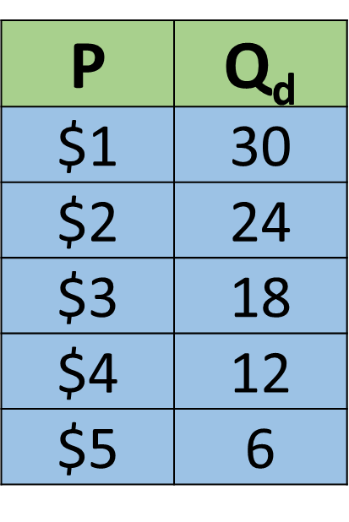

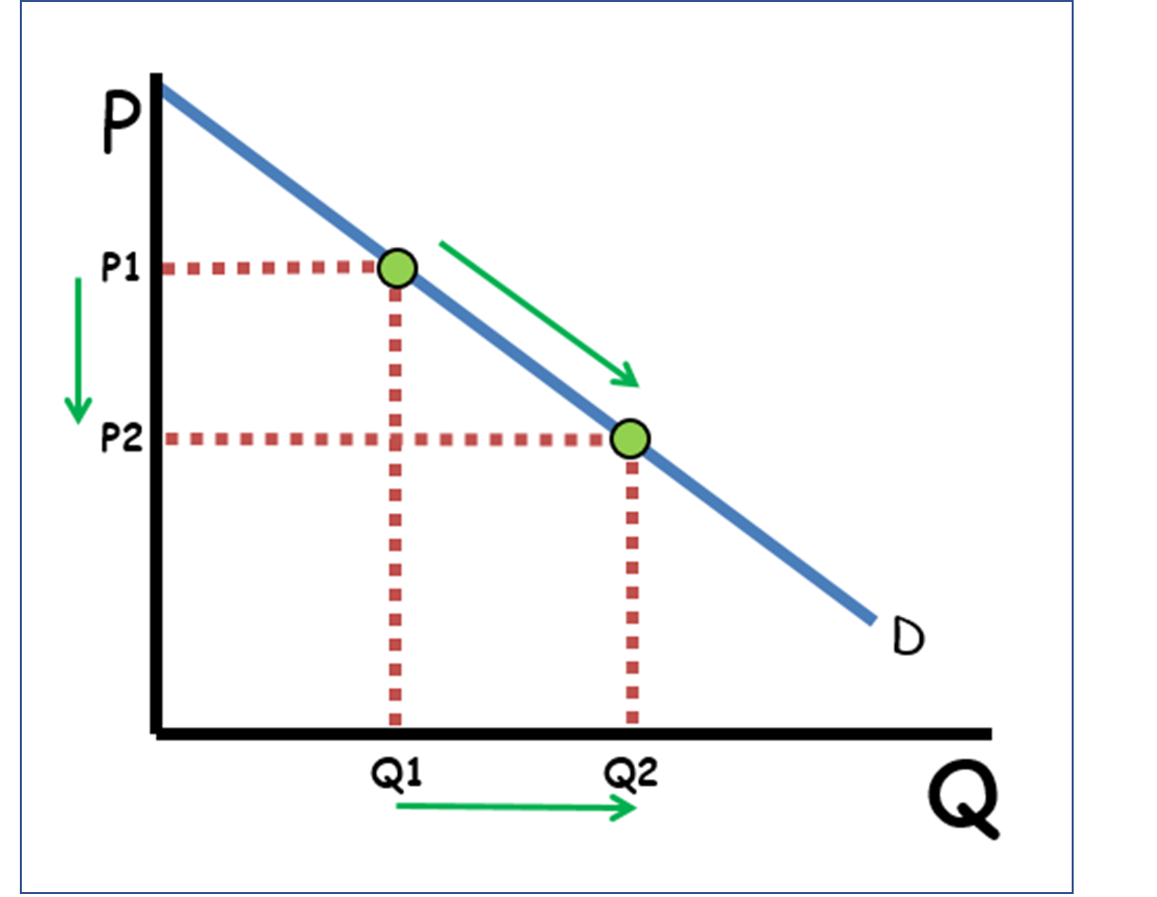
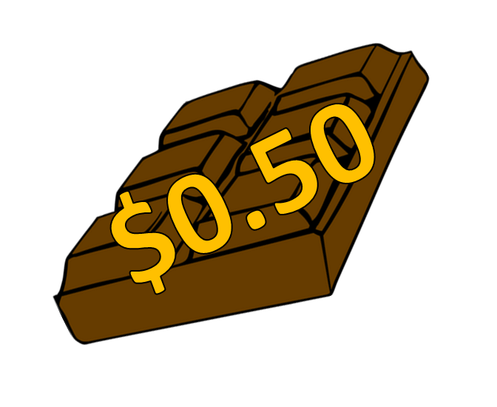

CED 1.4
Demand
Basic Economic
Concepts
Notes:
After completing this lesson, students should be able to:
Define demand and quantity demanded as key concepts illustrating the relationship between price and the quantity consumers are willing and able to purchase.
Explain the Law of Demand and identify the inverse relationship between price and quantity demanded using both demand schedules and demand curves.
Differentiate between demand and quantity demanded, recognizing that changes in price cause movement along a demand curve, while changes in non-price determinants cause the entire curve to shift.
Identify and interpret demand schedules and demand curves, demonstrating how they represent the same information in different formats.
Describe the five determinants (shifters) of demand:
Tastes and Preferences
Market Size (number of buyers)
Prices of Related Goods (substitutes and complements)
Changes in Income (normal and inferior goods)
Expectations for the Future
Analyze how changes in these determinants shift the demand curve, increasing or decreasing quantity demanded at all prices.
Apply the demand model to real-world examples, explaining how consumer behavior, market events, or news about future prices influence market demand.
Teacher Note:
This lesson introduces students to the first half of market behavior - the demand side-laying the foundation for the later study of supply and market equilibrium. Emphasize that demand reflects consumer choice and willingness to pay, not just desire.
Use relatable examples (such as pizza, sneakers, or streaming subscriptions) to help students visualize how price changes lead to movement along the curve, while factors like trends, income, or expectations shift the curve entirely.
Encourage students to connect these ideas to real markets they experience daily, reinforcing that understanding demand is key to analyzing how prices and quantities are determined in any economy.

Slide 2
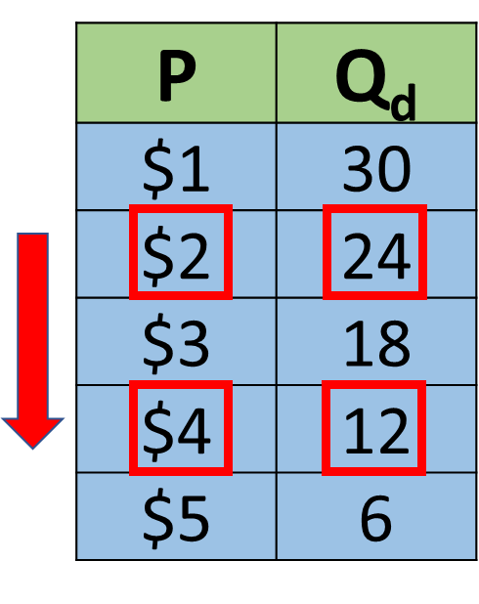
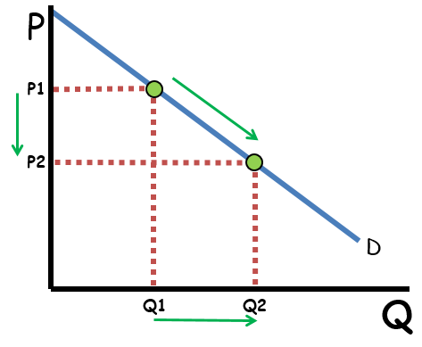
Law of Demand
The law of demand:
Ceteris Paribus, consumers buy more at low prices and less at high prices
Notes:
Main Objective:
Students will be able to define the Law of Demand and understand that, ceteris paribus, consumers buy more at lower prices and less at higher prices.
Key Concept:
The law of demand describes the inverse relationship between price and quantity demanded.
When the price decreases, consumers are willing and able to buy more.
When the price increases, consumers are willing and able to buy less.
The phrase “ceteris paribus” means “all other things held constant.”
This is important because it isolates price as the only variable changing in this scenario.
How to Present the Slide:
Start with the big red statement: read it aloud with emphasis - “Consumers buy more at low prices and less at high prices.”
Point to the table and trace the downward red arrow:
“As price falls from $4 to $2, the quantity demanded increases from 12 to 24.”
Move to the graph and highlight the movement along the demand curve (P1→P2, Q1→Q2).
Reinforce: “This is not a new curve - it’s movement along the same curve.”
Connect back: “So, when prices go down, we move down and to the right along the demand curve.”
Engagement Prompts:
“Why do you think people buy more when the price drops?”
“If the price of movie tickets doubled, what would you do?”
“What does ceteris paribus mean and why is it important here?”
Next Slide: “Now that we’ve seen what the Law of Demand says, let’s look at where market demand curves come from.”

Slide 3
Individual to Market Demand
Market Demand comes
from individual Demand
Pritpal
Linnea
Ryan
P | Q_{d}
$1 | 10
$2 | 8
$3 | 6
$4 | 4
$5 | 2
P | Q_{d}
$1 | 5
$2 | 4
$3 | 3
$4 | 2
$5 | 1
P | Q_{d}
$1 | 15
$2 | 12
$3 | 9
$4 | 6
$5 | 3
Notes:
Main Objective:
Students will understand that the market demand curve is derived by adding together all individual demand quantities at each price level.
Key Concept:
Each person (or buyer) has their own individual demand based on preferences, income, and price sensitivity.
Market demand represents the total quantity demanded by all consumers at each price.
To find market demand, we add up each individual’s quantity demanded for every price level.
This shows how individual choices aggregate to form the overall demand curve seen in markets.
How to Present the Slide:
Start by introducing the three consumers:
“Here we have three people - Pritpal, Linnea, and Ryan - each showing how much they’d buy at different prices.”
Point to each table as you say their name.
Ask:
“At $1, how many units does each person want to buy?”
Let students identify:
Pritpal = 10, Linnea = 5, Ryan = 15.
Reinforce: “So, if these are the only three people in the market, together they demand 10 + 5 + 15 = 30 units at $1.”
Continue briefly:
“At $2, they demand 8 + 4 + 12 = 24 units total.”
“At $3, it’s 6 + 3 + 9 = 18 units total.”
Summarize:
“We can add their quantities at every price to create a new market demand schedule - which will be shown on the next slide.”
“Notice that each individual’s demand still follows the law of demand - and so does the total market demand.”
Engagement Prompts:
“If a fourth consumer entered the market, what would happen to the market demand curve?”
“At which price do people buy the most?”
“Why don’t we average the quantities instead of adding them?”
Next Slide: “Now that we’ve added each person’s quantity at every price, let’s organize those totals into a market demand schedule to clearly see total quantity demanded at each price.”

Slide 4
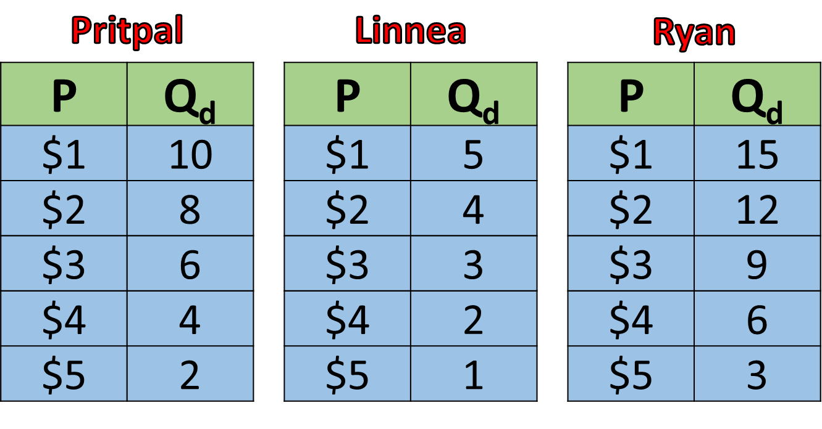
Individual to Market Demand
Market Demand comes
from individual Demand
Market
P | Q_{d}
$1 | 30
$2 | 24
$3 | 18
$4 | 12
$5 | 6
Notes:
Main Objective:
Students will learn how to construct a market demand schedule by adding individual quantities demanded at each price level. They’ll see how individual behavior aggregates to form the total demand in a market.
Key Concept:
The market demand is the sum of all individual demands for a good or service.
At each price, we add up how much every consumer in the market wants to buy.
We keep the same prices but total the quantities.
The result is a single schedule that represents the entire market’s demand.
How to Present the Slide:
Start by revisiting the previous slide.
“Last time, we saw how Pritpal, Linnea, and Ryan each had their own individual demand schedules.”
“Now, let’s see what happens when we combine them to find total market demand.”
Walk through the red-highlighted example:
“At $3, Pritpal wants 6 units, Linnea wants 3, and Ryan wants 9.”
“Add them together: 6 + 3 + 9 = 18 units total.”
“That total becomes part of our market demand schedule.”
Point out the completed market table on the right:
“We do this for each price level - $1, $2, $3, $4, and $5 - and we get the total market quantity demanded.”
“Notice that the law of demand still holds: as price rises, total quantity demanded falls.”
Transition the idea:
“This is how economists build the market demand curve - by summing up everyone’s individual demand.”
“On the next slide, we’ll see how this same process looks visually with demand curves.”
Engagement Prompts:
“If a new consumer entered the market, how would that change the market demand schedule?”
“Why don’t we average the numbers?”
“If one person’s demand doesn’t change, but others’ do, will market demand still shift?”
Next Slide: “Now that we’ve built the market demand schedule by adding quantities at each price, let’s translate that same information into a market demand curve on a graph.”

Slide 5
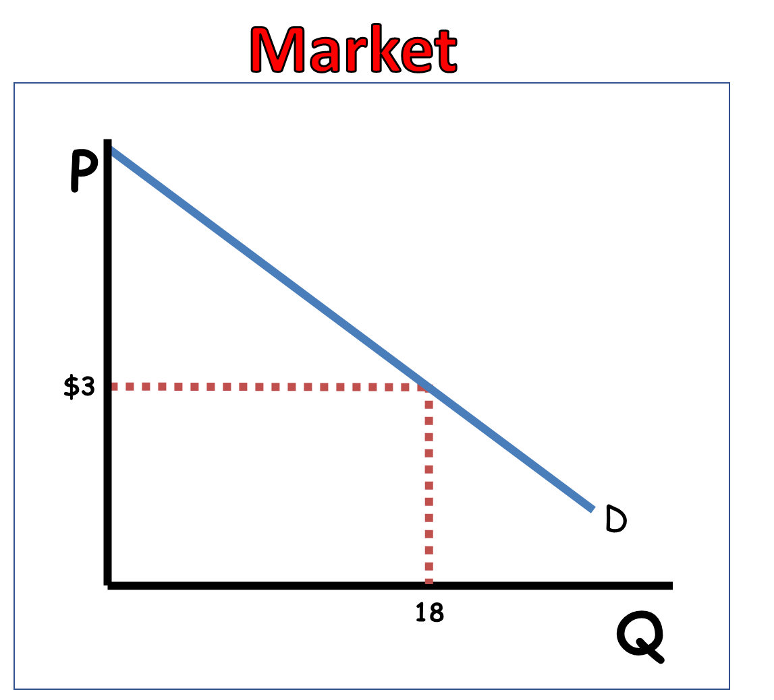
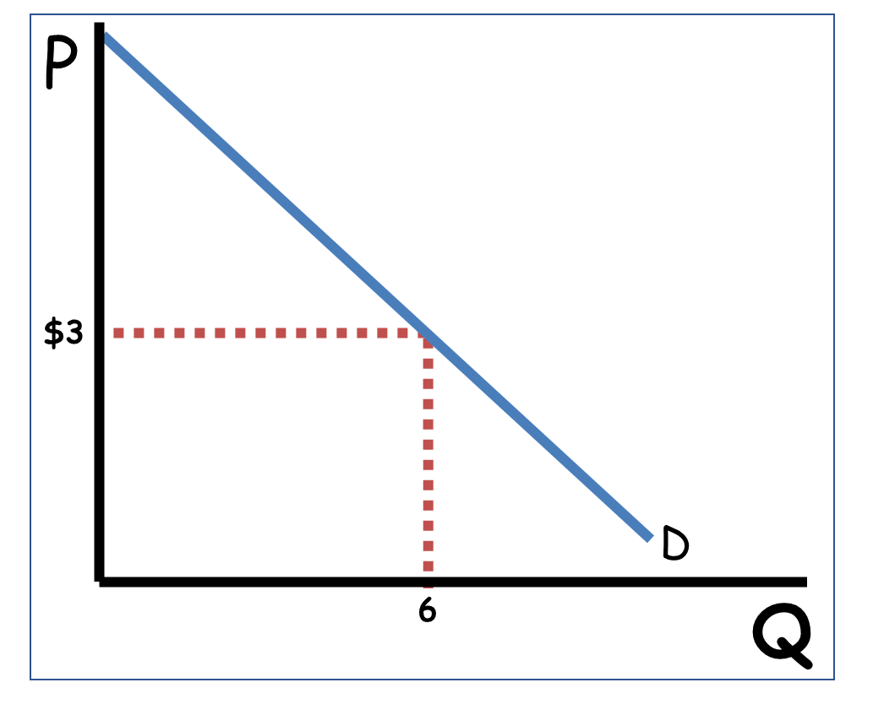
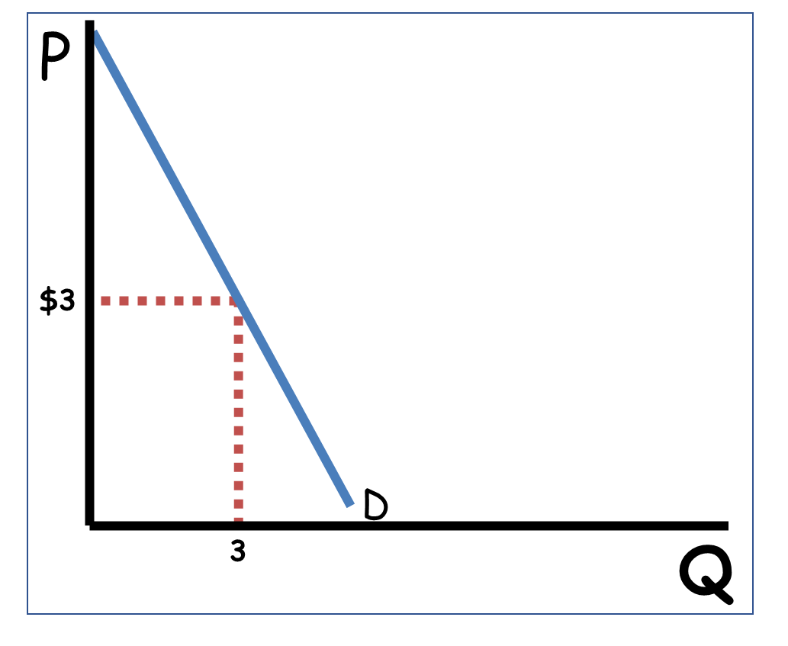
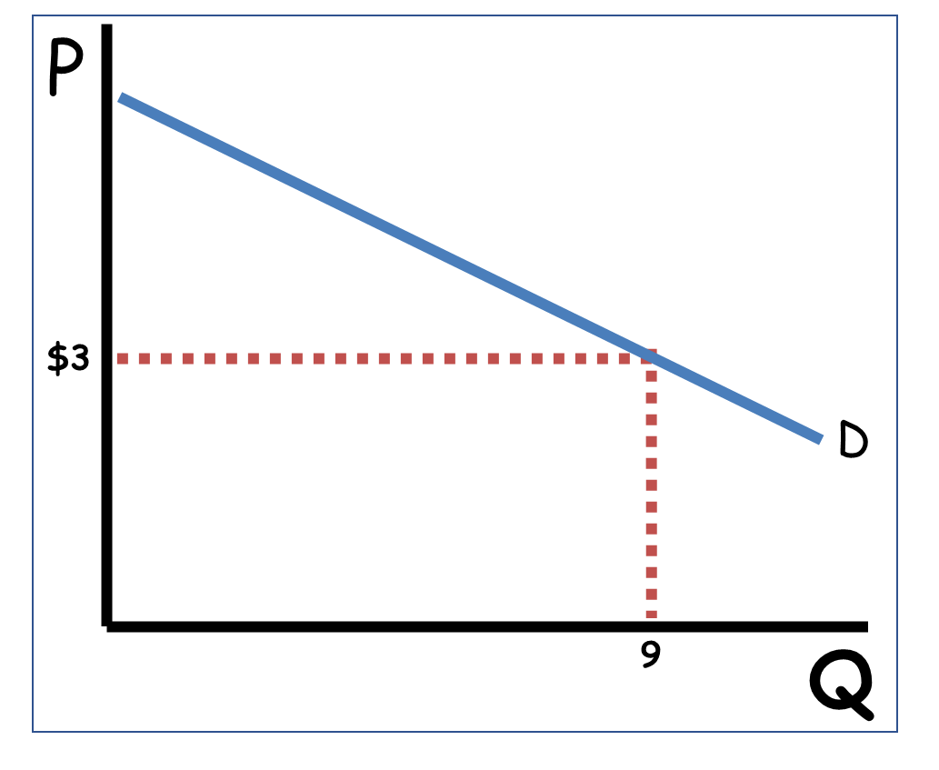
Individual to Market Demand
Market Demand comes
from individual Demand
Pritpal
Linnea
Ryan
Notes:
Main Objective:
Students will visualize how individual demand curves combine to form the market demand curve - showing that the total market quantity demanded at each price is the sum of individual quantities.
Key Concept:
The market demand curve is created by adding the quantities from all individual demand curves at each price level.
Each person’s demand curve represents their willingness to buy at different prices.
By combining everyone’s demand horizontally, we get the total market demand.
This visual demonstrates the same process shown in the previous slide’s tables - but now in graph form.
How to Present the Slide:
Start with the left graphs (Pritpal, Linnea, Ryan):
“Each of these curves shows one person’s demand for the same good - the relationship between price and quantity demanded for them.”
Animate or reveal the curves one by one:
“At the same price - $3, for example - Pritpal demands 6, Linnea 3, and Ryan 9.”
“When we combine them, the market as a whole demands 18 units at that same $3 price.”
Point to the large center graph (Market):
“Here’s the total, or market, demand curve. It reflects everyone’s buying behavior combined.”
“Just like the individual curves, it slopes downward because the law of demand still applies at the market level.”
Emphasize the connection between individual and market behavior:
“The market demand curve shows how an entire economy of consumers responds to price changes.”
“If individual consumers buy more when prices fall, so will the market as a whole.”
Engagement Prompts:
“At a price of $3, how did we get to the total quantity of 18 on the market graph?”
“What would happen to the market demand curve if one consumer left the market?”
“Why do you think the market demand curve still slopes downward like the individual ones?”
Next Slide: “We’ve been moving along these demand curves as price changes-now let’s pause and clarify an important distinction between a change in quantity demanded and a change in demand.”

Slide 6
Demand vs Quantity Demanded
P
The Entire Curve is Demand
Demand is all prices and all quantities
D
Q
Notes:
Main Objective:
Students will understand that “demand” refers to the entire relationship between price and quantity demanded - represented by the whole demand curve, not just one point.
Key Concept:
Demand means all possible price–quantity combinations shown by the entire curve.
It shows how much consumers are willing and able to buy at every price level.
Any factor that changes this overall relationship (like income, preferences, or number of buyers) will shift the entire curve.
This is different from quantity demanded, which refers to a specific point on the curve at one price.
How to Present the Slide:
Begin by pointing to the curve on the graph.
“This red line represents demand. Notice - it’s the entire curve, not just one point.”
Emphasize the key phrase:
“Demand is all prices and all quantities. It’s the full relationship between how price changes and how consumers respond.”
Provide a relatable example:
“If we’re talking about the demand for movie tickets, we’re talking about the entire relationship between price and how many tickets people would buy at each possible price.”
Clarify that this concept sets up the next idea:
“In the next slide, we’ll look at what happens when we only look at one point on this curve - that’s called quantity demanded.”
Engagement Prompts:
“What does this curve tell us about how consumers respond to different prices?”
“If income rises and people can afford more, would the entire demand curve change, or just one point on it?”
“Why do you think economists say demand is the ‘entire curve,’ not a single quantity?”
Next Slide: “So demand is the entire curve-now let’s see what demand looks like in table form.

Slide 7
Demand vs Quantity Demanded
The Entire Table is Demand
Market
P | Q_{d}
$1 | 30
$2 | 24
$3 | 18
$4 | 12
$5 | 6
Demand is all prices and all quantities
Notes:
Main Objective:
Students will recognize that when represented in a table (demand schedule), demand refers to the entire set of price and quantity relationships - not just one row of data.
Key Concept:
The entire demand schedule represents demand.
Each row shows a possible combination of price and quantity demanded.
Together, these rows describe the complete relationship between price and quantity demanded.
Any factor that changes this overall relationship (not the price itself) causes the entire table - and therefore the demand curve - to shift.
How to Present the Slide:
Point to the table and guide students through its meaning.
“Each row shows how much people in the market are willing to buy at a specific price.”
“The entire table - all the prices and all the quantities together - shows demand.”
Connect to previous learning:
“This table is the same information we’ve seen on a demand curve, just in numerical form.”
“Every point on the curve comes from one of these rows in the table.”
Emphasize the difference from quantity demanded:
“If we only look at one row - say, at a price of $3 and a quantity of 18 - that’s a single quantity demanded.”
“But when we include all of the rows, we’re describing demand.”
Transition to next slide:
“Next, we’ll take these same numbers and plot them on a graph to see demand visually.”
Engagement Prompts:
“What happens to the demand schedule if consumers’ incomes rise?”
“Which row of this table shows the highest quantity demanded? What does that tell us about the price?”
“How could we use this table to create a demand curve?”
Next Slide: “We’ve seen that the entire table represents demand-now let’s graph these same numbers and focus on one specific price, where a single point shows quantity demanded.”

Slide 8
Demand vs Quantity Demanded
Quantity Demanded is One Quantity for One Price
P
P1
Quantity demanded comes from a single point on the demand curve
D
Q_{d}
Q
Notes:
Main Objective:
Students will understand that quantity demanded refers to a specific amount consumers are willing and able to buy at one particular price, represented by a single point on the demand curve.
Key Concept:
Quantity demanded is not the entire relationship - it’s just one price–quantity combination on the curve.
When price changes, we move along the demand curve to a new point - this represents a change in quantity demanded, not a change in demand.
The curve itself (demand) doesn’t move - only the point on it changes.
How to Present the Slide:
Begin by contrasting this slide with the previous one.
“Earlier, we looked at the entire curve - that’s demand. Now we’re zooming in to just one point.”
Point to the highlighted dot on the curve.
“This point represents one specific combination - one price (P₁) and one quantity (Qd).”
Trace along the curve visually.
“If price rises or falls, the point moves along the same curve, showing a change in quantity demanded.”
Clarify the relationship between price and movement.
“Price changes cause movements along the curve, not shifts of the curve.”
Transition to the next slide.
“Next, we’ll look at how this same idea - one price and one quantity - appears on a demand schedule.”
Engagement Prompts:
“If the price changes from P₁ to a lower price, what happens to quantity demanded?”
“Does that represent a shift of the curve or movement along it?”
“What does this single point tell us about consumer behavior?”
Next Slide: “We’ve seen how one point on the graph represents quantity demanded-now let’s look at the table version, where one single row shows that same price–quantity combination.”

Slide 9
Demand vs Quantity Demanded
Market
Quantity Demanded is One Quantity for One Price
P | Q_{d}
$1 | 30
$2 | 24
$3 | 18
$4 | 12
$5 | 6
Quantity demanded comes from a single row on the demand schedule
Notes:
Main Objective:
Students will understand that quantity demanded represents a specific amount consumers are willing and able to purchase at one specific price - not the entire relationship between price and quantity.
Key Concept:
Quantity demanded = one point on the demand curve OR one row on the demand schedule.
It reflects a single combination of price and quantity.
How to Present the Slide:
Reinforce the contrast with demand:
“Remember - demand is all prices and all quantities together. But now we’re zooming in on just one pair.”
Point to the highlighted rows ($2 → 24 and $4 → 12) in the table:
“Each of these rows represents a single price–quantity relationship. That’s quantity demanded.”
“When price is $2, consumers buy 24. When price is $4, they buy 12. Each is one quantity demanded.”
Reinforce the connection to the graph:
“Each of these rows can be plotted as a single dot on the demand curve.”
Engagement Prompts:
“If the price is $3, what is the quantity demanded?”
“How many quantities demanded can exist on one demand schedule?”
“How is quantity demanded different from demand?”
Next Slide: “Now that we’ve locked in one price, one quantity as quantity demanded, let’s see what happens when price changes and how that causes a movement along the same demand curve.”

Slide 10
Demand vs Quantity Demanded
P
Price Does Not Change Demand!!
P2
P1
Price Changes Qd
Higher Price, Lower Qd
Lower Price, Higher Qd
D
Q2
Q1
Q
Notes:
Main Objective:
Students will understand that a change in price causes a change in quantity demanded, represented by movement along the same demand curve - not a shift of the curve.
Key Concept:
Price changes cause movement along the curve (change in quantity demanded).
Demand stays the same - the entire curve doesn’t move.
When price increases, consumers buy less (move up and left on the curve).
When price decreases, consumers buy more (move down and right on the curve).
This movement is the graphical representation of the Law of Demand.
How to Present the Slide:
Start with review:
“In the last slide, we learned that quantity demanded is one point on the demand curve. Now, let’s see what happens when the price changes.”
Use the graph animation:
“Notice what happens when price falls from P₁ to P₂ - we move down the same curve from Q₁ to Q₂.”
“That movement shows the change in quantity demanded.”
Clarify what does not change:
“The curve itself stays in the same place. That means overall demand hasn’t changed - only the amount people are willing to buy at each price.”
Emphasize the inverse relationship:
“Price and quantity demanded move in opposite directions - when one goes up, the other goes down.”
Engagement Prompts:
“When the price falls, do we move up or down the demand curve?”
“If the price rises, what happens to quantity demanded?”
“Is this a change in demand or a change in quantity demanded?”
Next Slide: “We’ve seen how a price change moves us along the demand curve, so now let’s look at the same movement shown in a demand schedule as price changes.”

Slide 11
Demand vs Quantity Demanded
Market
Price Does Not Change Demand!!
P | Q_{d}
$1 | 30
$2 | 24
$3 | 18
$4 | 12
$5 | 6
Price Changes Qd
Notes:
Main Objective:
Students will understand that a change in price causes a change in quantity demanded, which appears as a movement between rows on a demand schedule - not a change in the entire table (demand).
Key Concept:
Each row in a demand schedule shows one possible quantity demanded at a given price.
When the price changes, we move from one row to another.
The overall table (demand) stays the same - only the specific row (quantity demanded) changes.
This reflects the same concept shown on the graph - a movement along the demand curve, not a shift.
How to Present the Slide:
Start by recalling the graph:
“In the last slide, we saw how a change in price moves us along the curve. Here, we can see that same idea in a demand schedule.”
Use the red highlights ($2 → 24 and $4 → 12):
“When the price is $2, quantity demanded is 24. When price rises to $4, quantity demanded falls to 12.”
“That’s a change in quantity demanded - we’ve moved from one row to another.”
Clarify what doesn’t change:
“Notice the table itself doesn’t shift or change. The relationship between price and quantity is still the same - that means demand hasn’t changed.”
Reinforce the law of demand:
“Price and quantity demanded move in opposite directions - as price rises, quantity demanded falls.”
Engagement Prompts:
“When price changes from $2 to $4, what happens to quantity demanded?”
“Does the demand curve shift when price changes?”
“What might cause the entire table - or curve - to shift instead of just moving between rows?”
Next Slide: “Now that we’ve seen how a price change moves us between rows in the same demand schedule, let’s turn to what causes the entire demand curve to shift-a change in demand.”

Slide 12
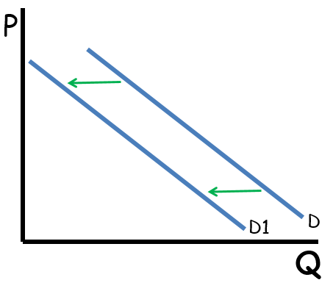
Demand vs Quantity Demanded
Right = Increase
Higher quantities at every price
Left = Decrease
Lower quantities at every price
Change in Demand
P
P | Q_{d}
$1 | 40
$2 | 34
$3 | 28
$4 | 22
$5 | 16
P | Q_{d}
$1 | 30
$2 | 24
$3 | 18
$4 | 12
$5 | 6
D
D1
Q
Notes:
Main Objective:
Students will understand that a change in demand means the entire demand curve shifts - not a movement along the curve - because something other than price has changed.
Key Concept:
A change in demand means consumers want to buy different quantities at every price.
The whole curve moves:
Right = Increase in Demand → higher quantities at every price.
Left = Decrease in Demand → lower quantities at every price.
This happens because of non-price determinants of demand (which we’ll cover next).
Price itself does not shift demand - only outside factors like income, tastes, expectations, population, or prices of related goods do.
How to Present the Slide:
Review the last concept:
“So far, we’ve only looked at movements along a curve - those were caused by price changes. Now, we’re talking about the entire curve moving.”
Use the animation:
“Watch as the curve shifts right - that’s an increase in demand, meaning consumers want to buy more at every price.”
“Now as it shifts left - that’s a decrease in demand, meaning consumers want less at every price.”
Point to the demand schedule:
“Notice how every quantity in the table changes, even though the prices stay the same. That’s the key difference - all quantities change at every price.”
Reinforce the terminology:
“A change in quantity demanded is a movement along the curve.
A change in demand is a shift of the whole curve.”
Engagement Prompts:
“If more people suddenly want this product at every price, which way does the curve shift?”
“If everyone loses interest in it, which direction will it move?”
“What kinds of things might make people want more or less of a product - even if the price doesn’t change?”
Next Slide: “So if price isn’t what shifts demand, let’s look at the first non-price determinant that causes the entire demand curve to move.”

Slide 13
Determinants of Demand
Demand Shifters
Tastes and Preferences
Notes:
Main Objective:
Students will understand that changes in consumer tastes and preferences cause the demand curve to shift right or left, depending on whether people become more or less interested in a good or service.
Key Concept:
Tastes and preferences refer to what consumers like, value, and find desirable.
When a good becomes more popular or more desirable, demand increases (shifts right).
When a good becomes less popular or less desirable, demand decreases (shifts left).
These changes can be influenced by:
Advertising and marketing campaigns
Trends and fads
Health information or public perception
Technological innovation (making old products less appealing)
Seasonal or cultural changes
How to Present the Slide:
Introduce the idea:
“So now that we know price doesn’t change demand, what does? These factors are called determinants or shifters of demand.”
“The first one is tastes and preferences - basically, how much people like something.”
Give concrete examples:
“If a celebrity endorses a product - like when Taylor Swift wears a specific brand - demand shifts right because people want it more.”
“If a health report says that soda causes serious health issues, demand for soda shifts left as people drink less.”
“Think about fidget spinners - everyone wanted one for a few months, and then suddenly no one did. That’s a change in taste and preference.”
Clarify what happens on the graph:
“When people like something more, at every price, they’re willing to buy more - so the entire curve moves to the right.”
“If people like it less, at every price they buy less - shifting the curve left.”
Engagement Prompts:
“Can you think of something that suddenly became popular because of social media?”
“What’s a product that people stopped buying because their tastes changed?”
“If a new style of shoes becomes the trend, what happens to the demand curve for those shoes?”
Next Slide: “Now let’s see this idea on the graph by watching how changes in tastes and preferences actually shift the entire demand curve.”

Slide 14


Determinants of Demand
Tastes and Preferences
P
D
D1
Q
Notes:
Main Objective:
Students will connect changes in consumer preferences to visible shifts in the demand curve, recognizing that liking a product more shifts demand right, while disliking it shifts demand left.
Key Concept:
This slide visualizes the effect of a change in tastes and preferences.
When people like a good more → Demand Increases → Curve shifts right 😊
When people like a good less → Demand Decreases → Curve shifts left 😞
The shift means that at every price, consumers now want to buy more or less than before.
Note: Price hasn’t changed - it’s the demand curve itself that moves.
How to Present the Slide:
Set up the context:
“We just learned what tastes and preferences mean. Now let’s see what happens when people’s preferences change.”
Use the animation deliberately:
“When the faces smile, that means consumers are happier with the product - they like it more. Watch how the entire curve shifts to the right - that’s an increase in demand.”
“When the faces frown, people lose interest or the product becomes less popular. The curve shifts to the left - that’s a decrease in demand.”
Emphasize the distinction from quantity demanded:
“Remember, the price didn’t change here. The curve moved because of people’s preferences, not because of price.”
Real-world examples:
“If a new study shows a health benefit from eating dark chocolate, demand for dark chocolate shifts right.”
“If people stop liking sugary drinks due to health concerns, the demand for soda shifts left.”
Engagement Prompts:
“What’s something people like more today than they did five years ago?”
“What’s a product you used to like but don’t buy anymore?”
“How would the demand curve for that product move?”
Next Slide: “Now that we’ve seen how changes in tastes and preferences shift demand, let’s examine another demand shifter: changes in the size of the market.”

Slide 15
Determinants of Demand
Demand Shifters
Tastes and Preferences
Market Size
Notes:
Main Objective:
Students will understand that changes in the number of consumers in a market cause the entire demand curve to shift. When more people enter the market, demand increases; when fewer people are in the market, demand decreases.
Key Concept:
Market size refers to the number of consumers willing and able to buy a product.
A larger market (more consumers) means higher demand at every price - curve shifts right.
A smaller market (fewer consumers) means lower demand at every price - curve shifts left.
Market size can change because of:
Population growth or decline
Changes in demographics (e.g., aging population, baby boom)
New markets opening (e.g., a product goes global or online)
Migration patterns (people moving in or out of an area)
Economic access changes (new technology or internet access in developing areas)
How to Present the Slide:
Introduce the idea:
“The second demand shifter is market size - basically, how many people are in the market buying the product.”
Give real-world examples:
“If a city’s population doubles, there are more people buying groceries, clothes, and homes - demand for nearly everything shifts right.”
“If people move out of a small town, demand for local restaurants, housing, and services shifts left.”
“When new countries get access to smartphones, the global demand for phones shifts right - even if prices stay the same.”
Relate to classroom context:
“If the number of students in this school doubled overnight, what would happen to the demand for lunch, parking spaces, or school supplies?”
Emphasize the mechanism:
“Market size affects how many consumers are buying at every price - it doesn’t change the price itself, but it shifts the entire curve.”
Engagement Prompts:
“What happens to the demand for housing when more people move to a city?”
“What about when a large company closes and lots of people move away - how would that affect demand?”
“How might the aging population affect the demand for healthcare or electric scooters?”
Next Slide: “Now let’s visualize how changes in the number of consumers shift the entire demand curve to the right or left.”

Slide 16
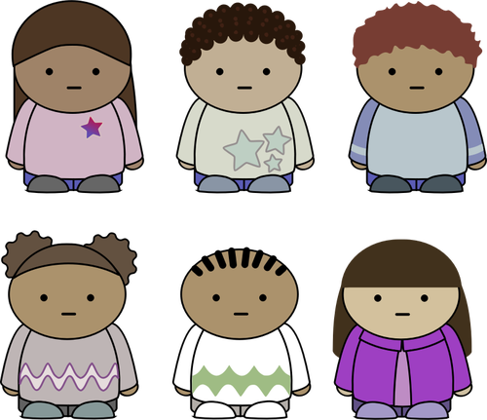
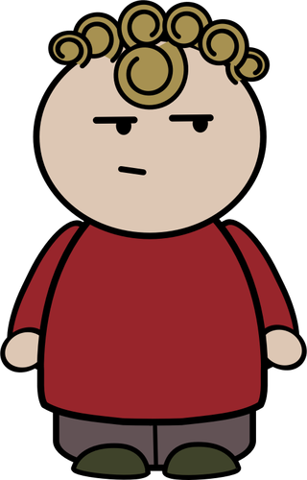
Determinants of Demand
Market Size
Number of Buyers
P
D
D1
Q
Notes:
Main Objective:
Students will understand that market size and the number of buyers are directly connected - as the number of consumers increases or decreases, the entire demand curve shifts to reflect higher or lower overall demand.
Key Concept:
Market size represents how many people are in the market who can and want to buy a product.
The number of buyers is what actually determines market size.
More buyers → Demand increases → Curve shifts right.
Fewer buyers → Demand decreases → Curve shifts left.
The shift happens at every price level because the total number of people demanding the good changes, not just how much each person buys.
How to Present the Slide:
Introduce the link between concepts:
“Market size and the number of buyers mean the same thing in economics. When we say the market grows, we mean there are more buyers in it.”
Walk through the animation:
“When there are more buyers - like when a city’s population grows or a product is sold globally - the entire demand curve shifts right.”
“When there are fewer buyers - like when people move away or stop using a product altogether - the curve shifts left.”
Point out what’s not happening:
“Notice that the price hasn’t changed. The curve is moving because there are simply more or fewer people in the market.”
Use visual and real-world examples:
“Think about smartphones - as more people around the world get access to them, the number of buyers increases, so the demand curve shifts right.”
“If fewer people have kids, demand for baby formula and diapers shifts left because there are fewer buyers.”
“If a new housing development brings 10,000 new residents to a town, demand for groceries, electricity, and restaurants all shift right.”
Engagement Prompts:
“If a new college opens nearby, what happens to the demand for apartments and pizza delivery?”
“If people start moving out of your town, how does that affect local businesses?”
“Can you think of a product where more global buyers suddenly increased demand?”
Next Slide: “Now that we’ve seen how the number of buyers shifts demand, let’s look at how changes in the prices of related goods can also shift the entire demand curve.”

Slide 17
Determinants of Demand
Demand Shifters
Tastes and Preferences
Market Size
Prices of Related Goods
Substitutes Complements .
Notes:
Main Objective:
Students will learn that the price of one good can affect the demand for another through two relationships: substitutes and complements.
Key Concept:
Some products are connected because consumers buy them instead of each other or together.
When the price of one good changes, it can cause the demand for another good to shift.
The effect depends on whether the goods are substitutes or complements.
-Substitutes
Definition:
Goods that are used in place of each other.
Rule:
When the price of one good increases, demand for the substitute increases (shifts right).
When the price of one good decreases, demand for the substitute decreases (shifts left).
Examples:
Pepsi and Coke
Burgers and hot dogs
Android phones and iPhones
Streaming services like Netflix and Disney+
Simple way to explain:
“If Coke’s price goes up, people buy more Pepsi. They’re substitutes - you switch to the cheaper option.”
-Complements
Definition:
Goods that are used together.
Rule:
When the price of one good increases, demand for its complement decreases (shifts left).
When the price of one good decreases, demand for its complement increases (shifts right).
Examples:
Peanut butter and jelly
Printers and ink
Hot dogs and buns
Streaming subscriptions and Wi-Fi service
Simple way to explain:
“If the price of peanut butter goes up, people buy less jelly - because they go together.”
How to Present the Slide:
Start broad:
“Sometimes, what happens to one product affects the demand for another. We call those related goods.”
Break it into two types:
“The first type - substitutes - move in the same direction as price.”
“The second type - complements - move in the opposite direction of price.”
Use visuals or gestures:
Use hand motions:
For substitutes, move one hand up and the other hand up - they move together.
For complements, move one hand up and the other down - they move opposite ways.
Make it relatable:
“If Starbucks raises prices, what happens to the demand for Dunkin coffee?”
“If video game consoles become cheaper, what happens to the demand for video games?”
Engagement Prompts:
“Can you name two products that are substitutes?”
“Can you name two that are complements?”
“If Netflix raises its subscription price, how does that affect Disney+?”
Next Slide: “Now let’s see this relationship on a graph by examining how a change in the price of a substitute shifts the demand curve for the other good.”

Slide 18



Determinants of Demand
Market for Honey
Price of Related Goods
Substitutes
Substitutes are goods that can be used in place of each other.
P
D
D1
$4
$4
Q
$3
$3
Notes:
Main Objective:
Students will understand that a change in the price of a substitute good causes the demand for the related good to shift in the same direction.
Key Concept:
Substitute goods are products that satisfy the same need - if one becomes cheaper or more expensive, people switch.
When the price of a substitute falls, demand for the related good decreases (shifts left).
When the price of a substitute rises, demand for the related good increases (shifts right).
The change happens because consumers substitute toward the better-priced option.
How to Present the Slide:
Introduce the example:
“This graph shows the market for honey. Its substitute here is jam - both can be used on toast or in recipes.”
Describe the animation sequence:
“When the price of jam falls from $4 to $3, people buy more jam and less honey - demand for honey decreases and shifts left.”
“When the price of jam rises again, people switch back to honey - demand for honey increases and shifts right.”
Highlight what’s changing:
“The change isn’t in the price of honey - it’s in the price of jam, a substitute. That’s why the entire curve for honey shifts.”
Reinforce the rule visually:
“For substitutes, price and demand move in the same direction - if the price of jam goes up, demand for honey goes up too.”
Make it relatable:
“If Starbucks raises prices, what happens to the demand for Dunkin coffee?”
“If Uber prices drop a lot, what happens to the demand for taxis?”
Engagement Prompts:
“Can you think of two goods that are substitutes?”
“If the price of Coke falls, what happens to the demand for Pepsi?”
“Why might a company care about the price of its competitors’ products?”
Next Slide: “We’ve seen that substitutes move in the same direction-now let’s contrast that by looking at complements, where a change in the price of one good affects demand for the other in the opposite direction.”

Slide 19

Determinants of Demand
Market for Peanut Butter
Price of Related Goods
Complements
Complements are goods that are used together.
P
D
D1
$4
$4
$3
Q
$3
Notes:
Main Objective:
Students will understand that when the price of a complement changes, the demand for the related good moves in the opposite direction.
Key Concept:
Complementary goods are products that are used together - the demand for one depends on the other.
When the price of one complement rises, the demand for the other falls (shift left).
When the price of one complement falls, the demand for the other rises (shift right).
The key is that these goods are jointly consumed, so people tend to buy (or skip) both.
How to Present the Slide:
Introduce the example:
“This graph shows the market for peanut butter. Its complement here is jam - people usually consume them together.”
Describe the animation:
“When the price of jam falls from $4 to $3, people buy more jam - and because jam and peanut butter are complements, they also buy more peanut butter. The demand for peanut butter shifts right.”
“But when the price of jam rises again, people buy less jam and also less peanut butter. The demand for peanut butter shifts left.”
Emphasize what’s changing:
“Notice - the price of peanut butter didn’t change! The change happened because of jam’s price, a related good.”
“That means this is a shift in demand, not a movement along the curve.”
Explain the relationship rule:
“For complements, price and demand move in opposite directions - when the price of one goes up, the demand for the other goes down.”
Connect to real-life examples:
“If movie ticket prices go down, what happens to popcorn sales?”
“If gas prices rise, what happens to demand for SUVs?”
“If smartphones become cheaper, what happens to the demand for apps and chargers?”
Engagement Prompts:
“Can you name two goods that are complements?”
“If the price of hot dogs rises, what happens to the demand for buns?”
“Why do you think gas prices affect car sales?”
Next Slide: “Now that we’ve seen how prices of related goods affect demand, let’s look at another major demand shifter-how changes in income affect demand differently for normal and inferior goods.”

Slide 20
Determinants of Demand
Demand Shifters
Tastes and Preferences
Market Size
Prices of Related Goods
Substitutes Complements .
Changes in Income
Normal Goods Inferior Goods .
Substitutes
Price of one increases, demand for other also increases
Complements
Price of one increases, demand for other decreases
Notes:
Main Objective:
Students will understand that changes in consumer income can cause the entire demand curve to shift - but the direction depends on the type of good (normal vs. inferior).
Key Concept:
When people’s income changes, their purchasing power changes.
But not all goods respond the same way - some are considered normal (we buy more when we have more money), while others are inferior (we buy less when we have more money).
Normal Goods
Definition:
Goods for which demand increases when income increases, and demand decreases when income decreases.
Examples:
Restaurant meals
New cars
Name-brand clothing
Air travel
Rule:
Income ↑ - Demand ↑
Income ↓ - Demand ↓
How to phrase it for students:
“When people have more money, they buy more of these things. They’re normal goods - we all want more of them when we can afford it.”
Inferior Goods
Definition:
Goods for which demand decreases when income increases, and demand increases when income decreases.
Examples:
Ramen noodles
Used cars
Generic or store-brand products
Bus rides (vs. taxis or rideshares)
Rule:
Income ↑ - Demand ↓
Income ↓ - Demand ↑
How to phrase it for students:
“When people get richer, they stop buying these - they switch to something better. Inferior goods are the ones we ‘upgrade from’ when our income goes up.”
How to Present the Slide:
Review prior shifters:
“So far, we’ve looked at things outside the product that change demand - like tastes, market size, and prices of related goods.”
Introduce income as a new factor:
“Now let’s talk about how a change in people’s income affects what they buy.”
Contrast normal vs. inferior:
“The direction of the demand shift depends on whether the good is normal or inferior.”
Use a relatable example:
“If your income doubled overnight, would you buy more ramen noodles or more Chipotle burritos?”
Engagement Prompts:
“What happens to the demand for luxury vacations when incomes rise?”
“If there’s a recession, what happens to the demand for used cars?”
“Can a good be normal for one person but inferior for another?”
Next Slide: “Let’s start by visualizing this with a normal good, and see how an increase in income shifts the entire demand curve.”

Slide 21


Determinants of Demand
Changes in Income
Normal Goods
Consumers buy more normal goods when they have more income.
P
D
D1
Q
Notes:
Main Objective:
Students will see how a change in income affects the demand for normal goods, causing the entire demand curve to shift right (increase) or left (decrease).
Key Concept:
Normal goods are items people buy more of when they have more money.
When income rises, consumers demand more of the good at every price level → Demand shifts right.
When income falls, consumers demand less of the good at every price level → Demand shifts left.
How to Present the Slide:
Start with the context:
“This graph shows what happens in the market for shoes - a typical normal good.”
Explain the animation:
“When consumers’ income increases, they can afford more shoes, shifting demand to the right.”
“When income decreases, they buy fewer shoes, shifting demand back to the left.”
Emphasize the distinction:
“Notice - the price of shoes didn’t change. What changed was people’s income, which affects how much they want to buy at all prices.”
Connect to the definition:
“That’s what makes shoes a normal good. Demand increases when income rises.”
Make it relatable:
“If you got a big raise, would you buy more ramen or more sneakers? Most people buy more sneakers - that’s a normal good response.”
Engagement Prompts: “Can you think of other examples of normal goods?”
“What do people tend to buy more of when they get richer?”
“Do you think the same good could be normal for one person but inferior for another?”
Next Slide: “Now let’s contrast this by looking at an inferior good, where an increase in income causes demand to shift in the opposite direction.”

Slide 22

Determinants of Demand
Changes in Income
Inferior Goods
Consumers buy fewer inferior goods when have more income.
P
D
D1
Q
Notes:
Main Objective:
Students will understand that for inferior goods, an increase in income decreases demand, and a decrease in income increases demand - the opposite of normal goods.
Key Concept:
Inferior goods are items people buy less of when their income goes up.
When income rises, consumers switch to higher-quality substitutes.
When income falls, consumers buy more of these cheaper options.
How to Present the Slide:
Set the context:
“Now that we’ve seen how income affects normal goods like shoes, let’s look at the opposite case - inferior goods.”
Describe the animation:
“Here we see the market for canned soup. As income increases, people buy fewer cans - demand shifts left.”
“But when income decreases, more people turn to canned soup as an affordable option - demand shifts right.”
Clarify the relationship:
“This time, the price of soup didn’t change. What changed was income, which influences how appealing these cheaper goods are.”
Connect to real life:
“Think about when people lose jobs during a recession - they might buy more instant noodles or canned goods instead of fresh meals or restaurant food.”
Engagement Prompts:
“What are some other examples of inferior goods?”
“What might you start buying more of if your income dropped suddenly?”
“Why do you think canned soup demand goes down when incomes rise?”
Teacher Tip:
Emphasize the contrast between normal and inferior goods:
Normal - income ↑ - demand ↑ (curve shifts right)
Inferior - income ↑ - demand ↓ (curve shifts left)
You can show this visually by gesturing right for normal goods and left for inferior goods.
Next Slide: “Finally, let’s look at how expectations about the future-like expected prices or income-can shift demand today, even before anything actually changes.”

Slide 23
Determinants of Demand
Demand Shifters
Tastes and Preferences
Market Size
Prices of Related Goods
Substitutes Complements .
Changes in Income
Normal Goods Inferior Goods
5.Expectations
Normal Goods
Price of one increases, demand for other also increases
Inferior Goods
Price of one increases, demand for other decreases
Notes:
Main Objective:
Students will learn that consumer expectations about the future-especially future prices or income-can affect current demand.
Key Concept:
Expectations change today’s demand because people act on what they believe will happen tomorrow.
If consumers expect higher future prices, they’ll buy more now (demand increases today).
If consumers expect lower future prices, they’ll wait to buy later (demand decreases today).
How to Present the Slide:
Transition from previous topic:
“We’ve already covered how changes in income affect demand for normal and inferior goods. Now we’ll look at one last demand shifter - expectations for the future.”
Introduce the logic:
“Sometimes demand changes not because prices have changed, but because people expect them to.”
“If you think prices will rise next week, you stock up today. If you think they’ll fall, you wait.”
Make it relatable:
“Think about gas prices - when people hear that prices will jump tomorrow, gas stations are packed tonight.”
“Or if Apple announces a sale on iPhones next month, people hold off buying now.”
Clarify what’s shifting:
“The price today doesn’t change. What changes is demand today because of what consumers expect in the future.”
Engagement Prompts:
“What goods do people buy early when they expect prices to go up?”
“How might future job loss expectations affect current demand for big purchases?”
“Can you think of an example where expectations caused shortages before prices changed?”
Next Slide: “Now let’s see this idea on a graph, showing how expected price changes cause the demand curve to shift right when prices are expected to rise and left when prices are expected to fall.”

Slide 24



Determinants of Demand
Expectations
Consumer guesses about the future can impact purchases.
P
$400
$400
$300
$300
D
D1
Q
Notes:
Main Objective:
Students will understand how expected future price changes affect current demand - causing the demand curve to shift right or left depending on consumer expectations.
Key Concept:
When consumers expect prices to rise in the future, they buy more now, shifting demand right (increase).
When consumers expect prices to fall in the future, they delay purchases, shifting demand left (decrease).
The current price doesn’t change - the shift happens because of expectations about the future.
How to Present the Slide:
Set the scenario:
“This graph shows the market for televisions.”
“Even though the current price hasn’t changed, demand can shift based on what people think will happen next.”
Describe the animation:
“If people hear that TV prices will go up next month, they rush to buy now - demand shifts right.”
“If people expect prices to drop during a big holiday sale, they wait - demand shifts left.”
Clarify the cause:
“Notice - this shift isn’t about price changing today, but about expectations of future price changes influencing current buying decisions.”
Relate to real life:
“You’ve probably seen this happen during Black Friday or before a new iPhone launch - people either hold off or buy early depending on what they expect prices to do.”
Engagement Prompts:
“What happens to demand for flights when people expect ticket prices to rise next week?”
“How might car dealerships use future price expectations to encourage buyers now?”
“Can expectations about future income also change current demand?”

