Slide 1

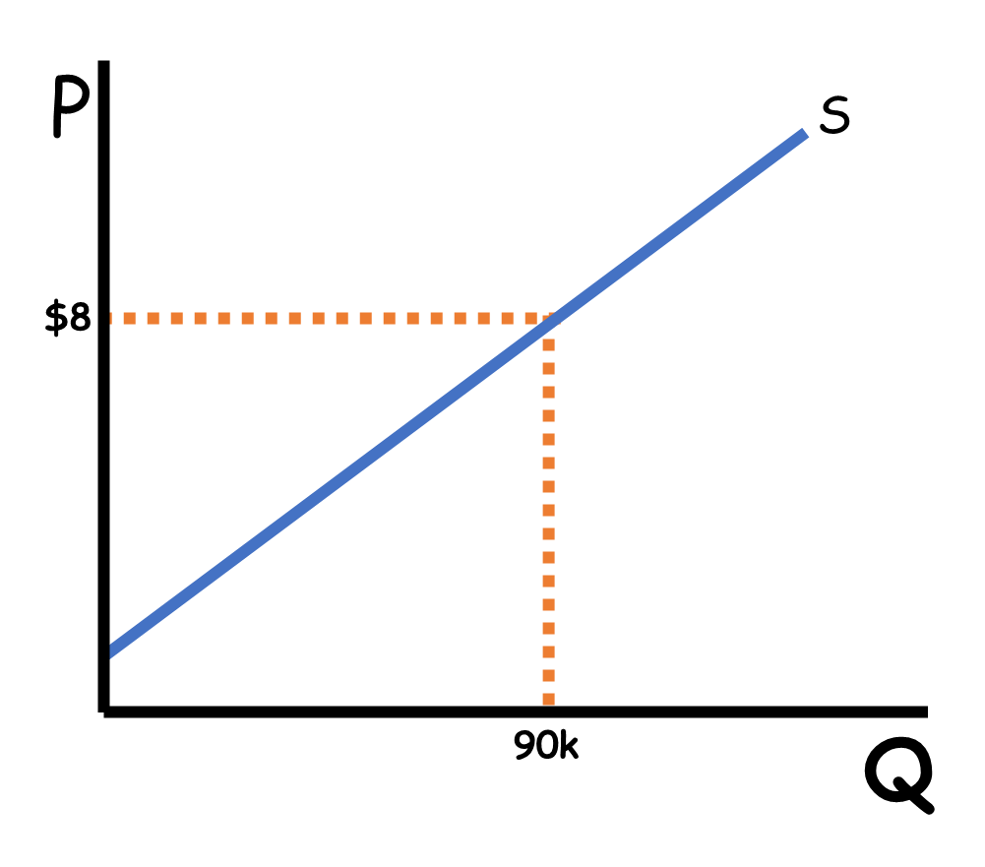
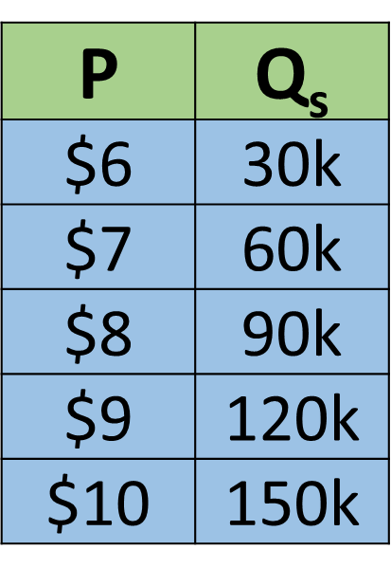

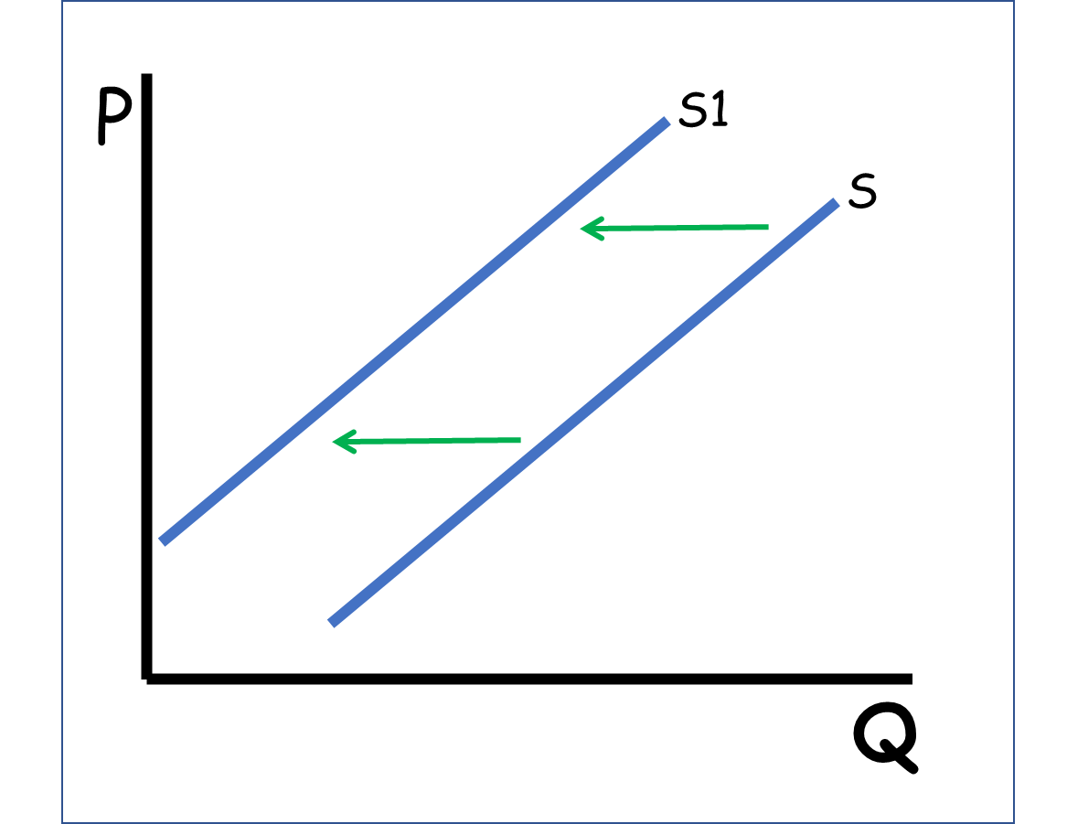


CED 1.5
Supply
Basic Economic
Concepts
Notes:
After completing this lesson, students should be able to:
Define supply as the relationship between price and the quantity producers are willing and able to offer for sale.
Differentiate between supply (the entire curve) and quantity supplied (a single point on the curve).
Explain how changes in price cause movements along the supply curve, while non-price determinants cause the supply curve to shift.
Identify and describe the major determinants (shifters) of supply
Illustrate increases and decreases in supply on a graph and a supply schedule.
Analyze how producer decisions respond to changes in production costs, technology, or profit opportunities.
Apply the concept of supply to real-world examples in individual, business, and market contexts (e.g., wheat farmers, tech firms, or manufacturing industries).
Teacher Note:
This lesson extends students’ understanding of markets by shifting focus from buyers to producers. Emphasize that supply represents producers’ behavior-the relationship between price and the quantity firms are willing to sell. Reinforce the distinction between movements along the curve (price changes) and shifts of the curve (non-price factors).
Encourage students to connect supply determinants to real-world events-such as rising input costs, government regulations, or new technologies-that affect businesses’ production decisions. Use examples like fertilizer prices for farmers, government subsidies for renewable energy, or changes in the number of competitors in an industry.
Remind students that, just like with demand, the supply curve reflects incentives: as profit potential rises, producers are motivated to supply more.

Slide 2
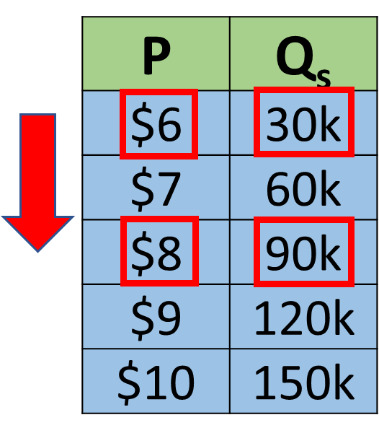
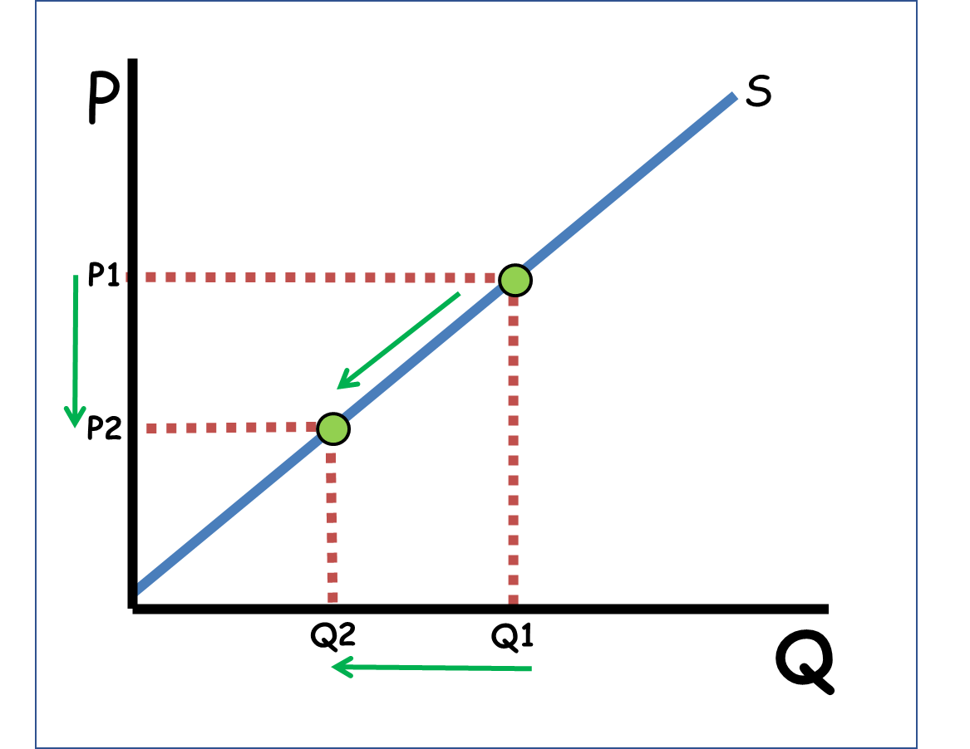
Law of Supply
The law of supply:
Ceteris Paribus, producers sell more at high prices and less at low prices.
Notes:
Main Objective:
Students will be able to define the Law of Supply and understand that, ceteris paribus, producers sell more at higher prices and less at lower prices.
Key Concept:
The Law of Supply describes the direct (positive) relationship between price and quantity supplied.
When the price increases, producers are willing and able to sell more.
When the price decreases, producers are willing and able to sell less.
The phrase “ceteris paribus” means “all other things held constant.” This is important because it isolates price as the only variable changing in this scenario.
How to Present the Slide:
Start with the big red statement and emphasize the producer perspective:
“Ceteris paribus, producers sell more at high prices and less at low prices.”
Point to the table and trace the upward pattern:
“As price rises from $6 to $8, the quantity supplied increases from 30,000 to 90,000 units.”
Move to the graph and highlight the movement along the supply curve (P1→P2, Q1→Q2).
Reinforce:
“This is not a new curve - it’s movement along the same supply curve.”
Connect back to the Law of Demand lecture:
“Notice how this is the mirror image of the Law of Demand. Buyers respond inversely to price, but sellers respond directly - they want to sell more when prices rise.”
Engagement Prompts:
“Why do you think producers are willing to sell more at higher prices?”
“Can you think of a real-world example where higher prices led to more production?”
“What does ceteris paribus mean and why does it matter here?”
Next Slide: The Profit Motive
“Okay, so we know what happens when prices rise - producers sell more. Now let’s talk about why that happens, which brings us to the profit motive.”

Slide 3


Law of Supply
Prices Signal Profits
Lower prices mean less profit, so businesses produce less
Higher prices mean more profit, so businesses produce more
$9
$8
Notes:
Main Objective:
Students will be able to explain the profit motive as the reason behind the Law of Supply, and understand how price changes signal producers to increase or decrease production.
Key Concept:
Prices signal profits. Producers respond to changes in price because higher prices mean higher potential profits.
When prices rise, profits increase, so businesses produce more to take advantage of the higher return.
When prices fall, profits decrease, so businesses produce less and shift resources elsewhere.
The profit motive explains why the supply curve slopes upward - it’s not about producing more out of need, but about chasing higher profitability.
How to Present the Slide:
Start by emphasizing the headline:
“Prices signal profits - that’s why producers behave the way they do.”
Use the farmer example to make it concrete:
“If the price of wheat falls, it might seem like the farmer should grow more to make up the lost income. But that’s not what happens. Lower prices mean lower profits - so the farmer shifts land and effort into something more profitable, like strawberries.”
Highlight how this shows rational decision-making:
“Producers allocate resources where they can earn the greatest return - they don’t produce more of something unprofitable.”
Make the connection to demand explicit:
“In demand, consumers respond to prices by changing what they buy.
In supply, producers respond to prices by changing what they make. Both sides of the market are reacting to incentives - but for opposite reasons.”
Engagement Prompts:
“Why would a farmer grow less wheat if the price of wheat drops?”
“Can you think of a real-world example where producers switched products when prices changed?”
“How is this similar to or different from how consumers react in the demand lesson?”
Next Slide: Individual vs. Market Supply Curves
“Now zoom out - if every individual producer is responding to prices and profits this way, the next step is to see how all of those decisions combine to form the market supply curve.”

Slide 4
Individual to Market Supply
Market Supply comes from individual Supply
Liam
May
Joseph
P | Q_{s}
$6 | 10k
$7 | 20k
$8 | 30k
$9 | 40k
$10 | 50k
P | Q_{s}
$6 | 5k
$7 | 10k
$8 | 15k
$9 | 20k
$10 | 25k
P | Q_{s}
$6 | 15k
$7 | 30k
$8 | 45k
$9 | 60k
$10 | 75k
Notes:
Main Objective:
Students will be able to explain how market supply is derived from individual supply schedules by summing the quantities supplied by all producers at each price level.
Key Concept:
The market supply represents the total quantity supplied by all individual producers in a market.
Each seller (Liam, May, Joseph) has their own supply schedule that shows how much they are willing and able to sell at various prices.
The market supply is found by adding together all individual quantities supplied at each price.
Just like market demand, market supply is an aggregate concept - it shows the overall behavior of all producers combined.
How to Present the Slide:
Start by reinforcing the connection to demand:
“Just like we added up all individual demand schedules to get market demand, we do the same with supply.”
Point to the three tables on the slide:
“Each person - Liam, May, and Joseph - represents a different producer. Notice that they all follow the Law of Supply: as price rises, each one increases quantity supplied.”
Then emphasize the big idea:
“Market supply comes from all producers. To get the total, we simply add together everyone’s quantities at each price level.”
Use a simple visual gesture or board example:
“At $6, Liam supplies 10k, May supplies 5k, and Joseph supplies 15k - together, that’s 30k total for the market.”
“As price increases, each producer offers more - and when we add them up, the total market supply also increases.”
Make sure to highlight the connection to real markets:
“In the real world, every farm, factory, or small business contributes to the total amount of a good supplied at any given price.”
Engagement Prompts:
“If another farmer joined this market, how would that affect market supply?”
“Does everyone have to produce the same amount at each price?”
“Why does market supply increase faster when more producers are involved?”
Next Slide: Market Supply Schedule
“Now that we’ve seen how individual producers add up to market supply, the next step is to organize that information into a market supply schedule - a table that shows the total quantity supplied at each price.”

Slide 5
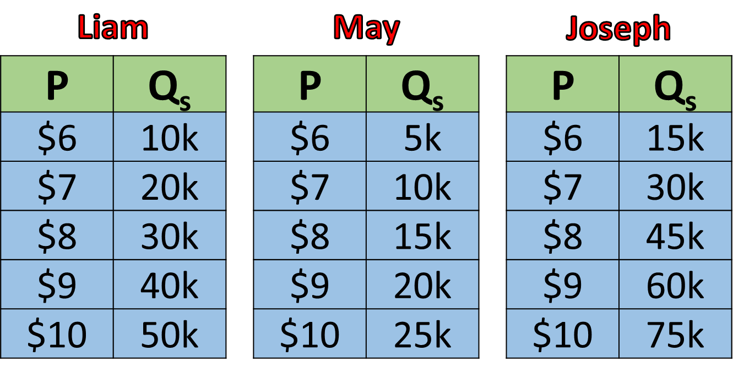
Individual to Market Supply
Market Supply comes from individual Supply
Market
P | Q_{s}
$6 | 30k
$7 | 60k
$8 | 90k
$9 | 120k
$10 | 150k
Notes:
Main Objective:
Students will be able to combine individual supply schedules to create the market supply schedule, showing how total quantity supplied at each price is determined by adding all individual producers’ quantities together.
Key Concept:
The market supply schedule is built by adding up the quantities each producer is willing and able to sell at every price level.
Each individual follows the Law of Supply - as price rises, they produce more.
The market supply schedule shows the total quantity supplied in the market at each price, representing the sum of all individual producers.
This process demonstrates that markets are made up of many independent suppliers whose behavior adds up to form overall supply.
How to Present the Slide:
Begin with a quick recap:
“On the last slide, we saw how individual producers like Liam, May, and Joseph each had their own supply schedules.”
Then move to this slide:
“Now, when we add their quantities together at each price, we get the market supply schedule - which shows the total quantity supplied in the entire market.”
Use the highlighted $8 row to illustrate the process:
“At $8, Liam supplies 30,000 units, May supplies 15,000, and Joseph supplies 45,000. Together, that makes 90,000 units supplied in the market.”
Emphasize the concept visually:
“Each individual column represents one producer - and the market column shows the total. As prices rise, everyone produces more, so total market supply increases too.”
Make the connection to the next concept explicit:
“Just like with demand, we can graph these totals. When we combine individual supply curves, we get the market supply curve. That’s what we’ll see next.”
Engagement Prompts:
“What happens to the market supply if one producer leaves the market?”
“If more producers enter this market, what will happen to the numbers in the Market column?”
“Does everyone have to respond to price changes in the exact same way for this to work?”
Next Slide: Market Supply Curve
“Now that we’ve added individual quantities together in a table, the next step is to graph those totals - by combining individual supply curves horizontally to form the market supply curve.”

Slide 6

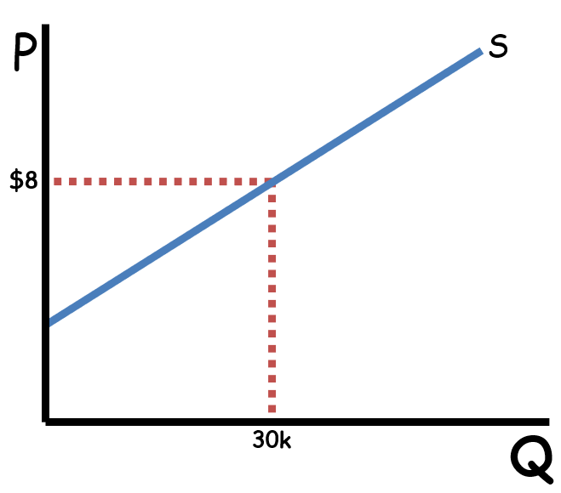
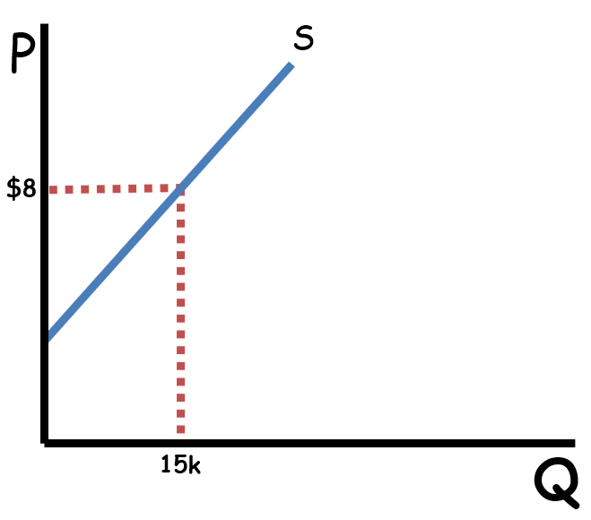
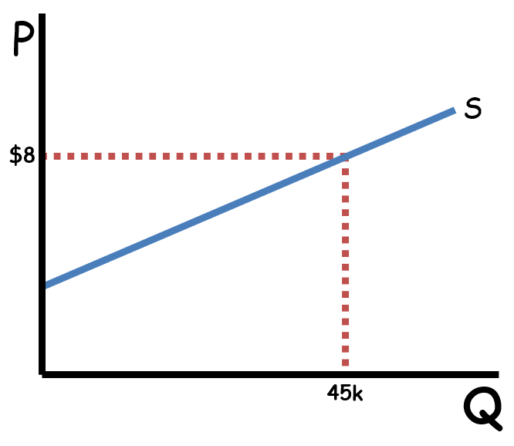
Individual to Market Supply
Market Supply comes from individual Supply
Liam
May
Joseph
Notes:
Main Objective:
Students will be able to illustrate how individual supply curves combine to form the market supply curve, showing how total market supply increases as more producers’ outputs are added together at each price level.
Key Concept:
The market supply curve is created by adding individual supply curves horizontally - summing quantities supplied by all producers at each price.
Each individual curve (Liam, May, Joseph) represents how one producer responds to price changes.
When we add all producers together, we get the total market response - the market supply curve.
Just like with demand, this process shows how individual behavior aggregates into market-level outcomes.
How to Present the Slide:
Start by reminding students what they just saw:
“In the last slide, we combined individual supply schedules to create the market supply schedule.”
Then transition to this visual:
“Now we’re doing the same thing with supply curves. Each curve here - Liam’s, May’s, and Joseph’s - represents an individual producer.”
“At a price of $8, Liam supplies 30k, May 15k, and Joseph 45k - together that’s 90k total. So, on the market graph, that’s where we plot the point for $8 and 90k.”
“When we add all three supply curves together like this, we get the market supply curve - it shows the total quantity supplied in the entire market at every price.”
Make a connection to demand for conceptual reinforcement:
“This process mirrors what we did with demand earlier - just as market demand adds up all consumers, market supply adds up all producers.”
Emphasize directionality:
“Notice we’re adding quantities horizontally - not vertically. Each producer’s output adds to total quantity supplied at the same price.”
Engagement Prompts:
“If a new producer entered the market, how would that affect the market supply curve?”
“Why do we add quantities horizontally instead of vertically?”
“What happens to the market supply if one producer leaves or cuts back?”
Next Slide:
“Now that we’ve built the market supply curve by adding individual producers together, let’s shift gears and look at what happens when price itself changes - causing movement along the supply curve rather than a shift.”

Slide 7
Supply vs Quantity Supplied
P
The Entire Curve is Supply
S
Supply is all prices and all quantities
Q
Notes:
Main Objective:
Students will be able to differentiate between “supply” and “quantity supplied”, recognizing that the entire supply curve represents supply, while a single point on that curve represents the quantity supplied at a specific price.
Key Concept:
Supply refers to the entire relationship between price and quantity supplied - it includes all possible prices and all possible quantities.
The supply curve itself represents supply.
Quantity supplied, on the other hand, is a specific amount producers are willing and able to sell at one particular price.
This distinction parallels what students learned in the demand lecture - the difference between “demand” (the entire curve) and “quantity demanded” (a single point on that curve).
How to Present the Slide:
Start by focusing attention on the curve on the graph:
“Here we see the entire supply curve - this red line shows all the different quantities producers would supply at all possible prices.”
Then, emphasize the definition visually and verbally:
“When we say supply, we mean the whole relationship - every price, every quantity, the full curve.”
Reinforce the key phrase from the slide:
“Supply is all prices and all quantities. It’s not one number - it’s the entire curve.”
Engagement Prompt:
“How is this similar to what we saw with demand?”
Next Slide: The Supply Schedule
“Now that we’ve clarified the difference between supply (the whole curve) and quantity supplied (one point at one price), let’s look at where that curve actually comes from - the supply schedule, shown in table form.”

Slide 8
Supply vs Quantity Supplied
The Entire Table is Supply
Market
P | Q_{s}
$6 | 30k
$7 | 60k
$8 | 90k
$9 | 120k
$10 | 150k
Supply is all prices and all quantities
Notes:
Main Objective:
Students will be able to identify supply on a supply schedule and understand that the entire table represents supply - showing the full relationship between price and quantity supplied at all possible price levels.
Key Concept:
Supply is not one number - it’s the entire relationship between price and quantity supplied.
The whole table (just like the whole curve) represents supply because it includes all prices and all quantities.
Each row of the table shows a specific quantity supplied at one price, but the full set of rows together is the supply.
This is a direct mirror of what we saw in the demand schedule earlier - except here, the relationship between price and quantity is positive, not negative.
How to Present the Slide:
Start by recalling the previous graph slide:
“We just saw that the entire curve represents supply. Now we’re looking at the same idea in table form - this is the supply schedule.”
Point to the table and emphasize:
“The entire table is supply because it shows every possible price and the quantity producers are willing to supply at each one.”
Engagement Prompt:
“How does this table help us visualize what producers do when prices rise or fall?”
Next Slide: Quantity Supplied on a Graph
“Now that we’ve seen that the entire table represents supply, let’s zoom in on just one price and see how that shows up on a graph as quantity supplied - a single point on the supply curve.”

Slide 9
Supply vs Quantity Supplied
Quantity Supplied is One Quantity for One Price
P
S
P1
Quantity supplied comes from a single point on the supply curve
Qs
Q
Notes:
Main Objective:
Students will be able to identify quantity supplied as a single point on the supply curve, representing the specific quantity producers are willing and able to sell at one particular price.
Key Concept:
Quantity supplied is not the entire curve - it is one specific point on the curve.
It shows the quantity producers are willing to sell at one specific price, holding all else constant (ceteris paribus).
How to Present the Slide:
Direct students’ attention to the graph:
“On this graph, the entire line represents supply - all prices and all quantities - but this one green point represents quantity supplied.”
Point to the price and quantity axes:
“At price level P₁, producers are willing to supply Qₛ units. This is one quantity for one price.”
Emphasize clarity between the two terms:
“If I only tell you one price, you can only find one point on this curve - that’s the quantity supplied. But if I show you all the prices, that gives you the entire supply curve.”
Reinforce the connection to demand:
“Remember how we said quantity demanded comes from one point on the demand curve? The same is true for supply - just with the opposite relationship between price and quantity.”
Engagement Prompts:
“If the price increased, what would happen to the quantity supplied on this graph?”
“What happens to the point on the curve when price falls?”
Next Slide: Quantity Supplied on a Supply Schedule
“Now that we’ve seen quantity supplied as a single point on the graph, let’s look at the same idea in table form and see how one specific price–quantity pair shows up in a supply schedule.”

Slide 10
Supply vs Quantity Supplied
Market
Quantity Supplied is One Quantity for One Price
P | Q_{s}
$6 | 30k
$7 | 60k
$8 | 90k
$9 | 120k
$10 | 150k
Quantity supplied comes from a single row on the supply schedule
Notes:
Main Objective:
Students will be able to identify quantity supplied on a supply schedule as a single row showing the specific quantity producers are willing and able to sell at one particular price.
Key Concept:
Quantity supplied refers to one price and one quantity combination - a single point from the supply schedule.
Each row of the table represents a specific quantity supplied at a specific price.
The entire table is supply, but any single row is quantity supplied.
This mirrors what students learned earlier with demand schedules - where one row represented quantity demanded.
How to Present the Slide:
Begin by referencing the previous slide:
“We just saw that quantity supplied is one point on the graph. Now we’re seeing that same concept in table form.”
Point to the table and highlight the rows using the arrows and red boxes:
“If the price is $6, producers are willing to supply 30,000 units. That’s one price, one quantity - one quantity supplied.”
“If the price increases to $8, quantity supplied increases to 90,000 units.”
Clarify the distinction:
“Each of these rows is a single price-quantity pair. So when we talk about quantity supplied, we’re talking about just one row on this schedule.”
Connect to the idea of movement along the curve:
Engagement Prompts:
“If the price is $9, what’s the quantity supplied?”
“If price drops to $6, do we move to a new curve or just to a new row?”
“How does this change compare to the demand side we studied earlier?”
Next Slide: Change in Quantity Supplied on a Graph
“Now let’s take that same idea back to the graph and see how a change in price moves us along the supply curve, creating a change in quantity supplied, not a change in supply.”

Slide 11
Supply vs Quantity Supplied
P
P
S
S
Price Does Not Change Supply!!
P2
P1
Price Changes Qs
Higher Price, Higher Qs
Lower Price, Lower Qs
P1
P2
Q
Q1
Q
Q2
Q2
Q1
Notes:
Main Objective:
Students will be able to differentiate between a change in supply and a change in quantity supplied, recognizing that a change in price causes movement along the supply curve - not a shift of the curve.
Key Concept:
Price changes do not shift the supply curve.
Instead, price changes cause movement along the existing curve - this is a change in quantity supplied.
A higher price increases the quantity supplied (producers sell more).
A lower price decreases the quantity supplied (producers sell less).
The supply curve itself stays in place because producers’ overall willingness to produce hasn’t changed - only their behavior at different prices.
How to Present the Slide:
Start by emphasizing the headline:
“Price does not change supply - it only changes quantity supplied.”
Walk through the graph step by step:
Point to the upper point (P₁, Q₁).
“At price P₁, producers supply Q₁ units.”
Move your pointer or cursor down to the lower point (P₂, Q₂).
“When price falls to P₂, producers decrease the quantity supplied to Q₂.”
Emphasize the type of movement:
“This is not a new curve - we’re just moving down along the same supply curve.”
Clarify the difference:
“If something besides price - like production costs or technology - changed, that would shift the entire supply curve. But here, only the price changed, so it’s just a movement along.”
Make the connection to demand for reinforcement:
“This is just like with demand - when the price changes, consumers move along the demand curve. But if something else changes, the whole curve shifts. Same logic applies here for producers.”
Engagement Prompts:
“If the price of wheat doubles, what will happen to the quantity supplied?”
“If the price of wheat falls, what will producers likely do?”
“Would this be called a change in supply or a change in quantity supplied?”
Next Slide: Change in Quantity Supplied on a Supply Schedule
“Now let’s show this exact same idea in table form and see how a change in price moves us from one row to another, creating a change in quantity supplied, not a change in supply.”

Slide 12
Supply vs Quantity Supplied
Market
P | Q_{s}
$6 | 30k
$7 | 60k
$8 | 90k
$9 | 120k
$10 | 150k
Price Does Not Change Supply!!
Price Changes Qs
Notes:
Main Objective:
Students will be able to identify how a change in price affects quantity supplied using a supply schedule - understanding that price changes cause movement along the supply curve (or between rows on the schedule), not a shift of the entire supply.
Key Concept:
Price changes do not change supply - supply refers to the entire table or curve.
Price changes quantity supplied - this means moving from one row of the table to another.
A higher price → higher quantity supplied (producers sell more).
A lower price → lower quantity supplied (producers sell less).
The overall supply schedule stays the same because the producers’ conditions haven’t changed - only the market price has.
How to Present the Slide:
Start by connecting to the previous slide:
“We just saw this concept on a graph. Now let’s look at it in table form.”
Point to the two red-highlighted rows:
“When price falls from $8 to $6, producers decrease the quantity supplied from 90,000 units to 30,000 units.”
“Notice - the table didn’t change; we’re just moving from one row to another.”
Emphasize the difference between supply and quantity supplied:
“Each of these rows represents a different quantity supplied at a specific price. But all together, the table still represents supply.”
Reinforce the concept from the demand lesson:
“Just like when we studied demand - price doesn’t shift the curve or change the whole table. It just changes where we are on it.”
Engagement Prompts:
“If the price rose to $10, what would happen to the quantity supplied?”
“When price falls from $8 to $6, what happens - do we move to a new supply schedule or a new row?”
“Why do we say ‘price does not change supply’ even though the number of goods changes?”
Next Slide: Change in Supply (Shift Right and Left)
“Up to now, price changes have only moved us along the supply curve. Next, we’ll look at what happens when something other than price changes - and that’s when the entire supply curve itself shifts left or right.”

Slide 13
Supply vs Quantity Supplied
Change in Supply
Right = Increase
Higher quantities at every price
Left = Decrease
Lower quantities at every price
P
P
S1
S
S
S1
P | Q_{s}
$6 | 30k
$7 | 60k
$8 | 90k
$9 | 120k
$10 | 150k
P | Q_{s}
$6 | 50k
$7 | 80k
$8 | 110k
$9 | 140k
$10 | 170k
Q
Q
Notes:
Main Objective:
Students will be able to distinguish between a change in quantity supplied and a change in supply, recognizing that changes in supply shift the entire curve (right or left) due to factors other than price.
Key Concept:
A change in supply means producers are now willing and able to produce different quantities at every price level.
The entire curve shifts - right for an increase, left for a decrease.
Right = Increase → more supplied at every price.
Left = Decrease → less supplied at every price.
This happens when something other than price changes (input costs, technology, number of sellers, etc.).
Price does not cause this shift - that only changes quantity supplied.
How to Present the Slide:
Begin by connecting to the previous lesson point:
“Up to now, we’ve talked about moving along the supply curve when price changes. Now, let’s look at what happens when something other than price changes.”
Direct attention to the graph:
“When supply increases, producers can make more at every price - the curve shifts to the right.”
“When supply decreases, producers make less at every price - the curve shifts to the left.”
Move to the table:
“Look at the quantities - at every price level, the numbers are higher for an increase in supply and lower for a decrease in supply.”
“That’s how we know the whole curve has shifted, not just one point.”
Reinforce the conceptual difference:
“A change in price causes movement along the curve. A change in anything else causes the curve itself to move.”
Draw a connection to demand shifts from the previous lecture:
“Just like we saw with demand - when income or preferences changed, the entire curve shifted. The same thing happens here for producers when their costs or conditions change.”
Engagement Prompts:
“If new technology makes production cheaper, which way would supply shift?”
“If the cost of fertilizer goes up, what happens to the supply curve?”
“What’s the difference between ‘moving along’ and ‘shifting’ the curve?”
Next Slide: First Supply Shifter - Input Prices
“So if price isn’t what shifts supply, the next question is what does. Let’s start with the most common supply shifter: input prices, and see how higher or lower costs move the entire supply curve.”

Slide 14
Determinants of Supply
Supply Shifters
Input Prices
Notes:
Main Objective:
Students will be able to explain how changes in input prices affect supply - recognizing that when the cost of production changes, producers’ willingness and ability to supply goods changes, shifting the entire supply curve.
Key Concept:
Inputs are the resources used to make goods and services (e.g., labor, raw materials, machinery, fuel, fertilizer, etc.).
When input prices increase, production becomes more expensive, so firms produce less at every price - supply decreases (shift left).
When input prices decrease, production becomes cheaper, so firms produce more at every price - supply increases (shift right).
These changes occur regardless of the good’s market price - they’re caused by changes in production costs, not selling price.
How to Present the Slide:
Begin by connecting to the previous “Change in Supply” slide:
“We just saw that when something besides price changes, the entire supply curve shifts. Now let’s look at one of the most common reasons that happens - input prices.”
Define input prices clearly:
“Inputs are the things businesses need to make their products - like ingredients, labor, equipment, electricity, and rent.”
Use clear logic:
“If inputs get more expensive, businesses can’t afford to make as much - supply shifts left.”
“If inputs get cheaper, businesses can afford to make more - supply shifts right.”
Give a real-world example to preview the next slide:
“For example, if fertilizer prices rise, farmers can’t grow as much wheat profitably, so the supply of wheat decreases. But if fertilizer prices fall, supply increases.”
Reinforce that this is not a movement along the curve:
“Notice - we’re not changing price. We’re changing production costs, so the whole curve moves.”
Engagement Prompts:
“Can you think of some inputs that might affect the cost of producing a car or a pizza?”
“What happens to supply if the minimum wage increases?”
“Why might a fall in electricity costs increase supply for energy-intensive products?”
“If the price of wheat itself changes, is that a change in input prices?”
Next Slide: Impact on Wheat Supply When Fertilizer Prices Change
“Let’s make this concrete. On the next slide, we’ll look at wheat and see exactly how a change in fertilizer prices-a key input-shifts the entire supply curve left or right.”

Slide 15

Determinants of Supply
Input Prices
Higher Input Prices, Less Supply
Lower Input Prices, More Supply
P
P
S1
S
S
S1
$15
$15
Q
Q
$10
$10
Notes:
Main Objective:
Students will be able to analyze how a change in input prices shifts the supply curve, using fertilizer costs and wheat production as a concrete example.
Key Concept:
Input prices directly affect producers’ costs.
When the price of an input (like fertilizer) increases, it becomes more expensive to produce the good - producers can’t afford to make as much at every price → supply decreases (shifts left).
When the price of an input decreases, production becomes cheaper, and producers are willing to supply more at every price → supply increases (shifts right).
This example highlights how cost changes - not market price - can shift the entire supply curve.
How to Present the Slide:
Start by referring to the fertilizer image:
“Here’s a farmer who uses fertilizer to grow wheat. Fertilizer is an input - something needed to produce the final product.”
Then walk through the visual step by step:
When fertilizer costs fall from $15 to $10 per bag:
Farmers’ costs drop.
They can now produce more at every price.
The supply curve shifts right - an increase in supply.
“So cheaper inputs encourage production - supply expands.”
When fertilizer costs rise from $10 to $15 per bag:
Production becomes more expensive.
Farmers can’t afford to produce as much wheat.
The supply curve shifts left - fewer goods supplied at every price.
“Notice how the entire curve moves left - this shows less supply, not just a lower quantity at one price.”
Reinforce key terminology:
“This isn’t a change in quantity supplied. It’s a change in supply - because the entire curve moves.”
Connect to earlier content:
“Just like demand shifted when something besides price changed, here supply shifts because a non-price factor - input costs - changed.”
Engagement Prompts:
“If the price of fertilizer rises, what happens to wheat supply?”
“What happens if a new, cheaper fertilizer is invented?”
“Can you think of other examples where rising input prices might reduce supply - like gasoline for delivery trucks or computer chips for electronics?”
Next Slide: Second Supply Shifter – Technology
“Input prices are one way supply can change-but they’re not the only one. On the next slide, we’ll look at technology and see how producing the same good more efficiently can also shift the entire supply curve to the right.”

Slide 16
Determinants of Supply
Supply Shifters
Input Prices
Government Tools
Taxes Subsidies Regulations
Notes:
Main Objective:
Students will be able to identify and explain how government actions-taxes, subsidies, and regulations-affect supply by changing producers’ costs and incentives.
Key Concept:
Government tools influence the costs of production or the incentives to produce, which shifts the entire supply curve.
Taxes increase costs for producers → decrease supply (shift left).
Subsidies reduce costs or increase incentives → increase supply (shift right).
Regulations can either raise costs or improve conditions, but usually reduce supply (shift left) by making production more expensive or complex.
How to Present the Slide:
Start by connecting to the previous concept (Input Prices):
“Just like changes in input prices affect supply, government actions can also make it easier or harder for businesses to produce goods.”
Then introduce the three main tools individually:
Taxes
“Taxes are payments producers must make to the government. When the government adds a new tax-like a carbon tax or a cigarette tax-it raises production costs. Higher costs mean producers make less at every price, shifting supply left.”
Subsidies
“A subsidy is the opposite-a financial payment from the government to encourage production. For example, a farm subsidy might pay farmers for every acre they plant. That reduces costs and increases supply, shifting the curve right.”
Regulations
“Regulations are government rules that producers must follow-like safety standards, environmental limits, or labeling requirements. These can protect consumers and workers but often raise production costs, which decreases supply.”
Use your tone to emphasize balance:
“Governments use these tools to meet goals-like safety, fairness, or stability-but they can also make production more or less profitable for businesses.”
Engagement Prompts:
“If the government adds a tax on soda, what happens to the soda supply?”
“What happens to the supply of electric cars if the government gives carmakers a subsidy?”
“Can you think of a regulation that might increase production costs for farmers or factories?”
Teaching Tip:
Use short real-world examples:
Taxes: “When gas taxes increase, fewer gas stations can afford to operate.”
Subsidies: “When the government pays farmers to grow corn for ethanol, corn supply increases.”
Regulations: “When factories must install new pollution filters, supply decreases.”
Encourage students to think of the government as another actor in the economy - one that can shift supply curves through policy decisions.
Next Slide: Government Tools and the Supply Curve
“We’ve talked about how taxes, subsidies, and regulations affect producers-now let’s put it all on a graph and see exactly how each government action shifts the supply curve left or right.”

Slide 17



Determinants of Supply
Subsidies
Increase Supply
Taxes
Decrease Supply
Regulations
Decrease Supply
P
P
S1
S
S
S1
Q
Q
Notes:
Main Objective:
Students will be able to explain and visualize how government tools-subsidies, taxes, and regulations-shift the supply curve and distinguish between increases and decreases in supply.
Key Concept:
Government policies can either encourage or discourage production by changing producer costs or incentives:
Subsidies reduce costs and increase supply (shift right).
Taxes raise costs and decrease supply (shift left).
Regulations-like bans or restrictions-typically decrease supply (shift left).
These are non-price factors that move the entire supply curve, not just a point along it.
How to Present the Slide:
Start with the subsidy effect (first animation):
“Let’s start with subsidies. A subsidy is a payment from the government to encourage production. It lowers producers’ costs-so at every price, they can make and sell more. This shifts the entire supply curve to the right.”
Point to the rightward shift on the graph.
Connect it to real examples like farm subsidies for corn or renewable energy incentives for solar panels.
Then move to taxes (second animation):
“Next, taxes have the opposite effect. When producers must pay taxes-like a per-unit tax or business tax-it increases their costs. That means they can’t supply as much at each price, so the curve shifts left.”
Trace the leftward shift and emphasize this is a change in supply, not a movement along the curve.
Finally, highlight regulations:
“Regulations are government rules that can make production safer or cleaner, but they can also limit output. For example, if the government bans a certain fertilizer to protect the environment, wheat farmers can’t produce as much. That shifts supply left, just like a tax.”
Point to the fertilizer image and note that this represents an example of a regulation that decreases supply.
Engagement Prompts:
“Which government tool encourages producers to make more?”
“If fertilizer is banned, what happens to the supply of wheat?”
“Can you think of an example of a subsidy that affects supply in the real world?”
“Why do you think the government might still pass costly regulations, even though they reduce supply?”
Next Slide: Number of Sellers (Firms)
“So far, we’ve seen how government policies change how much each firm can produce-next, we’ll look at what happens when the number of firms in the market itself changes, and how more or fewer sellers shift market supply.”

Slide 18
Determinants of Supply
Supply Shifters
Input Prices
Government Tools
Taxes Subsidies Regulations
3. Number of Sellers
Notes:
Main Objective:
Students will be able to explain how changes in the number of sellers (firms) in a market affect the overall supply and cause shifts in the supply curve.
Key Concept:
The number of sellers in a market determines how much of a product is available for sale.
More sellers → greater total market supply → supply curve shifts right.
Fewer sellers → smaller total market supply → supply curve shifts left.
This change occurs because each firm contributes to the total output, so when firms enter or exit the market, the entire market supply curve moves.
How to Present the Slide:
Begin by connecting to the previous concept:
“So far, we’ve seen that input prices and government actions affect how much each firm is willing to produce. Now let’s look at what happens when the number of firms themselves changes.”
Emphasize the logic:
“If new businesses open-say, more farms start growing wheat or more companies start making smartphones-total supply increases. The curve shifts to the right.”
“If businesses close-like if small farms go bankrupt or firms leave the market-supply decreases. The curve shifts to the left.”
Link to earlier lessons on demand:
“This is similar to what we saw on the demand side-when more consumers enter a market, demand increases. On the supply side, when more producers enter, supply increases.”
Engagement Prompts:
“What do you think happens to the supply of electric vehicles if more car companies start making them?”
“How might high startup costs affect the number of sellers in a market?”
“If several firms shut down due to rising costs, what happens to supply?”
Encourage students to give examples-like coffee shops in town, streaming services, or video game console makers.
Next Slide: Number of Sellers and the Supply Curve
“Now let’s put this on the graph and see how adding firms shifts supply to the right-and how firms leaving the market shifts it to the left.”

Slide 19

Determinants of Supply
Number of Sellers
More Firms, Increase Supply
Fewer Firms, Decrease Supply
P
P
S1
S
S
S1
Q
Q
Notes:
Main Objective:
Students will be able to explain how an increase or decrease in the number of sellers (firms) affects the market supply and causes shifts of the entire supply curve.
Key Concept:
The number of sellers in a market determines how much of a product is available overall:
More sellers → greater total output → supply increases (shift right).
Fewer sellers → less total output → supply decreases (shift left).
This shift represents a change in supply, not a change in quantity supplied.
How to Present the Slide:
Start with the increase in supply (rightward shift):
“Let’s start with what happens when there are more firms. Imagine new wheat farmers enter the market. Now there are more producers making wheat, so the total supply increases. At every price, there’s more wheat available, shifting the supply curve to the right.”
Point to the rightward shift (S → S1) on the graph.
Reference the row of farmers along the bottom - “More farmers means more total output.”
Then move to the decrease in supply (leftward shift):
“Now, if some farmers stop producing wheat - maybe because prices are too low or they switch to another crop - the number of sellers decreases. That means less total supply at every price, so the curve shifts left.”
Trace the leftward shift on the graph and remind students this is a change in supply, not just moving along the curve.
Clarify the difference:
“This change isn’t about the price of wheat - it’s about how many producers are in the market. More producers means a larger market supply, and fewer producers means a smaller one.”
Engagement Prompts:
“Can you think of an industry where new firms are entering and increasing supply?”
“What might cause sellers to leave a market?”
“How does competition between more sellers affect prices?”
Next Slide: Changes in Technology
“Now that we’ve seen how the number of sellers can shift supply, let’s look at another reason supply changes-technology, and how better tools or methods let firms produce more at every price.”

Slide 20
Determinants of Supply
Supply Shifters
Input Prices
Government Tools
Taxes Subsidies Regulations
3. Number of Sellers
4. Technology
Notes:
Main Objective:
Students will understand that improvements in technology can increase supply by making production more efficient, while technological setbacks or disruptions can decrease supply.
Key Concept:
Technology affects how efficiently producers can make goods and services:
Better technology → lower production costs → higher supply (rightward shift).
Worse or disrupted technology → higher costs or lower productivity → lower supply (leftward shift).
Technology doesn’t just mean computers - it includes any improvement in production methods, equipment, or processes that make output faster, cheaper, or easier.
How to Present the Slide:
Transition from the previous slide:
“We’ve seen that the number of sellers affects supply. Now let’s look at how technology plays a role in production.”
Define clearly:
“Technology means using better methods, machines, or tools to produce goods. When technology improves, producers can make more output with the same resources - that shifts supply to the right.”
“If technology breaks down or becomes unavailable, production slows down - that shifts supply to the left.”
Connect to relatable examples:
“Think of farmers using tractors instead of horses - that was a major increase in agricultural supply.”
“Or a smartphone factory using automation to assemble phones faster - that increases supply.”
“But if a major piece of technology fails, like a chip shortage or a broken machine, supply decreases.”
Engagement Prompts:
“What new technologies have made products cheaper or more available?”
“Can you think of a time when technology problems caused shortages?”
“How might AI or robotics affect supply in the future?”
Next Slide: Technology and the Supply Curve
“Now that we’ve explained why technology can change supply, let’s visualize it. On the next slide, we’ll see how better technology shifts the supply curve to the right, and how technological disruptions shift it to the left-moving the entire curve, not just a point.”

Slide 21

Determinants of Supply
Technology
Increases Supply
P
S
S1
Q
Notes:
Main Objective:
Students will be able to explain how advances in technology shift the supply curve to the right, representing an increase in supply due to improved production efficiency.
Key Concept:
Technology improves the ability of producers to make goods more efficiently.
Better technology → lower costs → producers can supply more at every price → rightward shift of supply curve.
This is not a movement along the curve-it’s a shift of the entire supply curve.
How to Present the Slide:
Draw students’ attention to the graph:
“Here we see that when new technology is introduced-like better machinery or improved methods of production-the supply curve shifts to the right. Producers can make more goods at every price level.”
Explain the example visually:
“In this example, imagine wheat farmers start using modern harvesting machines instead of doing everything by hand. That reduces time and labor costs, so they can produce more wheat. The supply curve shifts from S to S1.”
Point to the combine harvester image and connect it to the real-world idea of farming efficiency.
Clarify that this is a change in supply, not quantity supplied:
“This isn’t about price changing-it’s about producers being more capable of producing at all prices. The entire curve moves.”
Optional discussion point:
“Sometimes technology can temporarily decrease supply-like if a new system causes disruptions before it’s fully implemented-but overall, technology tends to increase supply over time.”
Engagement Prompts:
“Can you think of examples of new technology that made goods cheaper or more available?”
“How do 3D printers, automation, or AI change how much firms can produce?”
“Why does better technology make production costs go down?”
Next Slide: Prices of Other Goods
“Technology makes producers more efficient, but it’s not the only thing that affects supply-next, we’ll look at how the prices of other goods can cause firms to shift production and change supply.”

Slide 22
Determinants of Supply
Supply Shifters
Input Prices
Government Tools
Taxes Subsidies Regulations
3. Number of Sellers
4. Technology
5. Prices of Other Goods
Notes:
Main Objective:
Students will understand that the prices of other goods producers can make influence how resources are allocated-causing shifts in supply as producers switch production toward more profitable goods and away from less profitable ones.
Key Concept:
Producers often have choices about what to produce. When the price of one good rises, producers are incentivized to make more of that good - and less of others.
Price of an alternative good increases → supply of the current good decreases (leftward shift).
Price of an alternative good decreases → supply of the current good increases (rightward shift).
This is because producers chase profits - they’ll shift their resources (labor, machines, land, etc.) toward what earns the most revenue.
How to Present the Slide:
Introduce the idea of production alternatives:
“Many producers can make more than one kind of product. If one product suddenly becomes more profitable, producers will shift their resources toward that product.”
Use clear examples:
Farm example: “If the price of corn goes up, some farmers may plant more corn instead of wheat. The supply of wheat decreases.”
Factory example: “If a factory can make either electric scooters or electric bikes and the price of bikes rises, the company will produce more bikes and fewer scooters.”
Connect to opportunity cost:
“Producers always consider opportunity cost. Choosing to make more of one product means making less of something else - and that change shows up as a shift in supply.”
Transition to the next visual slide:
“Let’s look at what this shift looks like on a graph - when producers switch from one good to another based on changes in prices.”
Engagement Prompts:
“What are some examples of products made by the same company or using the same resources?”
“If the price of one product you sell doubled, would you keep producing the same mix of goods?”
“Can you think of industries where producers can easily switch what they make?”
Teaching Tip:
Reinforce that this is not caused by the price of the same good changing - it’s about the price of a different good.
Consider writing on the board:
“Price of other good ↑ - Supply ↓”
“Price of other good ↓ - Supply ↑”
Emphasize how this relates to profit motive - firms respond to higher profit opportunities.
Next Slide: Graph of Prices of Other Goods
“When the price of another good changes, producers reallocate resources-now let’s see how that decision shows up as a shift of the supply curve on a graph.”

Slide 23

Determinants of Supply
Market For Wheat
Prices of Other Goods Producers Can Make
Price of other good Decreases, Supply Increases
Price of other good Increases, Supply Decreases
P
P
S1
S
S
S1
$7
$7
$5
Q
$5
Q
Notes:
Main Objective:
Students will be able to explain how changes in the prices of other goods producers can make (like strawberries) can shift the supply of a different good (like wheat).
Key Concept:
Producers often have limited land, labor, and equipment. When the price of another good changes, they may reallocate resources to produce the more profitable option.
If the price of strawberries falls → farmers switch to wheat → supply of wheat increases (rightward shift).
If the price of strawberries rises → farmers switch back to strawberries → supply of wheat decreases (leftward shift).
This shift happens because producers chase profit incentives - they will supply more of whichever product brings in more revenue.
How to Present the Slide:
Direct attention to the graph:
“Here we see how a change in the price of another product can affect supply. Suppose some farmers can grow either strawberries or wheat. If strawberry prices drop, farmers make less money from strawberries, so they plant more wheat. The wheat supply increases - the curve shifts right.”
Then explain the second half of the animation:
“Later, if strawberry prices rise again, those same farmers will switch back to growing strawberries, since that’s more profitable. The wheat supply decreases - the curve shifts left.”
Summarize:
“Notice this has nothing to do with the price of wheat itself. The change happens because the price of another good changed, pulling resources toward or away from wheat production.”
Example Extension (optional):
Cattle vs. Corn: “If beef prices rise, farmers might use more land to raise cattle and less to grow corn - decreasing the supply of corn.”
Oil vs. Natural Gas: “If oil becomes more profitable, energy companies might shift drilling operations toward oil, reducing gas supply.”
Engagement Prompts:
“If you owned land that could grow either wheat or strawberries, what would you plant if strawberry prices tripled?”
“What kinds of businesses today can easily switch between products depending on prices?”
“Why is it important for producers to stay flexible in what they produce?”

