Slide 1


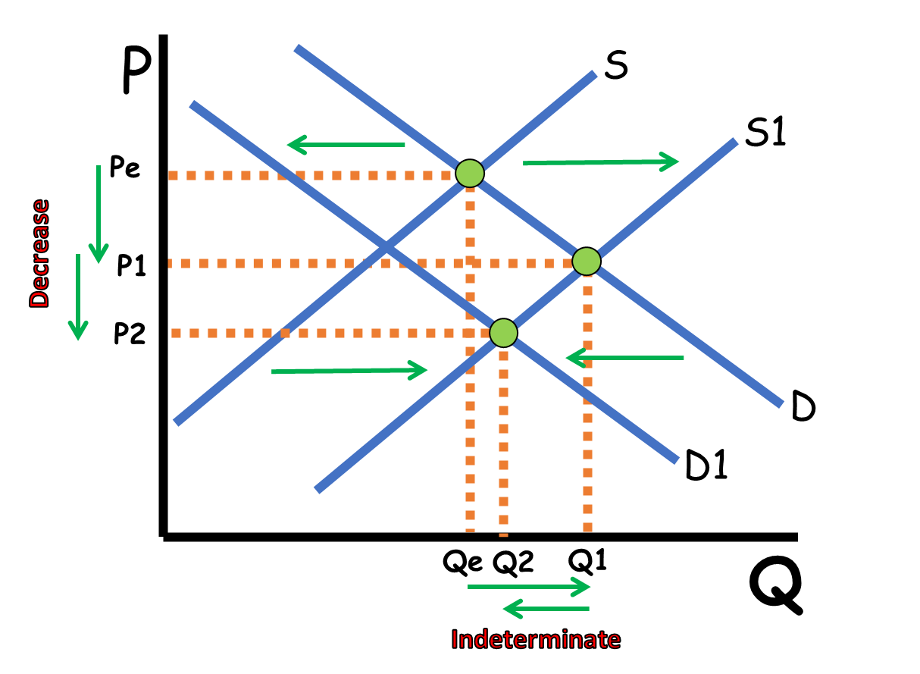

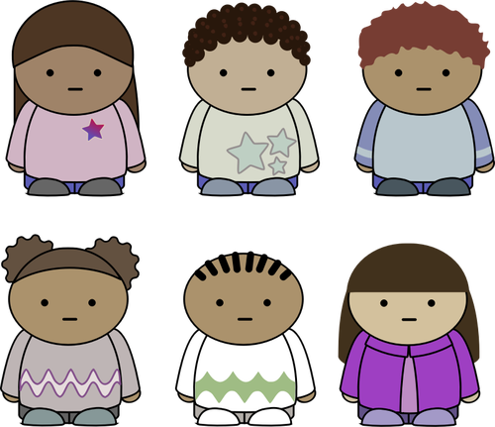

CED 1.6
Market Equilibrium
Basic Economic
Concepts
Notes:
After completing this lesson, students should be able to:
Define market equilibrium and explain how it represents the balance between supply and demand.
Illustrate and interpret changes in equilibrium price (Pe) and quantity (Qe) resulting from shifts in demand or supply.
Analyze how increases or decreases in supply or demand affect equilibrium outcomes.
Explain the process by which markets self-correct temporary surpluses or shortages to reach a new equilibrium.
Predict outcomes when both supply and demand shift simultaneously, identifying which variable is determinate and which is indeterminate.
Teacher Note:
This lesson builds on students’ prior understanding of supply and demand by showing how the interaction of these forces determines market equilibrium. Emphasize that equilibrium is not static - it changes whenever market conditions shift. Encourage students to think of equilibrium as the “meeting point” between producers and consumers, constantly moving as preferences, costs, and technology evolve.
Use clear visual examples and step-by-step graph analysis to help students see how price and quantity respond to curve shifts. Reinforce that on the AP Exam, students should assume the market immediately reaches the new equilibrium unless otherwise stated.
As the lesson progresses into double shifts, highlight the logic behind indeterminate outcomes and remind students:
“When in doubt, graph it out.”

Slide 2
Market Equilibrium
Markets connect buyers and sellers
P
S
D
Q
Notes:
Main Objective:
Students will understand that markets connect buyers (demand) and sellers (supply), and that market equilibrium occurs where the two sides meet - determining the price and quantity at which goods are exchanged.
Key Concept:
A market is any place (physical or digital) where buyers and sellers interact to exchange goods and services.
Markets can exist anywhere - grocery stores, online platforms, stock exchanges, or local farmers’ markets.
Economists represent markets graphically by combining supply and demand curves on one graph.
The point where the two curves intersect shows where buyers’ willingness to pay equals sellers’ willingness to sell.
How to Present the Slide:
Begin by emphasizing that “a market is not just a place - it’s an interaction.”
“Every time someone buys or sells something, they’re part of a market - even if it’s just ordering from Amazon or selling on eBay.”
Highlight the two sides of the market on the graph:
Demand (D) slopes downward, showing the inverse relationship between price and quantity demanded.
Supply (S) slopes upward, showing the direct relationship between price and quantity supplied.
Connect the two ideas visually:
“When we put demand and supply on the same graph, we can see how the market brings buyers and sellers together - that intersection is where the market naturally settles.”
Engagement Prompts:
“Where do you think markets exist in your everyday life?”
“Can a market exist without a physical location?”
“What do you think happens if buyers and sellers disagree on price?”
Next Slide:
“Now that we’ve seen how demand and supply come together in a market, let’s focus on the exact point where they intersect - the equilibrium - to see how the market determines the price and quantity with no shortage or surplus.”

Slide 3
Market Equilibrium
The price that clears the market
P
Q_{d}=Q_{s}
S
Pe
Equilibrium Point
D
Q
Qe
Notes:
Main Objective:
Students will understand that equilibrium is the point where quantity demanded (Qd) equals quantity supplied (Qs), and that the equilibrium price (Pe) and equilibrium quantity (Qe) represent the balance between buyers and sellers in a market.
Key Concept:
The equilibrium point is where the supply and demand curves intersect.
The equilibrium price (Pe) is the price where buyers and sellers agree - it clears the market because there’s no surplus or shortage.
The equilibrium quantity (Qe) is the amount bought and sold at that price.
At this point:
All consumers who are willing to buy at Pe can purchase.
All producers who are willing to sell at Pe can sell.
The market is in balance - there is neither excess supply nor excess demand.
How to Present the Slide:
Start by reviewing the graph:
“Here we see supply and demand together again. The point where they meet is the equilibrium point - this is where the plans of buyers and sellers match perfectly.”
Label and explain the components:
Point of intersection: Equilibrium Point
Horizontal line: Equilibrium Price (Pe)
Vertical line: Equilibrium Quantity (Qe)
Reinforce equality:
“At equilibrium, quantity demanded equals quantity supplied, or Qd = Qs. Economists say this is the price that clears the market, meaning everything produced is sold and everyone who wants to buy can do so.”
Connect to intuition:
“If prices were higher than Pe, sellers would have extra products they can’t sell - a surplus. If prices were lower than Pe, buyers would want more than producers can supply - a shortage. Only at Pe do we have balance.”
Engagement Prompts:
“What do you think would happen if a store set its prices higher than Pe?”
“Can you think of a product that seems to find its own ‘perfect’ price over time?”
“Why do you think economists call this the clearing price?”
Next Slide:
“Now that we’ve identified equilibrium - where quantity demanded equals quantity supplied - let’s see what happens when the price is set above equilibrium and how that creates a surplus and pushes the market back toward balance.”

Slide 4

Market Equilibrium
Surplus when price is above equilibrium
Qd<Qs
Surplus = Qs-Qd
P
S
P1
Price falls to equilibrium
Pe
$5
$3
D
Qe
Q
Qd
Qs
Notes:
Main Objective:
Students will understand that when the market price is set above equilibrium, a surplus (excess supply) occurs because producers are willing to sell more than consumers are willing to buy. This surplus puts downward pressure on price, moving the market back toward equilibrium.
Key Concept:
A surplus happens when Qs > Qd (quantity supplied is greater than quantity demanded).
The difference between Qs and Qd represents the surplus amount - goods that remain unsold.
This situation typically occurs when the market price (P₁) is above equilibrium price (Pₑ).
Because sellers have extra goods, they lower prices to attract buyers, which reduces the surplus and brings the market back to equilibrium.
How to Present the Slide:
Start with the graph:
“Here the price is higher than equilibrium - notice the price line at P₁ above Pₑ.”
Trace the surplus visually:
At P₁, move horizontally to the demand curve to show Qd.
Then move horizontally to the supply curve to show Qs.
Emphasize the gap between them: ‘This gap is the surplus - sellers have more goods than buyers want to purchase.’
Connect to reasoning:
“When prices are too high, consumers cut back on purchases, but producers keep producing more. The result? Unsold goods pile up.”
Conclude with adjustment mechanism:
“Sellers want to get rid of excess inventory, so they start lowering prices. As the price falls, Qd rises and Qs falls - until the market returns to equilibrium.”
Engagement Prompts:
“What happens to unsold bread if bakeries set the price too high?”
“Can you think of an example where stores dropped prices to clear out extra stock?”
Next Slide:
“Now let’s flip the situation and see what happens when the price is set below equilibrium, creating a shortage and upward pressure on price.”

Slide 5
Market Equilibrium
Shortage when price is below equilibrium
P
Q_{d}>Q_{s}
Shortage = Q_{d}-Q_{s}
S
Pe
Price rises to equilibrium
P1
$3
$1
D
Qe
Q
Qs
Qd
Notes:
Main Objective:
Students will understand that when the market price is set below equilibrium, a shortage (excess demand) occurs because consumers want to buy more than producers are willing to sell. This shortage puts upward pressure on price, pushing the market back toward equilibrium.
Key Concept:
A shortage happens when Qd > Qs (quantity demanded is greater than quantity supplied).
The difference between Qd and Qs represents the shortage amount - goods that consumers want but can’t obtain at the current price.
This situation typically occurs when the market price (P₁) is below equilibrium price (Pₑ).
Because buyers compete for the limited goods, prices rise until equilibrium is restored.
How to Present the Slide:
Begin with the graph:
“Here, the price is set below equilibrium - look at P₁, which is lower than Pₑ.”
Trace the shortage visually:
At P₁, move horizontally to the supply curve to show Qs.
Then move horizontally to the demand curve to show Qd.
Emphasize the gap between them: ‘This is the shortage - there’s not enough product to satisfy everyone who wants one.’
Explain the market dynamics:
“When prices are too low, everyone wants to buy, but producers can’t or won’t supply enough. Lines form, items sell out quickly, and some consumers are left empty-handed.”
Show how the market corrects:
“Because buyers are competing for limited goods, they’re willing to pay more. Sellers raise prices, quantity supplied increases, quantity demanded decreases - and the market moves back to equilibrium.”
Engagement Prompts:
“Can you think of a time when you couldn’t buy something because it sold out or was underpriced?”
“What might sellers do if they see people waiting in line to buy their product?”
“Why do you think shortages make prices go up?”
Next Slide:
“Now let’s put both situations side by side and see how surpluses and shortages show up numerically in a market schedule when prices are above or below equilibrium.”

Slide 6
Market Equilibrium
With Numbers
A market schedule
Surplus at High Prices
Q_{s}>Q_{d}
Shortage at Low Prices
Q_{s}<Q_{d}
Equilibrium Price is where Q_{d}=Q_{s}
P | Q_{s} | Q_{d}
$10 | 100 | 30
$9 | 95 | 60
$8 | 90 | 90
$7 | 85 | 120
$6 | 80 | 150
Notes:
Main Objective:
Students will learn to identify surplus, shortage, and equilibrium using a market schedule - a numerical table showing how quantity supplied (Qs) and quantity demanded (Qd) change at different prices.
Key Concept:
A market schedule is a chart that shows how buyers and sellers respond to different prices.
When price is high, sellers want to supply more, but buyers want to buy less - this creates a surplus (Qs > Qd).
When price is low, buyers want to buy more, but sellers supply less - this creates a shortage (Qd > Qs).
The equilibrium price is the one where Qd = Qs, meaning the market is balanced and there is neither shortage nor surplus.
How to Present the Slide:
Introduce the table:
“This table shows a market schedule - the relationship between price and the quantities that buyers and sellers are willing to exchange.”
Walk through the high-price scenario:
“At $10, producers want to sell 100 units, but consumers only want to buy 30 units. That’s a surplus of 70 units - too much product left over.”
Walk through the low-price scenario:
“At $6, sellers supply only 80 units, but consumers want 150 units. That’s a shortage of 70 units - not enough product to satisfy demand.”
Identify equilibrium:
“At $8, quantity demanded equals quantity supplied - 90 and 90. That’s the equilibrium price and quantity where the market clears.”
Tie it back to the graph:
“This table represents what’s happening on our supply and demand graph - the numbers show the same relationships between prices, shortages, surpluses, and equilibrium.”
Engagement Prompts:
“If the price were set at $9, would there be a shortage or a surplus?”
“What do you predict would happen to price when there’s a surplus?”
“Why do you think equilibrium is sometimes called the ‘market-clearing’ price?”
Next Slide:
“Now that we can identify surplus, shortage, and equilibrium numerically, let’s connect this back to demand shifters and see how changes in demand move the market to a new equilibrium price and quantity.”

Slide 7
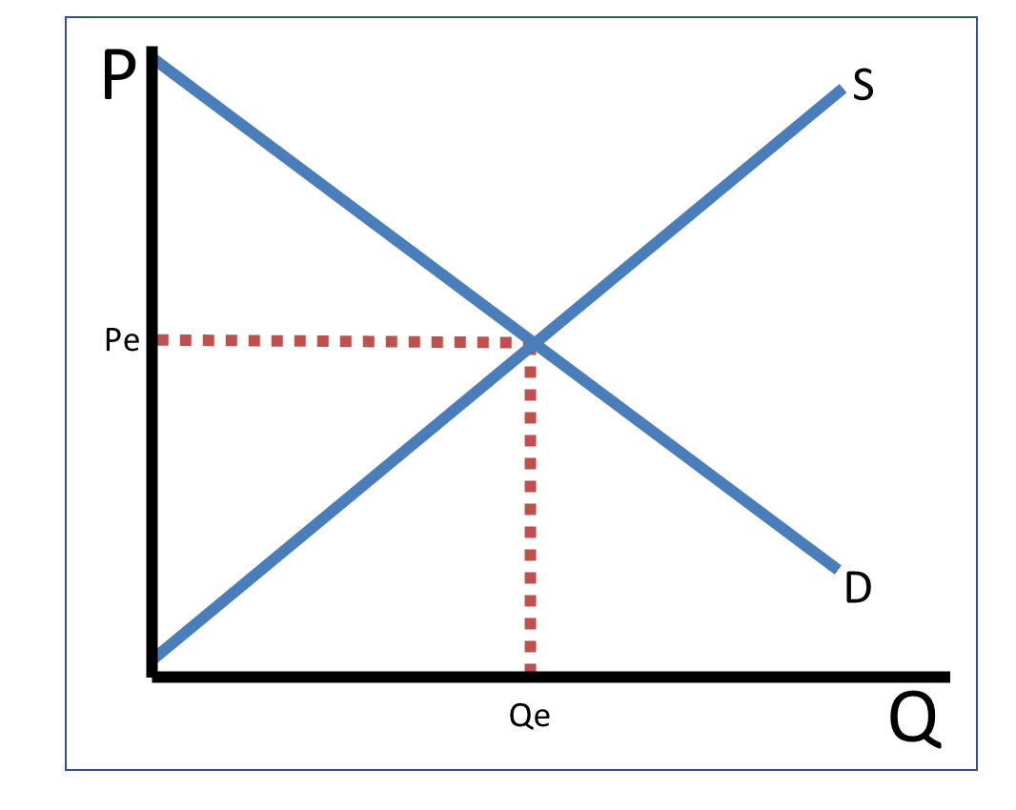
Changes in Equilibrium
Demand Shifters
Tastes and Preferences
Market Size
Prices of Related Goods
Substitutes Complements
Changes in Income
Normal Goods Inferior Goods
5. Expectations
Notes:
Main Objective:
Students will review the determinants of demand (demand shifters) and understand how each can cause the demand curve to shift, leading to new equilibrium prices (Pe) and quantities (Qe).
Key Concept:
Demand doesn’t change because of price alone - price causes movement along the curve, but shifters cause the entire curve to move.
When demand increases, the entire demand curve shifts right; when demand decreases, it shifts left.
The five determinants of demand are:
Tastes and Preferences – Changes in consumer preferences increase or decrease demand.
Example: A new health study praises blueberries → demand for blueberries increases.
Market Size – Changes in the number of buyers affect demand.
Example: More people move into a city → demand for housing rises.
Prices of Related Goods – The demand for one good can change depending on what happens to another.
Substitutes: Goods used in place of each other.
If the price of Pepsi rises, demand for Coke increases (shift right).
Complements: Goods used together.
If the price of hot dogs rises, demand for hot dog buns decreases (shift left).
Changes in Income – Income affects demand differently for different types of goods.
Normal Goods: If Income rises, Demand shifts right (e.g., restaurant meals).
Inferior Goods: If Income falls, Demand shifts right (e.g., instant noodles).
Expectations – If consumers expect prices or availability to change, demand shifts now.
Example: Expecting a future sale might decrease today’s demand; expecting shortages might increase it.
How to Present the Slide:
Start with a quick recap:
“We’ve already learned how price moves us along the demand curve. But now we’ll look at what causes the whole curve to shift.”
Walk through each determinant briefly:
“Every one of these changes affects demand at all prices, not just one price.”
Preview the next slide:
“Next, we’ll see what happens to equilibrium price and quantity when demand increases - when the whole curve shifts to the right.”
Engagement Prompts:
“Can you name a real-world event that caused demand for something to skyrocket?”
“Which of these shifters do you think changes most often?”
“How might expectations about gas prices next month affect demand today?”
Next Slide:
“Now that we’ve reviewed what causes demand to shift, let’s see what happens on the graph when demand actually increases - and how that rightward shift changes both equilibrium price and equilibrium quantity.”

Slide 8


Changes in Equilibrium
Increase in Demand
An increase in demand causes Pe and Qe to increase
P
S
Pe1
Pe
D1
D
Qe
Qe1
Q
Notes:
Main Objective:
Students will understand how an increase in demand shifts the demand curve to the right, leading to a higher equilibrium price (Pe) and higher equilibrium quantity (Qe).
Key Concept:
When a determinant of demand (like income, preferences, or market size) causes consumers to want more of a good at every price, the entire demand curve shifts right from D to D1.
This results in a new equilibrium where:
Price increases (Pe → Pe1)
Quantity increases (Qe → Qe1)
The market moves to a new point where Qd = Qs again, but at a higher price and larger quantity.
How to Present the Slide:
Start with the base graph:
“Here we have our original equilibrium at price Pe and quantity Qe.”
Animate the rightward shift:
“When demand increases, the curve shifts to the right - consumers want more at every price.”
Explain the new equilibrium:
“At the old price, there’s now a shortage - too many buyers, not enough goods. Prices rise until a new equilibrium is reached at a higher price and higher quantity.”
Emphasize the cause-and-effect relationship:
“The shift wasn’t caused by price - it was caused by one of our demand shifters. Prices respond to the change in demand.”
Engagement Prompts:
“Can you think of a time when something suddenly became really popular and prices went up?”
“Which demand shifter could cause a rightward shift in demand for electric cars?”
“What happens to total sales when demand increases?”
Next Slide:
“We’ve just seen how an increase in demand pushes equilibrium price and quantity up. Now let’s flip the situation and look at what happens when demand decreases - and how a leftward shift changes equilibrium in the opposite direction.”

Slide 9
Changes in Equilibrium
Decrease in Demand
A decrease in demand causes Pe and Qe to decrease
P
S
Pe
Pe1
D
D1
Qe1
Qe
Q
Notes:
Main Objective:
Students will understand how a decrease in demand shifts the demand curve to the left, resulting in a lower equilibrium price (Pe) and lower equilibrium quantity (Qe).
Key Concept:
When one of the determinants of demand decreases consumers’ willingness or ability to buy, the entire demand curve shifts left, from D to D1.
This means consumers now want less of the good at every price.
The market adjusts to a new equilibrium where:
Price decreases (Pe → Pe1)
Quantity decreases (Qe → Qe1)
The market “clears” again at this lower point of equilibrium where Qd = Qs, but at a smaller scale.
How to Present the Slide:
Start with the original equilibrium:
“Here’s our starting point at equilibrium - Pe and Qe, where demand and supply intersect.”
Show the leftward shift:
“When demand decreases, the entire curve shifts to the left - fewer consumers are willing to buy at all price levels.”
Discuss what happens at the old price:
“At the old price, there’s now a surplus - sellers have more than buyers want. Prices fall until we reach a new equilibrium.”
Point out the result:
“At the new equilibrium, both price and quantity are lower. We sell less overall, and the price in the market has dropped.”
Engagement Prompts:
“What might cause demand to decrease for a product like smartphones or soda?”
“If people suddenly lose interest in a good, what happens to the sellers?”
“Can you think of a time when prices dropped because fewer people were buying something?”
Next Slide:
“So far, we’ve focused on how changes in demand shift equilibrium. Now we’ll turn to the other side of the market and look at the determinants of supply-the factors that cause the entire supply curve to shift and change equilibrium in a different way.”

Slide 10
Changes in Equilibrium
Supply Shifters
Input Prices
Government Tools
Taxes Subsidies Regulations
3. Number of Sellers
4. Technology
5. Prices of Other Goods
Notes:
Main Objective:
Students will review the determinants of supply (supply shifters) and understand how changes in these factors shift the entire supply curve, which alters equilibrium price (Pe) and equilibrium quantity (Qe).
Key Concept:
When something other than price changes producers’ willingness or ability to supply a good, the entire supply curve shifts.
A rightward shift = increase in supply (producers are willing to sell more at every price).
A leftward shift = decrease in supply (producers sell less at every price).
These changes lead to new equilibrium points on the supply-and-demand graph.
The Five Determinants of Supply:
Input Prices
Costs of production inputs (labor, raw materials, energy, etc.).
If input prices rise, production becomes more expensive → supply decreases.
If input prices fall, production becomes cheaper → supply increases.
Government Tools
Taxes: Increase production costs → supply decreases.
Subsidies: Lower production costs → supply increases.
Regulations: Can make production more difficult or costly → supply decreases.
Number of Sellers
More firms entering the market → overall supply increases.
Firms exit the market → overall supply decreases.
Technology
Better technology makes production more efficient → supply increases.
Outdated or broken technology can reduce productivity → supply decreases.
Prices of Other Goods
When producers can make multiple products, they may shift resources toward whichever good offers the highest profit.
Example: If the price of corn rises, farmers might plant more corn and less wheat → wheat supply decreases.
How to Present the Slide:
Start by connecting to demand:
“Just like demand can shift, supply can too - but for completely different reasons.”
Explain that price doesn’t shift supply:
“A change in price causes movement along the curve, but these factors cause the entire curve to move.”
Point out each determinant:
“Each of these five causes producers to adjust how much they’re willing and able to produce at every price level.”
Preview what’s next:
“Next, we’ll see what happens when supply increases - when producers can make and sell more at every price.”
Engagement Prompts:
“If the price of fertilizer dropped, what would happen to wheat supply?”
“How do subsidies help farmers or clean energy producers?”
“Can you think of a technology that increased supply in a major industry?”
Next Slide:
“Next, we’ll look at how an increase in supply shifts the supply curve right and changes equilibrium price and quantity.”

Slide 11
Changes in Equilibrium
Increase in Supply
An increase in supply causes Pe to decrease and Qe to increase
P
S
S1
Pe
Pe1
D
Qe
Qe1
Q
Notes:
Main Objective:
Students will understand how an increase in supply, caused by a rise in the number of sellers (firms), shifts the supply curve to the right and results in a lower equilibrium price (Pe) and higher equilibrium quantity (Qe).
Key Concept:
When more producers enter a market, the total market supply increases.
This means at every price, sellers are willing to produce and sell more - the supply curve shifts right (from S to S1).
The increased competition leads to:
Lower prices (Pe → Pe1)
Higher quantities sold (Qe → Qe1)
The new equilibrium forms where buyers and sellers agree at this lower price and larger output.
How to Present the Slide:
Begin with the original equilibrium:
“We start here at our original equilibrium, where price Pe and quantity Qe balance supply and demand.”
Introduce the scenario:
“Now imagine more firms enter the market - maybe new wheat farmers start growing crops or new producers enter the electric car market.”
Explain the curve shift:
“More producers means more goods available at every price, so the supply curve shifts right from S to S1.”
Discuss the results:
“With extra competition, sellers must lower prices to sell their output. As prices fall, consumers buy more - moving us to a new equilibrium with lower price (Pe1) and higher quantity (Qe1).”
Reinforce the takeaway:
“An increase in supply causes prices to fall and output to rise - more goods at cheaper prices.”
Engagement Prompts:
“What happens to prices when more companies start selling the same product?”
“If more wheat farmers enter the market, who benefits - consumers or producers?”
“Can you think of a product where prices dropped because more firms started producing it?”
(Examples: smartphones, streaming services, electric vehicles.)
Next Slide:
“Now that we’ve seen how more sellers increase supply, let’s examine what happens when sellers leave the market and supply falls.”

Slide 12
Changes in Equilibrium
Decrease in Supply
A decrease in supply causes Pe to increase and Qe to decrease
P
S1
S
Pe1
Pe
D
$15
$15
Qe1
Qe
Q
$10
$10
Notes:
Main Objective:
Students will understand that a decrease in supply, often caused by rising input costs (like fertilizer prices), shifts the supply curve to the left, resulting in a higher equilibrium price (Pe) and a lower equilibrium quantity (Qe).
Key Concept:
When production costs rise, producers are willing and able to supply less at every price.
This shift in production behavior moves the entire supply curve leftward (from S to S1).
The new equilibrium occurs where the new supply curve meets demand, leading to:
Higher prices (Pe → Pe1)
Lower quantities sold (Qe → Qe1)
This outcome reflects scarcity and higher production costs-less supply means competition among buyers pushes prices up.
How to Present the Slide:
Start with the original equilibrium:
“We begin at the original equilibrium price Pe and quantity Qe, where the market clears.”
Describe the event:
“Now suppose fertilizer prices rise. That increases the cost of producing wheat, so farmers are willing to supply less at every price.”
Show and explain the shift:
“This is a decrease in supply - shown by the supply curve shifting left from S to S1.”
Explain the results:
“Because there’s now less wheat available, buyers compete for the smaller quantity. Prices rise from Pe to Pe1, and the new equilibrium quantity falls from Qe to Qe1.”
Summarize clearly:
“So, a decrease in supply causes prices to rise and quantities to fall.”
Engagement Prompts:
“What might cause supply to decrease for a product you buy regularly?”
(Example: higher labor costs, supply chain problems, or natural disasters.)
“If oil prices go up, what happens to the supply of airline flights or plastic products?”
“Who benefits when supply decreases - producers or consumers?”
Next Slide:
“In the real world, prices don’t always adjust instantly - there’s often a temporary surplus or shortage before the market finds its new equilibrium. The next slide illustrates that process: how markets move toward equilibrium after a shift.”

