Slide 1





CED 1.2
Economic Systems
Basic Economic
Concepts
Notes:
After completing this lesson, students should be able to:
Define the three basic economic questions that every society must answer: what to produce, how to produce, and for whom to produce.
Explain how scarcity forces individuals and societies to make choices about the allocation of limited resources.
Differentiate between the major economic systems: traditional, market, command, and mixed economies.
Describe how traditional economies rely on cultural customs and inherited roles to answer economic questions.
Explain how market economies use private property, voluntary exchange, and price signals to allocate resources.
Describe how command economies rely on central planners and government control to make economic decisions.
Analyze how mixed economies combine elements of market and command systems in varying proportions.
Compare different allocation methods such as first come, first serve; lottery; competition; command; and prices.
Evaluate the strengths and weaknesses of different economic systems in terms of efficiency, freedom, incentives, and equity.
Teacher Note:
This lesson introduces students to the fundamental ways societies organize economic activity to solve the problem of scarcity. Emphasize that while all economies face the same challenge of limited resources and unlimited wants, they differ in how economic decisions are made and who makes them. Encourage students to think of economic systems as existing on a continuum rather than as perfectly pure categories, with most modern economies functioning as mixed systems that blend market forces and government involvement. This lesson establishes a conceptual framework that will support future discussions of markets, government intervention, and macroeconomic policy throughout the course.

Slide 2










Scarcity and Choice
Resources are scarce
Products are scarce
We must make choices
Notes:
Main Objective:
Students will understand that scarcity forces all societies to make choices, and that those choices create the need for different systems to answer the basic economic questions.
Key Framing Idea:
"Because resources are limited but wants are unlimited, every society must decide what to produce, how to produce it, and who gets it."
This slide establishes the foundational economic problem before introducing how different economic systems solve it differently.
How to Present the Slide:
Start with the title:
“Scarcity and Choice.”
Tell students:
"Everything in economics starts here. Before we can talk about capitalism, socialism, command economies, market economies, or mixed economies, we need to understand the problem all economic systems are trying to solve."
Move to the first statement:
“Resources are scarce.”
Point to each image across the top.
Tell students:
"Scarcity does NOT mean something is rare like diamonds. In economics, scarcity simply means resources are limited relative to our wants."
Emphasize:
"Even wealthy countries face scarcity. No society has unlimited land, unlimited labor, unlimited factories, or unlimited time."
Move to the second section:
“Products are scarce.”
Explain:
"Because resources are scarce, the products made from those resources are also limited."
Tell students:
"There is only so much food that can be grown, only so many workers available to provide services, and only so much productive capacity in an economy."
Make the connection explicit:
"Scarcity of resources creates scarcity of goods and services."
Move to the final section:
“We must make choices.”
Pause here for emphasis.
Tell students:
"Since we can’t produce unlimited amounts of everything, societies must make decisions."
Explain:
"This is the classic economics trade-off: Guns or Butter."
Define:
More guns = more resources devoted to military production
More butter = more resources devoted to consumer goods
Tell students:
"If resources are limited, choosing more of one thing means giving up some of another."
Introduce opportunity cost:
"That sacrifice is called opportunity cost, the value of the next best alternative given up."
Bridge toward economic systems:
"Different countries answer these trade-off questions in different ways. That’s what economic systems are really about."
Engagement Prompts:
Ask:
“If society suddenly had unlimited resources, would economics even exist?”
Follow-up:
“If the government spends more on national defense, what might society have less of?”
Ask:
“Who should decide whether resources go toward healthcare, national defense, education, or entertainment?”
This naturally sets up the transition into economic systems.
Transition to Next Slide:
"Now that we understand WHY societies must make choices, let’s look at the three basic economic questions every economic system must answer."

Slide 3






3 Basic Questions
1. What to produce?
2. How to produce?
3. For whom to produce?
Notes:
Main Objective:
Students will understand the three fundamental economic questions that every society must answer because of scarcity, and begin thinking about how different economic systems answer those questions differently.
Key Framing Idea:
"Scarcity forces societies to make choices, and every economy must answer the same three basic questions, even if they answer them in very different ways."
This slide introduces the decision-making framework that economic systems are built around.
How to Present the Slide:
Begin by connecting back to the previous slide:
"On the last slide, we established that resources are scarce, which means societies can’t produce unlimited amounts of everything. That leads to an important question: how do societies decide what gets made?"
Introduce the title:
“3 Basic Questions”
Tell students:
"Every economic system, must answer these exact same three questions."
Pause for emphasis:
"The differences between economic systems are not in the questions themselves, the differences are in the answers."
Question 1: What to produce?
Read the first question:
“What to produce?”
Explain:
"Because resources are limited, society must decide which goods and services to produce."
Clarify:
"Should resources go toward food? Luxury goods? Entertainment? Healthcare? National defense? Education?"
Ask:
"Should scarce steel, labor, and factory space be used to build luxury cars, or affordable public transportation?"
Emphasize:
"Choosing more of one product usually means producing less of something else."
Tie to scarcity:
"This is essentially a large-scale version of the guns-versus-butter trade-off we just discussed."
Question 2: How to produce?
Read the second question:
“How to produce?”
Explain:
"Even after deciding WHAT to make, society must decide HOW to make it."
Contrast the images:
Machines = capital-intensive production
Workers = labor-intensive production
Tell students:
"Should a company use expensive automation and robotics, or should it hire more workers?"
Example:
"A factory might use robots to assemble cars, while a small bakery might rely mostly on human labor."
Explain the trade-off:
"Using more machines may increase productivity but reduce employment. Using more workers may create jobs but be less efficient."
Connect to economic systems:
"Different systems may place different values on efficiency, cost, employment, or equality."
Question 3: For whom to produce?
Read the third question:
“For whom to produce?”
Explain:
"Once goods and services are produced, who actually gets them?"
Clarify:
"Does everyone get the same amount? Do goods go to the people who can afford them? Are some goods distributed based on need? Based on political decisions?"
Point to the tug-of-war visual.
Explain:
"This image represents competition over scarce resources. Since there isn’t enough for everyone to have everything they want, some system has to determine distribution."
Provide examples:
Who gets beachfront homes?
Who gets luxury cars?
Who gets life-saving medical care?
Who gets concert tickets?
Tell students:
"This third question is often where economic systems differ most dramatically."
Preview:
"We’re about to zoom in on this question because it’s one of the clearest ways to distinguish economic systems."
Engagement Prompts:
Ask:
“If you were designing a society from scratch, what would be the hardest of these three questions to answer?”
Follow-up:
“Who should decide what gets produced, consumers, businesses, or the government?”
Ask:
“Should everyone get the same amount of goods regardless of what they contribute?”
Transition to Next Slide:
"Of these three questions, the most controversial is often the last one: who gets the goods and services once they’re produced? Let’s take a closer look at how societies answer the question: ‘For whom to produce?’”

Slide 4





For whom to produce?
Allocation systems
First come, first serve
Lottery
Competition
Command
Prices
Command and prices are used in
societies today
$100
Notes:
Main Objective:
Students will understand that the question “For whom to produce?” is really about how scarce goods and services are allocated, and that societies use different allocation systems to determine who receives resources.
Key Framing Idea:
"Scarcity means there isn’t enough of everything for everyone to have whatever they want, so every society needs a system for deciding who gets what."
This slide introduces allocation methods and prepares students to compare how different economic systems rely on different mechanisms.
How to Present the Slide:
Begin by connecting to the previous slide:
"We just introduced the three basic economic questions. Now we’re zooming in on one of the most important: For whom to produce?"
Read the subtitle:
“Allocation systems”
Define the concept clearly:
"Allocation simply means distribution, how scarce goods, services, and resources are handed out."
Tell students:
"Since scarcity exists, not everyone can automatically get everything they want. So societies need rules, or systems, for deciding who gets scarce resources."
Work through each allocation system.
First come, first serve
Explain:
"One simple allocation method is first come, first serve."
Examples:
Black Friday sales
Waiting in line for concert tickets
Limited enrollment in a class
Seating at a restaurant without reservations
Explain the logic:
"The first people to arrive get the resource. Everyone else may miss out."
Ask:
"Is this fair?"
Point out:
"It rewards speed, timing, or willingness to wait, not necessarily need."
Lottery
Explain:
"Another allocation method is random chance."
Examples:
Housing lotteries
School admission lotteries
Vaccine appointment lotteries (historical example)
Ticket raffles
Explain:
"This system gives everyone an equal chance, regardless of wealth or speed."
Clarify:
"Equal chance doesn’t mean equal outcome, it just means selection is random."
Competition
Explain:
"Competition allocates resources based on performance."
Examples:
Athletic tryouts
Academic scholarships
Job hiring decisions
College admissions (partially)
Tell students:
"In this system, scarce opportunities go to whoever performs best according to some criteria."
Ask:
"Does competition always reward merit, or can some people start with advantages?"
That usually sparks useful discussion.
Command
Define:
"Command means an authority figure or central planner decides who gets resources."
Examples:
Government rationing during wartime
A military assigning equipment
A centrally planned economy deciding production/distribution
Explain:
"Instead of consumers or markets deciding, someone in power makes the allocation decisions."
Clarify:
"This can prioritize social goals, but it can also reduce individual choice."
Prices
Explain:
"One of the most important allocation methods in modern economies is prices."
Define:
"In a price system, goods go to the people willing and able to pay for them."
Examples:
Concert tickets
Homes
Cars
Restaurant meals
Tell students:
"If demand is high and supply is limited, prices rise, and that helps ration scarce goods."
Important AP framing:
"Prices act as signals and incentives in a market economy."
Highlight the green box
Point to the boxed terms:
Command and Prices
Explain:
"These are especially important because modern economic systems rely heavily on one or both of these allocation mechanisms."
Reference the note at the bottom:
“Command and prices are used in societies today.”
Clarify:
"Real-world economies are usually mixed systems, not purely command or purely market."
Avoid going too deep here since traditional economies are next.
Preview:
"We’re about to look at a third allocation approach, tradition, which helps explain another type of economic system."
Engagement Prompts:
Ask:
“If there were only 10 tickets to a huge concert, what would be the fairest way to allocate them?”
Follow-up:
“Should scarce medical care go to whoever pays the most, whoever needs it most, or whoever gets there first?”
Ask:
“Which of these allocation systems do you think the United States relies on most?”
This creates a clean bridge to economic systems.
Transition to Next Slide:
"So far, we’ve looked at allocation through prices and command, but some societies historically answered economic questions very differently. Let’s look at traditional economies."

Slide 5
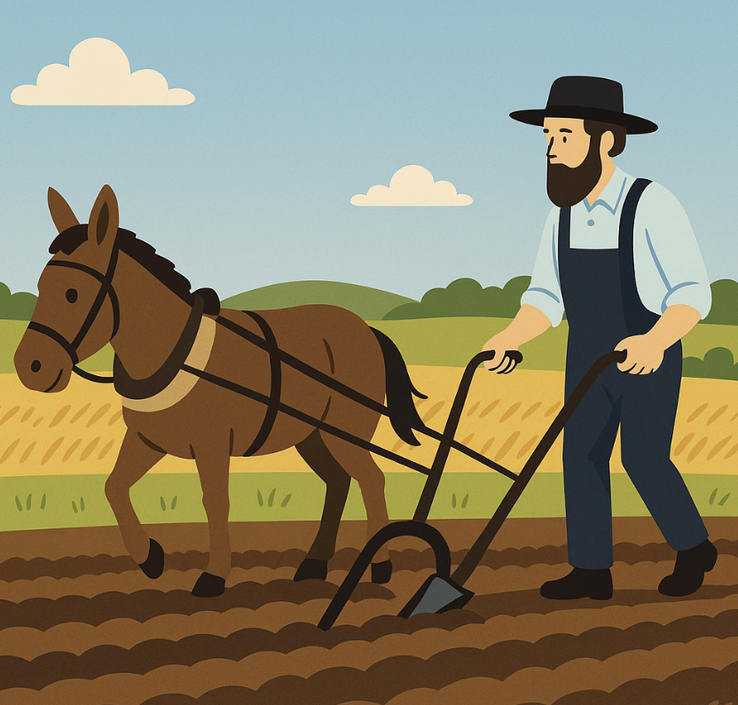

Economic Systems
Traditional Economies
What, how, for whom
answered by cultural custom
Notes:
Main Objective:
Students will understand that in a traditional economy, the three basic economic questions, what to produce, how to produce, and for whom to produce, are answered primarily through customs, traditions, and inherited roles rather than markets or central planning.
Key Framing Idea:
"In a traditional economy, people often do what has always been done before."
Economic decisions are guided by cultural habits, family roles, and long-established social expectations rather than prices or government directives.
How to Present the Slide:
Begin by connecting to the previous slide:
"We just discussed different ways societies allocate scarce resources. Now let’s look at the first major type of economic system: the traditional economy."
Read the title:
“Traditional Economies”
Then read the red text:
“What, how, for whom answered by cultural custom.”
Pause and emphasize:
"This is the defining characteristic of a traditional economy."
Explain:
"Instead of asking consumers what they want through prices, or having the government issue commands, economic decisions are based largely on tradition, what families and communities have historically done."
Define the core concept clearly:
Tell students:
"A traditional economy is one where economic roles are inherited, production methods change slowly, and customs strongly influence decision-making."
Clarify:
"People often produce the same goods their parents produced, using similar methods, for similar groups of people."
Work through the visuals.
Farming image
Point to the farmer with the horse-drawn plow.
Explain:
"This represents traditional agricultural production."
Tell students:
"If your family has farmed for generations, you may continue farming because that is the expected role in your community."
Connect to the three questions:
What to produce? Crops the community has traditionally grown
How to produce? Established methods passed down over time
For whom to produce? Family, village, or local community
Emphasize:
"The key idea is continuity, economic behavior stays relatively stable over time."
Fishing image
Point to the ice fisher.
Explain:
"This shows another traditional occupation, fishing."
Tell students:
"In some traditional economies, skills are passed from one generation to the next. Children may learn family trades rather than choosing completely different careers."
Important clarification:
"This doesn’t mean traditional economies are primitive or inferior, it simply means economic organization is guided heavily by custom."
Crafting image
Point to the artisan weaving.
Explain:
"This represents handcraft production, goods made using traditional knowledge and manual labor."
Tell students:
"Production methods in traditional economies often rely less on advanced machinery and more on labor, skills, and community knowledge."
Contrast with modern economies:
"In a market economy, producers constantly innovate to increase efficiency. Traditional economies usually change much more slowly."
Strengths and weaknesses
Briefly introduce evaluation:
Advantages:
Stability
Strong community ties
Predictability
Clear social roles
Disadvantages:
Limited innovation
Lower productivity
Reduced economic growth
Less individual economic freedom
Keep this concise since the slide focuses on definition.
Engagement Prompts:
Ask:
“If your family had been bakers for 300 years, would you feel expected to become a baker too?”
Follow-up:
“What are the benefits of having stable traditions?”
Then ask:
“What problems might happen if society never changed production methods?”
This helps set up comparison with market economies.
Transition to Next Slide:
"Traditional economies rely on custom and inherited roles, but modern economies often answer economic questions very differently. Let’s look at market economies, where prices and consumer choice play the central role."

Slide 6


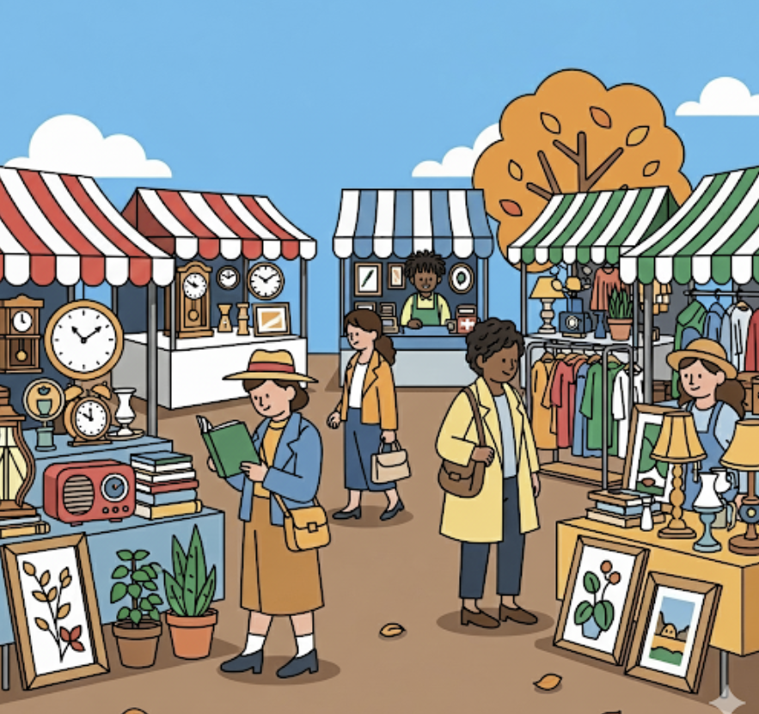
Economic Systems
Market Economies
What, how, for whom
answered by individuals
Private ownership of resources
Private property rights
Buyers and sellers
Markets
Prices drive allocation of resources
Notes:
Main Objective:
Students will understand that in a market economy, the three basic economic questions are answered primarily through individual decision-making in markets, with prices coordinating economic activity.
Key Framing Idea:
"In a market economy, individuals, not tradition or central planners, make economic decisions, and prices help coordinate those choices."
This slide introduces the defining characteristics of market economies and establishes the role of prices as the key allocation mechanism.
How to Present the Slide:
Begin by connecting to the previous slide:
"We just looked at traditional economies, where customs and inherited roles guide economic decisions. Now let’s look at a very different system: the market economy."
Read the title:
“Market Economies”
Then read the red text:
“What, how, for whom answered by individuals.”
Pause and emphasize:
"That’s the big idea here: economic decisions are decentralized."
Define decentralized:
"That means decisions are not made by a single authority. Instead, millions of consumers, workers, business owners, and investors all make their own individual choices."
Clarify:
"No one person is in charge of deciding everything the economy produces."
Work through each characteristic.
Private ownership of resources
Explain:
"In a market economy, productive resources, land, labor, capital, and entrepreneurship, are largely privately owned."
Clarify:
"That means individuals or businesses, not the government, own factories, stores, farmland, machines, and other productive assets."
Example:
"If you own a business, the building, equipment, and profits generally belong to you, not the state."
Private property rights
Define:
"Private property rights mean owners have legal control over their property and can use, sell, rent, or transfer it."
Explain why this matters:
"Without property rights, there would be much less incentive to invest, improve resources, or take entrepreneurial risks."
Example:
"You’re much more likely to improve land or start a business if you know the rewards belong to you."
Important AP framing:
"Strong property rights create incentives for economic activity.“
Buyers and sellers
Explain:
"Market economies rely on voluntary exchange between buyers and sellers."
Define voluntary exchange:
"Both sides agree because they expect to benefit."
Example:
"You buy lunch because you value the food more than the money. The restaurant values the money more than the food."
Emphasize:
"Both sides believe they’re better off, or the exchange doesn’t happen."
Markets
Point to the marketplace image.
Define:
"A market is any place, or system, where buyers and sellers interact."
Clarify:
"This doesn’t have to be a physical farmers market. Amazon is a market. The stock market is a market. Labor markets are markets."
Tell students:
"Markets help coordinate decisions across the economy."
Prices drive allocation
This is the most important section.
Tell students:
"In a market economy, prices are the primary allocation mechanism."
Define:
"Prices help answer the economic questions by signaling scarcity and coordinating behavior."
Examples:
What to produce?
"If consumers are willing to pay high prices for electric cars, firms have an incentive to produce more electric cars."
How to produce?
"Firms compare input costs and choose the least costly production methods to maximize profit."
For whom to produce?
"Goods generally go to those willing and able to pay market prices."
Important AP Macro framing:
"Prices act as both signals and incentives."
“Answered by individuals”
Return to the red text.
Clarify:
"This does NOT mean every individual gets whatever they personally want."
Instead:
"It means economic outcomes emerge from the combined decisions of many individuals interacting in markets."
Useful phrasing:
"This is decentralized coordination rather than centralized planning."
Real-world nuance
Brief clarification:
"Pure market economies are theoretical. Modern economies, including the United States, are mixed economies with significant government involvement."
Since command economies are next, don’t over-explain yet.
Preview:
"Next, we’ll look at the opposite end of the spectrum."
Engagement Prompts:
Ask:
“If nobody tells businesses what to produce, how do they decide?”
(Expected answer: consumer demand / prices / profit incentives.)
Follow-up:
“Why would private ownership encourage innovation?”
Ask:
“Is it fair that in a market system, goods generally go to those who can pay?”
This sets up a natural contrast with command systems.
Transition to Next Slide:
"Market economies rely on individual choice and prices, but not all economies work this way. Let’s look at command economies, where economic decisions are made very differently."

Slide 7



Economic Systems
Command Economies
What, how, for whom
answered by central planners
Public (gov) ownership of resources
Less enforcement of property rights
Lots of government intervention
Central Planners
Notes:
Main Objective:
Students will understand that in a command economy, the three basic economic questions are answered primarily by a central authority or government planners, rather than through markets or tradition.
Key Framing Idea:
"In a command economy, economic decisions are centralized, the government decides what gets produced, how it gets produced, and who receives it."
This slide contrasts command systems with market economies by emphasizing centralized control over economic resources and decision-making.
How to Present the Slide:
Begin by connecting to the previous slide:
"On the last slide, we saw that market economies rely on individual choice and prices. Now we’re looking at the opposite end of the spectrum: command economies."
Read the title:
“Command Economies”
Then read the red text:
“What, how, for whom answered by central planners.”
Pause for emphasis.
Tell students:
"Instead of millions of individual buyers and sellers making decentralized decisions, a command economy relies on a small group of government decision-makers to direct economic activity."
Define central planners:
"Central planners are government officials who decide what should be produced, how resources should be used, and who receives the output."
Work through the characteristics.
Public (government) ownership of resources
Explain:
"In command economies, productive resources are largely owned or controlled by the government."
Clarify:
"Factories, natural resources, transportation systems, and major industries are often publicly owned instead of privately owned."
Contrast with market economies:
"In a market system, businesses own productive resources. In a command system, the state often controls them."
Les enforcement of private property rights
Point to the “thief” image.
Explain carefully here.
Tell students:
"Compared to market economies, command economies generally place much less emphasis on private property rights."
Clarify:
"This does NOT mean all personal belongings disappear, but ownership of productive resources is heavily restricted or controlled by the state."
Explain why:
"If the government controls production, strong private ownership of major productive assets becomes much less important."
Lots of government intervention
Explain:
"Government involvement in a command economy is extensive."
Examples:
Production quotas
Wage controls
Price controls
Resource allocation decisions
Employment assignments
Distribution targets
Tell students:
"The government doesn’t just regulate around the edges, it actively directs much of the economy."
Central planners
Explain:
"These planners attempt to coordinate economic activity for the entire country."
Walk through the 3 questions:
What to produce?
"The government decides whether resources go toward food, military equipment, housing, healthcare, or heavy industry."
How to produce?
"The government decides production methods, labor allocation, and resource use."
For whom to produce?
"The government determines distribution priorities."
Strengths and weaknesses
Introduce evaluation briefly.
Potential strengths:
Can rapidly mobilize resources
Can pursue social goals directly
May reduce some forms of income inequality
Can prioritize public goods or infrastructure
Example:
"A command system can quickly redirect factories toward wartime production."
Potential weaknesses:
This is the key teaching point.
Explain incentive problems:
"If firms don’t compete for profit, incentives to innovate and improve efficiency may weaken."
Explain information problem:
"One of the biggest economic challenges is information. How can a small group of planners accurately predict what millions of consumers want?"
Example:
"How many shoes should be produced? What sizes? What colors? Where should they go?"
Explain inefficiency:
"Without price signals, shortages and surpluses are much more likely."
Important AP framing:
"Prices communicate information in market economies. Command systems lose much of that signaling mechanism."
Historical examples
If helpful, briefly mention:
Former Soviet Union
Maoist China
North Korea (modern example)
Keep examples brief since this is conceptual.
Engagement Prompts:
Ask:
“Do you think a small group of planners could accurately decide everything an economy should produce?”
Follow-up:
“What information would they need?”
Ask:
“What might be an advantage of having the government direct all resources during a crisis?”
Then:
“What might go wrong if planners make bad decisions?”
Transition to Next Slide:
"Market economies rely on individual choice. Command economies rely on central planning. But most real-world economies fall somewhere in between. Let’s look at mixed economies."

Slide 8


Economic Systems
Mixed Economies
Capitalism
A mixed economy closest to free market
Private markets with prices
Limited government intervention
Communism
Mixed economy closest to command
Government controls most of the economy
Notes:
Main Objective:
Students will understand that most real-world economies are mixed economies, combining elements of both market and command systems, but differing in how much government involvement they allow.
Key Framing Idea:
"Pure market and pure command economies are theoretical extremes, most countries fall somewhere in between."
Mixed economies blend private decision-making with government involvement to varying degrees.
How to Present the Slide:
Begin by connecting to the previous slide:
"We’ve now looked at traditional economies, market economies, and command economies. But here’s the important real-world takeaway: almost no country fits perfectly into just one category."
Introduce the title:
“Mixed Economies”
Define clearly:
"A mixed economy combines elements of market systems and command systems."
Emphasize:
"The question is not whether the government participates, the question is HOW MUCH."
Tell students:
"Think of economic systems as a spectrum rather than separate boxes."
Capitalism side
Read:
“Capitalism”
Clarify terminology:
"In AP Economics, capitalism generally refers to an economic system built primarily around private ownership, markets, and price signals."
“A mixed economy closest to free market”
Explain:
"This means the economy relies mostly on private decision-making, even though some government involvement still exists."
Clarify:
"No modern economy is a perfectly pure free market."
“Private markets with prices”
Explain:
"Most production and exchange happen through markets, where buyers and sellers interact and prices coordinate decisions."
Connect back:
"That means prices largely answer the questions of what to produce, how to produce, and for whom to produce."
Examples:
Grocery stores
Housing markets
Labor markets
Retail businesses
“Limited government intervention”
Clarify:
"Limited does NOT mean zero."
Give examples:
Environmental regulations
Consumer protection laws
Public education
National defense
Roads and infrastructure
Monetary policy
Important AP framing:
"Even highly market-oriented economies still involve government participation."
Communism / command-oriented side
Read:
“Communism”
Frame carefully:
"This represents a mixed economy much closer to the command end of the spectrum."
Clarify:
"Pure command economy is theoretical, but historically some economies moved much closer to command economy central planning."
“Government controls most of the economy”
Explain:
"In these systems, the government controls major industries, directs production decisions, and limits private market activity."
Examples:
State-owned factories
Government production targets
Restricted private enterprise
Contrast:
"Instead of prices coordinating most activity, government decisions play the larger role."
Big conceptual takeaway
Step back from the slide.
Tell students:
"The most important idea here is that real economies exist on a continuum."
Visual explanation:
"The United States is more market-oriented, but it still has public schools, government regulations, Medicare, and central banking."
"Other economies may allow markets but involve much heavier government control."
Important AP Macro clarification:
"Economic systems are rarely pure categories. Mixed economies dominate the modern world."
Address possible misconceptions
Clarify:
"A mixed economy does NOT mean exactly 50/50 market and command."
Explain:
"It simply means the economy combines features of both systems in some proportion."
Optional quick examples:
United States = market-oriented mixed economy
China = mixed economy with substantial state involvement
Scandinavian economies = market-based with stronger social safety nets
Keep this high level.
Engagement Prompts:
Ask:
“Would you want the government deciding what kind of phone you can buy?”
Follow-up:
“Would you want zero government rules on pollution, fraud, or workplace safety?”
Then:
“If both extremes have drawbacks, does a mixed economy make the most sense?”
This creates a useful concluding discussion.
Transition to End of Lecture:
"Today we started with the fundamental economic problem of scarcity, limited resources forcing societies to make choices. We then looked at the three basic economic questions: what to produce, how to produce, and for whom to produce. From there, we explored how different economic systems answer those questions: traditional economies through custom, market economies through prices and individual choice, command economies through central planning, and mixed economies through some combination of markets and government involvement. As we move forward in AP Microeconomics, we’ll spend much of our time analyzing how these decision-making systems affect incentives, efficiency, equity, and economic outcomes."

