Slide 1


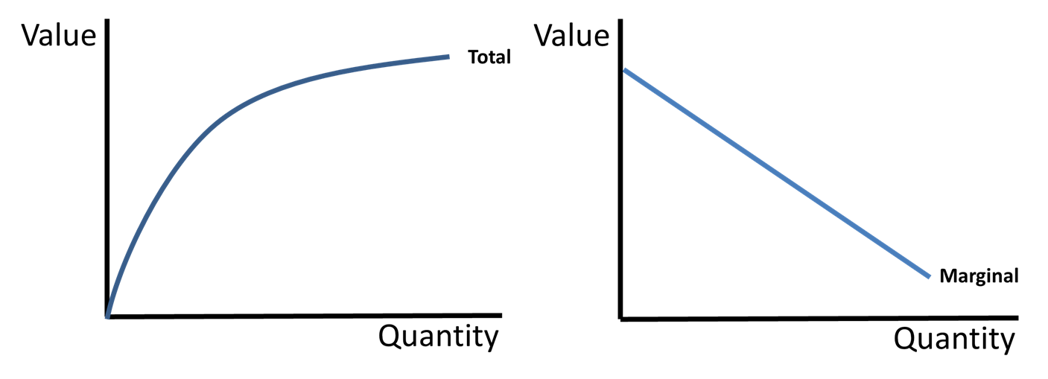


CED 1.6
Marginal Analysis
& Consumer Choice
Basic Economic
Concepts
Notes:
After completing this lesson, students should be able to:
Define marginal analysis as decision-making based on comparing additional benefits and additional costs.
Distinguish between total and marginal values (total benefit vs. marginal benefit; total cost vs. marginal cost).
Explain the graphical relationship between total and marginal values.
Apply the benefit-maximizing rule (MB = MC) to determine the rational quantity of an activity or good.
Define utility as consumer satisfaction and explain the Law of Diminishing Marginal Utility.
Interpret how diminishing marginal utility causes the marginal benefit curve to slope downward.
Apply the utility-maximizing combinations rule (MUa/Pa = MUb/Pb) to allocate spending across multiple goods.
Determine the utility-maximizing combination of goods given a budget constraint.
Teacher Note:
This lesson expands students’ understanding of rational decision-making by introducing marginal analysis, one of the most important ways economists evaluate choices. Emphasize that rational people do not compare total costs and total benefits alone; they compare the additional benefit and additional cost of the next unit. Connect this lesson back to earlier ideas like opportunity cost and cost-benefit analysis, showing that economics often focuses on decisions made at the margin. As the lesson progresses, help students see how diminishing marginal utility explains consumer behavior, downward-sloping marginal benefit, and the logic behind utility-maximizing consumption choices under limited budgets.

Slide 2
Marginal vs Total
Marginal means change in total
Quantity | Total | Marginal
0 | 0 | -
1 | 5 | 5
2 | 15 | 10
3 | 30 | 15
4 | 50 | 20
5 | 80 | 30
Formula:
ΔTotal/ΔQuantity
Change in quantity is nearly always 1
Notes:
Main Objective:
Students will understand the difference between total values and marginal values and learn that marginal means the change in total resulting from one additional unit.
Key Framing Idea:
"Economics is less concerned with totals and more concerned with changes at the margin - because decisions are usually made one unit at a time."
This slide introduces one of the most foundational concepts in AP Microeconomics: thinking at the margin.
How to Present the Slide:
Begin by introducing the big idea:
"This lesson is about one of the most important words in all of economics: marginal."
Pause.
Tell students:
"If you understand marginal thinking, you understand how economists analyze decision-making."
Introduce the title:
“Marginal vs Total”
Then read:
“Marginal means change in total”
Repeat it slowly.
Tell students:
"This definition is incredibly important. Marginal does NOT mean small. It means additional or change."
That distinction matters because students often misunderstand the term.
Introduce the table
Point to the table.
Explain:
"This table shows total values changing as quantity increases."
Clarify:
"Quantity simply represents how many units we have."
Tell students:
"Notice the totals keep increasing as quantity rises."
Then ask:
"But by how much are they increasing each time?"
This naturally sets up marginal.
Calculate marginal values
Point to the marginal column.
Tell students:
"Marginal tells us the change in total when quantity increases."
Read the formula:
ΔTotal / ΔQuantity
Define delta if needed:
"That triangle symbol means change in."
So:
"Marginal = change in total divided by change in quantity."
Work through the rows together.
From Quantity 0 to 1:
Total changes from:
0 → 5
Change:
+5
Quantity changes:
+1
Marginal:
5 ÷ 1 = 5
Fill in:
Marginal = 5
From 1 to 2:
Total changes:
5 → 15
Change:
+10
Quantity:
+1
Marginal:
10
From 2 to 3:
Total:
15 → 30
Change:
+15
Quantity:
+1
Marginal:
15
From 3 to 4:
Total:
30 → 50
Change:
+20
Quantity:
+1
Marginal:
20
From 4 to 5:
Total:
50 → 80
Change:
+30
Marginal:
30
Explain why quantity change is usually 1
Explain:
"In most AP economics problems, we look at one additional unit at a time."
That means:
ΔQuantity = 1
So the formula becomes easier:
"Marginal often just equals the change in total."
Tell students:
"That’s why economists often mentally skip dividing by 1."
But clarify:
"The full formula still matters conceptually."
Connect to real economics
Tell students:
"This idea applies everywhere in economics."
Examples:
Marginal cost = cost of producing one more unit
Marginal benefit = benefit from consuming one more unit
Marginal product = extra output from one more worker
Marginal revenue = revenue from selling one more unit
Tell students:
"This single idea shows up constantly in AP Micro."
That helps frame importance.
Big conceptual takeaway
Step back.
Tell students:
"Totals tell you where you are."
"Marginals tell you what happens when you change your decision."
Repeat:
"Economics focuses heavily on marginal thinking because decisions are rarely all-or-nothing - they happen incrementally."
That’s the key setup for the rest of the lesson.
Common misconception
Address directly.
Tell students:
"Students often confuse total and marginal values."
Clarify:
If total cost = $100
That does NOT mean marginal cost = $100
Marginal cost only measures the change caused by the next unit.
Repeat:
Total = cumulative
Marginal = additional
Engagement Prompts:
Ask:
“If total rises from 50 to 70, what is the marginal change?”
(Expected: 20.)
Then:
“If quantity increases by 1, what does marginal usually equal?”
(Expected: the change in total.)
Follow-up:
“Does marginal mean total?”
(Expected: no.)
Quick check:
“What does marginal mean?”
(Expected: change in total / additional.)
Transition to Next Slide:
"Now that we understand the numerical relationship between total and marginal, let’s see what that relationship looks like visually on a graph."

Slide 3
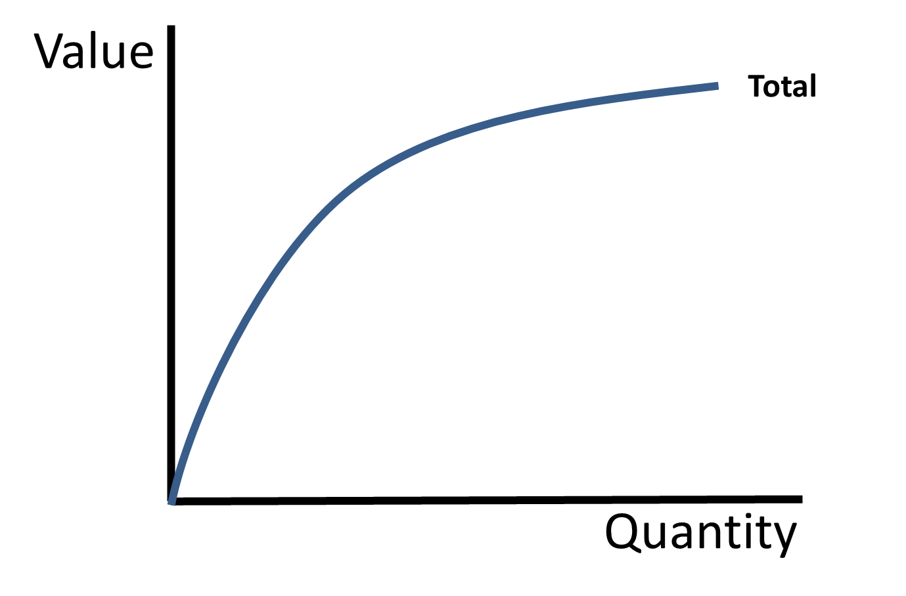
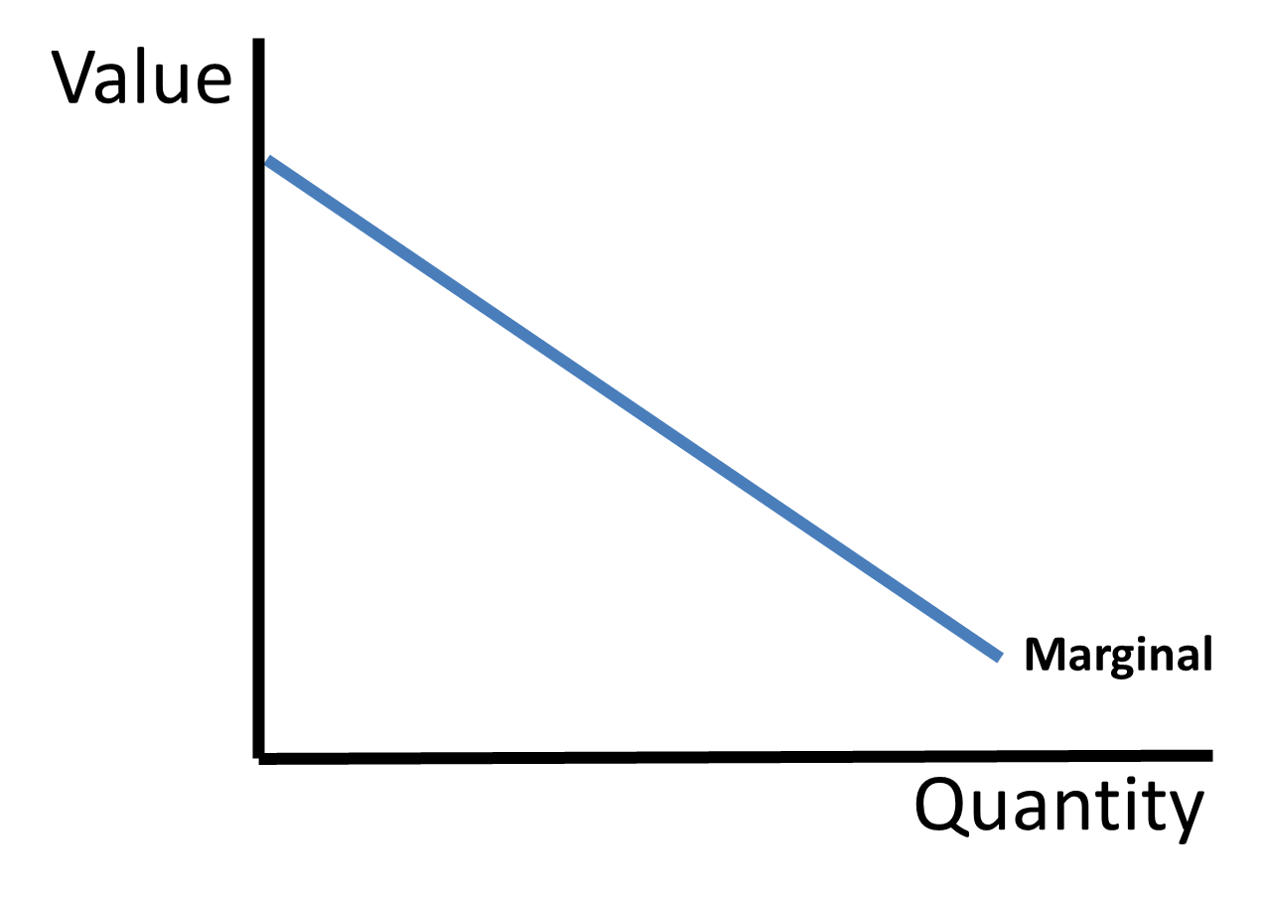
Marginal vs Total
If Total is increasing at a decreasing rate
Marginal is positive and decreasing
Notes:
Main Objective:
Students will interpret the graphical relationship between total values and marginal values, specifically recognizing that when total increases at a decreasing rate, marginal remains positive but falls.
Key Framing Idea:
"Marginal tells us the slope of the total curve."
If the total is still rising, marginal must be positive. If the total is rising more slowly, marginal must be getting smaller.
How to Present the Slide:
Begin by connecting to the previous slide:
"We just calculated marginal values numerically. Now let’s visualize that same relationship on graphs."
Introduce the title:
Read:
“If Total is increasing at a decreasing rate”
Pause.
Tell students:
"This is one of the most important graphical relationships in AP Micro, because it shows up everywhere - production, utility, total benefit, total product, and more.“
Start with the left graph (Total)
Point to the left graph.
Explain:
"This graph shows TOTAL value as quantity increases."
Orient students:
Vertical axis:
Value
Horizontal axis:
Quantity
Now describe the shape.
Tell students:
"Notice the total curve is going upward."
Important question:
"If total is going up, what does that tell us?"
Expected response:
"Marginal must be positive."
Confirm:
"Exactly. If adding another unit makes total larger, marginal is positive."
Explain “increasing at a decreasing rate”
Now focus on the curve’s shape.
Tell students:
"But notice something else - the curve gets flatter as we move to the right."
Point to the early steep section.
Explain:
"At first, total rises quickly."
Then point to the flatter section.
"Later, total still rises - but much more slowly."
Clarify the phrase:
Increasing = total still going up
At a decreasing rate = each additional unit adds less than the one before
Tell students:
"The total is still growing, but each extra unit contributes less and less."
Connect to marginal
Now move to the right graph.
Tell students:
"Since marginal measures the additional contribution from each extra unit, this means marginal must be getting smaller."
Point to the marginal graph.
Explain:
"That’s exactly what we see here."
The marginal curve:
stays above zero
slopes downward
Interpret each piece.
Above zero:
"Still positive."
Downward:
"But getting smaller."
Make the slope connection explicit
This is the most important part.
Tell students:
"Marginal is basically the slope of the total curve."
Point to the steep early part of the total curve.
Explain:
"A steep slope means large marginal values."
Then point to the flatter part.
"A flatter slope means smaller marginal values."
Thus:
"As total flattens, marginal falls."
That’s the key AP connection.
Numerical analogy
Give a quick example.
Suppose total changes:
+20
+15
+10
+5
Ask:
"Is total still increasing?"
Yes.
Ask:
"Is marginal positive?"
Yes.
Ask:
"Is marginal falling?"
Yes.
This reinforces visually.
Real-world AP Micro examples
Connect conceptually.
Examples:
Marginal Product
"Adding workers still increases total output - but each additional worker adds less than the previous worker."
That creates:
rising total product
falling marginal product
This sets up diminishing returns later.
Or consumer example:
"Eating pizza slices - early slices create lots of satisfaction, later slices less."
Same graphical logic.
Big takeaway
Repeat clearly:
If total rises at a decreasing rate → marginal is positive and falling
Tell students:
"That sentence alone can help you answer multiple AP questions."
Common misconception
Address directly.
Tell students:
"Students sometimes see marginal falling and assume total must be falling too."
Correct:
"Not true."
Clarify:
"As long as marginal stays positive, total continues increasing."
Even if marginal is shrinking.
This is a very common error.
Engagement Prompts:
Ask:
“If total is increasing, can marginal be negative?”
(Expected: no.)
Then:
“If the total curve becomes flatter, what happens to marginal?”
(Expected: it decreases.)
Follow-up:
“Does falling marginal automatically mean falling total?”
(Expected: no.)
Quick check:
“What does marginal represent graphically?”
(Expected: slope of total.)
Transition to Next Slide:
"Now let’s change the shape of the total curve and see how marginal responds when the total starts increasing faster instead of slower."

Slide 4
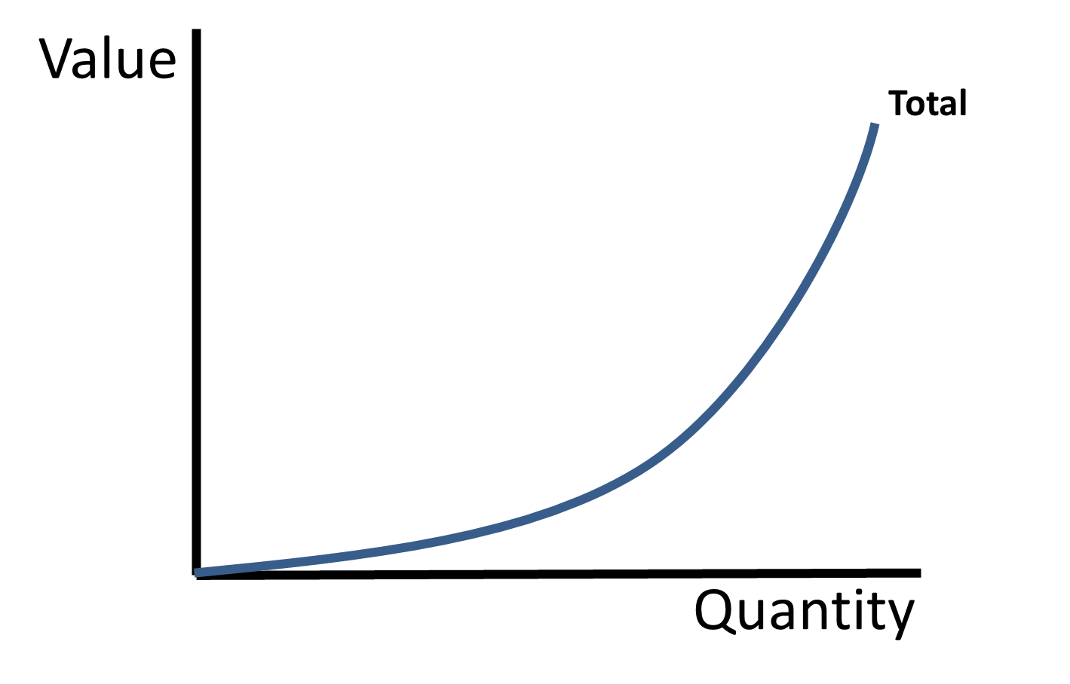
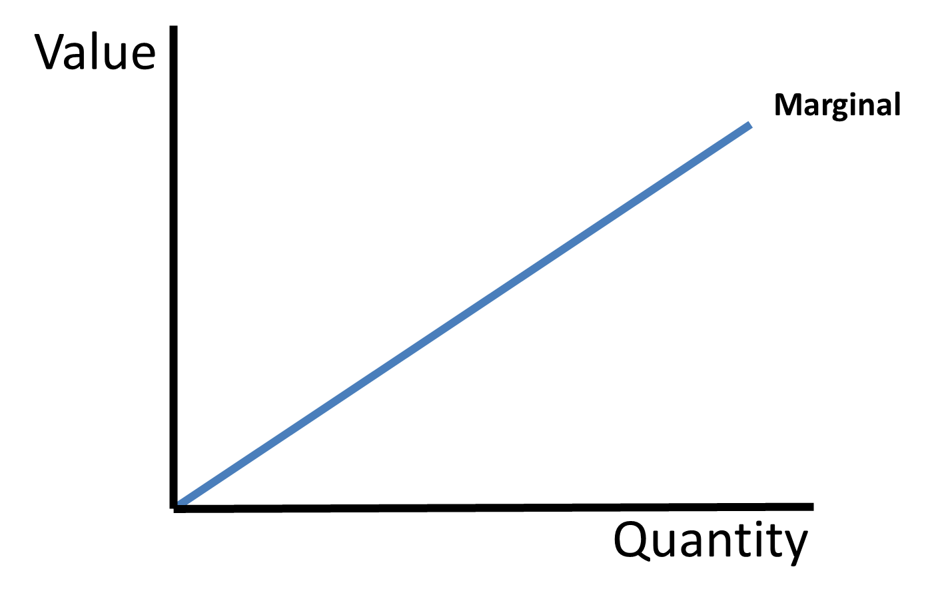
Marginal vs Total
If Total is increasing at an increasing rate
Marginal is positive and increasing
Notes:
Main Objective:
Students will interpret the graphical relationship between total values and marginal values, recognizing that when total increases at an increasing rate, marginal remains positive and rises.
Key Framing Idea:
"If each additional unit adds more than the one before, marginal must be increasing."
Because marginal reflects the slope of the total curve, a steepening total curve means larger and larger marginal values.
How to Present the Slide:
Begin by connecting to the previous slide:
"On the last slide, total was still increasing, but it was flattening out - so marginal was positive but falling. Now let’s flip that relationship."
Read:
“If Total is increasing at an increasing rate”
Pause.
Tell students:
"This is the opposite graphical relationship from the previous slide."
Start with the total graph (left)
Point to the left graph.
Explain:
"This graph shows total value increasing as quantity increases."
Ask:
"Is the total going up?"
Expected response:
Yes.
Then:
"That tells us marginal must be positive."
Confirm:
"Exactly. If total increases, marginal cannot be negative."
Focus on the curve shape
Now emphasize the curve.
Tell students:
"But look closely at the shape. This curve gets steeper as we move to the right."
Point to the early flatter portion.
Explain:
"At first, total increases slowly."
Then point to the later steep section.
"Later, total rises much faster."
Define the phrase:
Increasing
= total goes up
At an increasing rate
= each new unit adds MORE than the previous one
Tell students:
"The additions keep getting bigger."
Connect to marginal
Now move to the right graph.
Tell students:
"If each additional unit contributes more than the one before, marginal must be rising."
Point to the upward-sloping marginal curve.
Explain:
"That’s exactly what this graph shows."
Interpret:
Above zero:
"Marginal is positive."
Upward slope:
"Marginal is increasing."
Read the bottom statement:
“Marginal is positive and increasing”
Make the slope connection explicit
This is the key AP idea.
Tell students:
"Remember: marginal is the slope of the total curve."
Point to the total curve.
Explain:
"When the slope gets steeper, marginal gets larger."
Repeat:
Steeper total = bigger marginal
That visual connection is critical.
Numerical example
Give a quick example.
Suppose total changes:
+5
+10
+20
+35
Ask:
"What do you notice?"
Expected:
Each increase gets bigger.
Then ask:
"So what happens to marginal?"
Expected:
It increases.
Tie it back:
"That’s exactly what this graph represents."
Real-world examples
Connect to AP Micro.
Marginal Benefit example:
"Imagine the first few units of a product become more useful as you consume more - maybe a social media app becomes more valuable as more friends join."
Or production example:
"If workers become more specialized and coordinated, each additional worker could initially add more output than the previous one."
Clarify:
"This kind of increasing marginal relationship can happen, especially early in production processes."
This helps keep it realistic.
Compare directly to previous slide
Contrast helps retention.
Previous slide:
total rising
getting flatter
marginal positive but falling
This slide:
total rising
getting steeper
marginal positive and rising
Tell students:
"Same total direction - different marginal behavior because the slope changed."
Common misconception
Address directly.
Tell students:
"Students sometimes assume if total increases, marginal must always increase too."
Correct:
"Not true."
Clarify:
"Marginal depends on HOW total increases - not just whether total increases."
That distinction is very important.
Engagement Prompts:
Ask:
“If total gets steeper, what happens to marginal?”
(Expected: increases.)
Then:
“If total is increasing, can marginal be negative?”
(Expected: no.)
Follow-up:
“What does marginal measure graphically?”
(Expected: slope of total.)
Quick comparison:
“How is this different from the previous slide?”
(Expected: previous marginal was falling.)
Transition to Next Slide:
"Now let’s examine what happens when the total stops increasing altogether - and see what that means for marginal."

Slide 5
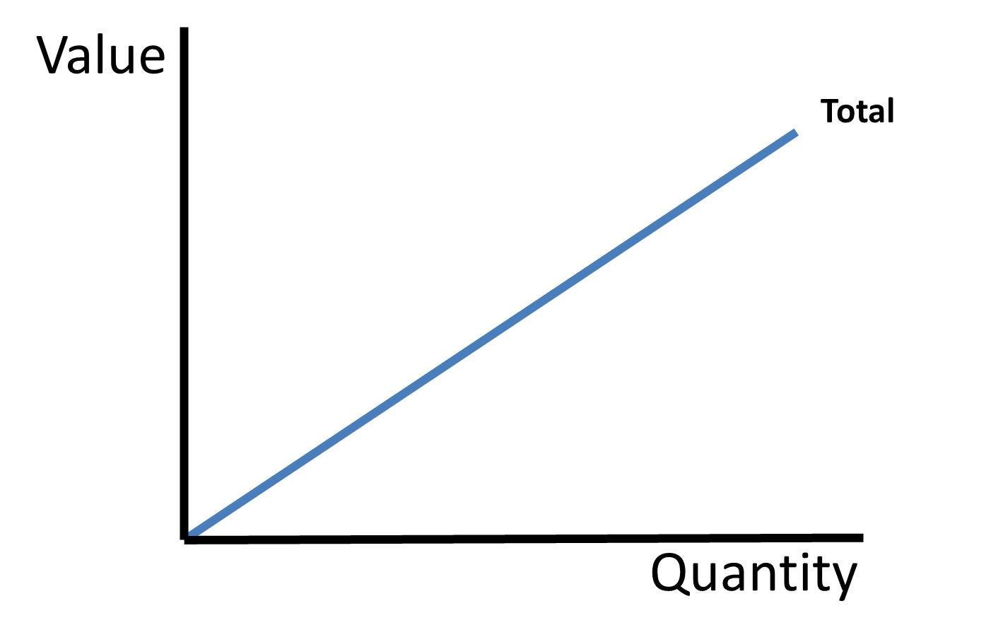
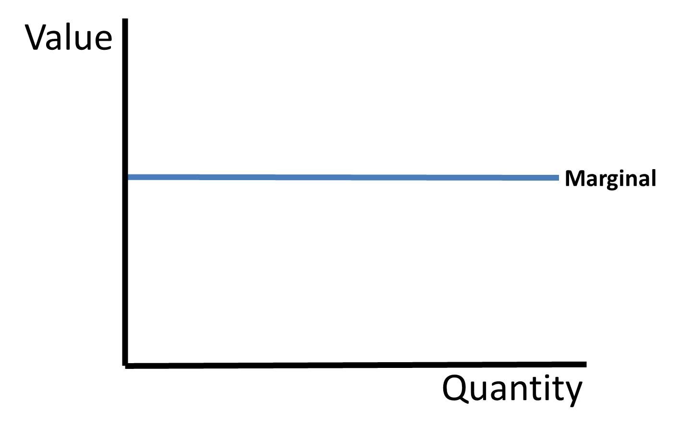
Marginal vs Total
If Total is increasing at a constant rate
Marginal is positive and constant
Notes:
Main Objective:
Students will interpret the graphical relationship between total values and marginal values, recognizing that when total increases at a constant rate, marginal remains positive and constant.
Key Framing Idea:
"If every additional unit adds exactly the same amount to the total, marginal stays constant."
Because marginal measures the slope of the total curve, a constant slope means a constant marginal value.
How to Present the Slide:
Begin by connecting to the previous slide:
"We’ve already seen two cases: total increasing more slowly created falling marginal, and total increasing more quickly created rising marginal. Now let’s look at the middle case."
Read:
“If Total is increasing at a constant rate”
Pause.
Tell students:
"This is the simplest graphical relationship because the slope never changes."
Start with the total graph (left)
Point to the left graph.
Explain:
"This graph shows total value increasing as quantity increases."
Ask:
"Is total rising?"
Expected response:
Yes.
Then:
"That means marginal must be positive."
Confirm:
"Exactly."
Focus on the shape
Point to the straight upward-sloping line.
Tell students:
"Notice this line is perfectly straight - not curved."
Explain:
"That means the slope stays the same the entire time."
Clarify:
"Each additional unit adds exactly the same amount to total."
Define the phrase:
Increasing
= total goes up
At a constant rate
= the increase is identical each time
Tell students:
"Nothing is changing about the additional contribution from one unit to the next."
Connect to marginal
Move to the right graph.
Explain:
"If every extra unit adds the same amount, marginal should stay exactly the same."
Point to the horizontal marginal line.
Interpret:
Above zero:
"Marginal is positive."
Flat:
"Marginal is constant."
Read the bottom statement:
“Marginal is positive and constant”
Make the slope connection explicit
This is the key concept.
Tell students:
"Marginal is the slope of the total curve."
Point to the straight total line.
Explain:
"Because the slope never changes, marginal never changes."
Repeat:
Constant slope = constant marginal
That simple visual rule is useful.
Numerical example
Use an easy example.
Suppose total changes:
10
20
30
40
50
Ask:
"How much is total increasing each time?"
Expected:
10
Then:
"So what is marginal?"
Expected:
10 every time
Explain:
"That’s exactly what this graph represents."
AP Micro examples
Connect to familiar economic concepts.
Example:
Constant marginal cost
"Suppose producing each additional unit always costs exactly $5."
Then:
Total cost rises steadily
Marginal cost stays constant
Or:
Perfectly linear production relationship
"Each worker adds exactly 20 units of output."
Then:
Total product rises at a constant rate
Marginal product stays constant
Tell students:
"This case is less common in real life, but it’s very useful for understanding the logic."
Compare all three cases so far
This comparison helps students organize visually.
Summarize:
Slide 1
Total increasing at decreasing rate
→ marginal positive and falling
Slide 2
Total increasing at increasing rate
→ marginal positive and rising
Slide 3
Total increasing at constant rate
→ marginal positive and constant
Tell students:
"The only thing changing is the slope of the total curve."
That’s the unifying principle.
Common misconception
Address directly.
Tell students:
"Students sometimes think any upward-sloping total means upward-sloping marginal."
Correct:
"Not true."
Clarify:
"Marginal depends on whether the slope changes - not simply whether total rises."
Engagement Prompts:
Ask:
“If total rises by exactly 8 every time, what happens to marginal?”
(Expected: stays at 8.)
Then:
“What does a straight upward total curve tell us?”
(Expected: constant slope / constant marginal.)
Follow-up:
“Can marginal be constant while total rises?”
(Expected: yes.)
Quick check:
“What does a flat marginal curve represent?”
(Expected: constant marginal.)
Transition to Next Slide:
"Now let’s complete the pattern by looking at what happens when total actually begins to fall - and see what that means for marginal."

Slide 6
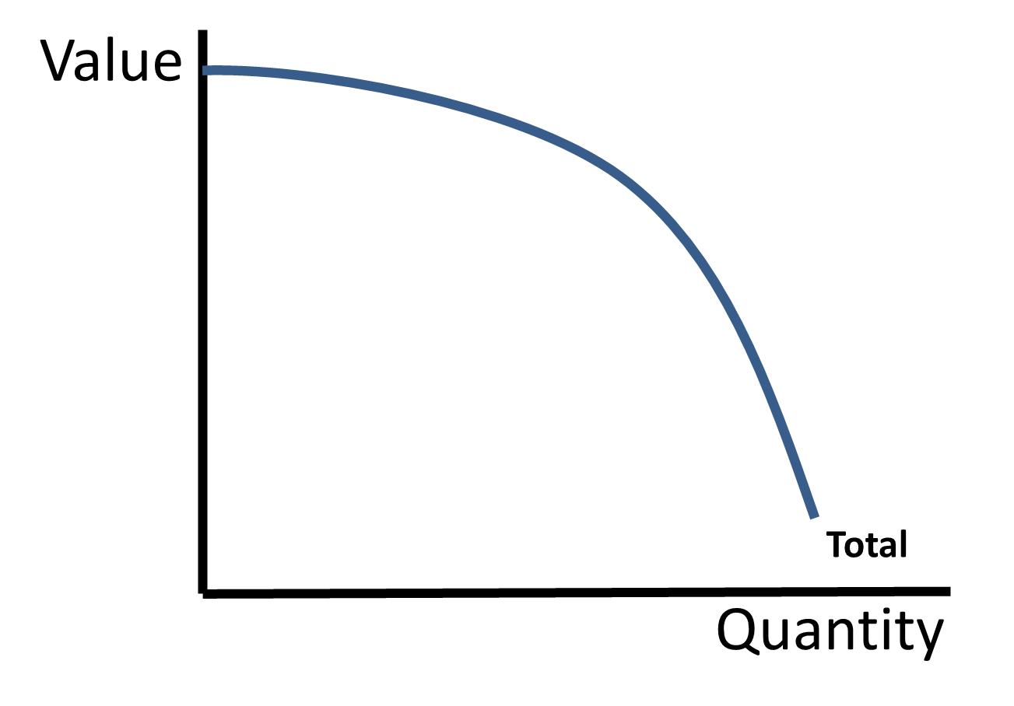
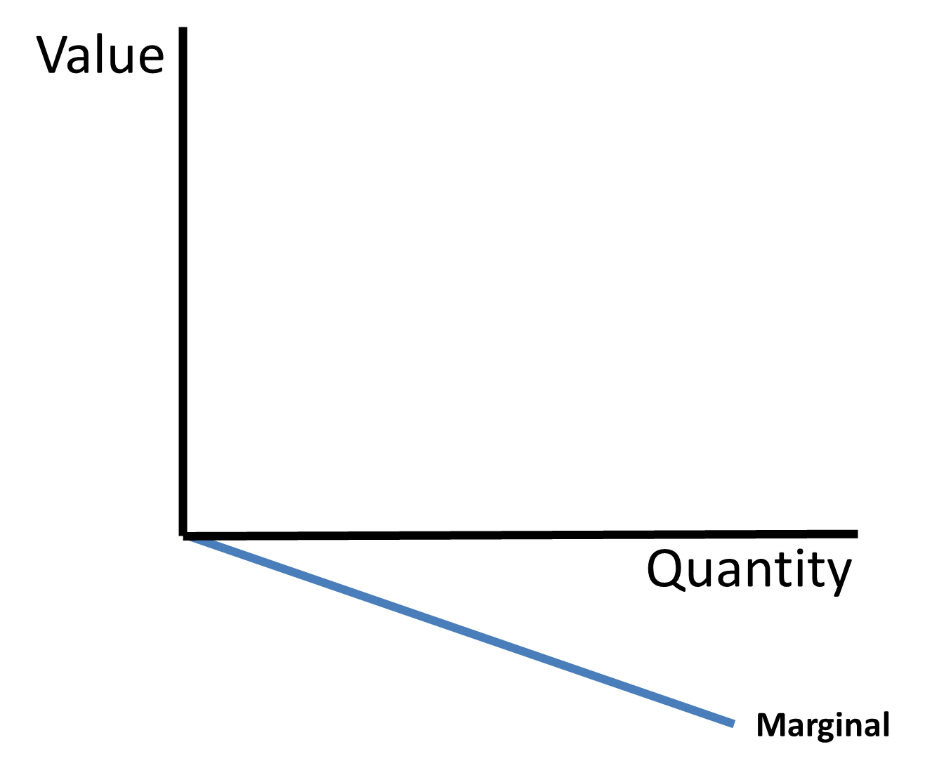
Marginal vs Total
If Total is decreasing
Marginal is negative
Notes:
Main Objective:
Students will interpret the graphical relationship between total values and marginal values, recognizing that when total decreases, marginal becomes negative.
Key Framing Idea:
"If adding another unit causes the total to fall, the marginal value must be negative."
Because marginal measures the change in total, a downward-sloping total curve means each additional unit reduces the overall total.
How to Present the Slide:
Begin by connecting to the previous slides:
"We’ve now seen three situations: total increasing more slowly, increasing more quickly, and increasing steadily. Let’s complete the full pattern with the final case."
Read:
“If Total is decreasing”
Pause.
Tell students:
"This is the point where adding another unit actually makes things worse."
That framing helps prepare them for marginal analysis.
Start with the total graph (left)
Point to the left graph.
Explain:
"This graph shows total value changing as quantity increases."
Then ask:
"What direction is total moving?"
Expected response:
Down
Confirm:
"Exactly - total is falling."
Interpret what decreasing total means
Explain:
"If adding another unit causes the total to shrink, that means the additional contribution from that unit must be negative."
Clarify:
"Instead of helping, the next unit actually hurts overall value."
That’s the key economic meaning.
Connect to marginal
Move to the right graph.
Point to the marginal line below zero.
Explain:
"That’s why marginal is negative."
Interpret visually:
Below the horizontal axis:
"Negative marginal."
Downward slope:
"Marginal becomes even more negative as quantity increases."
But emphasize the core takeaway:
"The most important point is simply that marginal is below zero."
Read the red statement:
“Marginal is negative”
Make the slope connection explicit
Repeat the big rule:
"Marginal is the slope of the total curve."
Point to the total curve.
Explain:
"A downward-sloping total curve has a negative slope."
Therefore:
"Negative slope means negative marginal."
Repeat:
Downward total = negative marginal
That should be automatic by this point.
Numerical example
Use a quick simple example.
Suppose total values are:
100
90
75
50
Ask:
"What’s happening to total?"
Expected:
Falling.
Then calculate:
Changes:
–10
–15
–25
Ask:
"What does that make marginal?"
Expected:
Negative.
This reinforces the graph.
Real-world AP Micro examples
This is a great bridge into marginal decision-making.
Marginal benefit example:
"Imagine studying for a test."
First few hours:
very helpful
Later hours:
less helpful
Eventually:
exhaustion sets in
concentration drops
performance gets worse
Then:
"Another hour of studying could actually reduce total benefit."
That creates:
negative marginal benefit
Or:
Production example
"Adding too many workers into a tiny kitchen could reduce total output because everyone gets in each other’s way."
That creates:
negative marginal product
These examples help make the concept realistic.
Summarize all four relationships
This is the perfect wrap-up.
Tell students:
If total increases at a decreasing rate
→ marginal positive and falling
If total increases at an increasing rate
→ marginal positive and rising
If total increases at a constant rate
→ marginal positive and constant
If total decreases
→ marginal negative
Tell students:
"If you understand these four relationships, you understand one of the most important graph-reading skills in AP Microeconomics."
Common misconception
Address directly.
Tell students:
"Students sometimes think marginal can be negative while total still rises."
Clarify:
“If marginal is negative, Each additional unit reduces total."
That means total must fall.
Engagement Prompts:
Ask:
“If total falls from 200 to 180, what is marginal?”
(Expected: –20.)
Then:
“What does negative marginal mean economically?”
(Expected: the next unit makes things worse.)
Follow-up:
“Where would the marginal curve be if marginal is negative?”
(Expected: below zero.)
Quick check:
“What does a downward-sloping total curve tell us?”
(Expected: negative marginal.)
Transition to Next Slide:
"Now that we understand the graphical relationship between total and marginal, let’s apply this to a real marginal analysis example by looking at the total benefit of studying."

Slide 7

Marginal Benefit
Total Benefit vs Marginal Benefit
Marginal Benefit is the change in the Total Benefit
Hours Studied | Total Benefit
0 | 30%
1 | 65%
2 | 85%
3 | 95%
4 | 100%
5 | 95%
Notes:
Main Objective:
Students will understand that marginal benefit is the change in total benefit created by one additional unit, using a studying example to prepare for calculation and decision-making.
Key Framing Idea:
"Total benefit tells us the overall payoff, but marginal benefit tells us whether doing one more unit is worth it."
This slide introduces the formal definition of marginal benefit and sets up the calculations that will drive rational decision-making.
How to Present the Slide:
Begin by connecting to the previous discussion:
"We just looked at total benefit from studying, but economists rarely make decisions based only on totals."
Pause.
Tell students:
"Instead, economists ask a much more important question: what happens if I do ONE MORE?"
Introduce the title:
“Marginal Benefit”
Then read:
“Marginal Benefit is the change in the Total Benefit”
Pause for emphasis.
Tell students:
"This is one of the most important definitions in microeconomics."
Repeat:
Marginal = change
Benefit = payoff or improvement in wellbeing
So:
"Marginal benefit means the additional benefit from one more unit."
Revisit the table
Point to the highlighted Total Benefit column.
Tell students:
"These are TOTAL benefits - not marginal benefits."
Read the numbers:
0 hours → 30%
1 hour → 65%
2 hours → 85%
3 hours → 95%
4 hours → 100%
5 hours → 95%
Explain:
"Each number shows the student’s total expected test score after that amount of studying."
Clarify:
"These are cumulative outcomes - not the added benefit from each hour."
Explain why total is not enough
Ask:
"If the student is already at 95% after 3 hours, should they study a fourth hour?"
Pause.
Tell students:
"You can’t answer that by looking only at the total."
Why?
Because:
"The real question is what the NEXT hour adds."
That is the bridge to marginal thinking.
Walk through intuition before calculation
Point to the numbers.
Compare early hours.
From:
30% → 65%
Ask:
"Big improvement or small improvement?"
Expected:
Big.
Then compare later:
95% → 100%
Expected:
Small.
Then:
100% → 95%
Expected:
Negative.
Tell students:
"Even before calculating, we can already see that the additional benefit is changing."
That’s the key insight.
Connect to marginal thinking
Tell students:
"This is exactly why economics focuses on marginal analysis."
Explain:
"Rational decision-makers don’t ask, ‘What is my total benefit?’"
They ask:
“What is the benefit of doing one more?”
Repeat:
"Should I study one more hour?"
"Should I hire one more worker?"
"Should I produce one more unit?"
"Should I consume one more slice of pizza?"
Tell students:
"That’s marginal thinking."
Set up next slide
Point to the highlighted benefit column.
Tell students:
"On this slide, we only have total benefits."
"On the next slide, we’ll calculate the marginal benefit created by each additional hour."
That helps pacing.
Common misconception
Address directly.
Tell students:
"Students often confuse total benefit with marginal benefit."
Clarify:
If total benefit = 100%
That does NOT mean marginal benefit = 100%.
Marginal only measures the additional change caused by the next unit.
Repeat:
Total = overall
Marginal = additional
Engagement Prompts:
Ask:
“Is 100% the marginal benefit of the fourth hour?”
(Expected: no.)
Then:
“Which hour appears to add the most benefit?”
(Expected: probably the first.)
Follow-up:
“What seems to happen to the added benefit as studying continues?”
(Expected: it falls.)
Prediction:
“Do you think the final hour will have positive or negative marginal benefit?”
(Expected: negative.)
Transition to Next Slide:
"Now let’s calculate the marginal benefit from each additional hour and see exactly how the added payoff changes as studying continues."

Slide 8
Marginal Benefit
Marginal Benefit is the change
in the Total Benefit
Hours Studied | Total Benefit | Marginal Benefit
0 | 30% | -
1 | 65% | 35%
2 | 85% | 20%
3 | 95% | 10%
4 | 100% | 5%
5 | 95% | -5%
Formula:
ΔTotal Benefit/ΔQuantity
Notes:
Main Objective:
Students will calculate marginal benefit using the change in total benefit formula and interpret how the added benefit from each additional unit changes over time.
Key Framing Idea:
"Marginal benefit tells us what the NEXT unit adds - not the total payoff."
This slide moves students from conceptual understanding into actual calculation, preparing them for rational decision-making using marginal analysis.
How to Present the Slide:
Begin by connecting to the previous slide:
"Now that we know what marginal benefit means conceptually, let’s actually calculate it."
Introduce the formula
Point to the formula.
Read:
ΔTotal Benefit / ΔQuantity
Define delta again:
"That triangle symbol means change in."
Explain:
"So we take the change in total benefit and divide by the change in quantity - in this case, additional hours studied."
Point out:
"Since each row increases by one hour, the denominator is almost always 1."
Therefore:
"Marginal benefit usually just equals the change in total benefit."
That keeps calculations simple.
Walk through the table
Point to the marginal benefit column.
Tell students:
"Let’s fill this in together."
First hour
From:
0 hours → 1 hour
Total benefit:
30% → 65%
Calculate:
65 – 30 = 35
Quantity change:
1
Marginal benefit:
35
Fill in:
35%
Explain:
"That first hour creates a huge benefit."
Interpret:
"The student learns a lot quickly because the first hour covers important material."
Second hour
From:
1 → 2 hours
Total benefit:
65% → 85%
Calculate:
85 – 65 = 20
Marginal benefit:
20%
Fill it in.
Tell students:
"Still helpful, but smaller than the first hour."
Third hour
From:
2 → 3 hours
85% → 95%
Change:
10
Marginal benefit:
10%
Explain:
"The extra benefit keeps shrinking."
Fourth hour
From:
3 → 4 hours
95% → 100%
Change:
5
Marginal benefit:
5%
Tell students:
"Still positive, but much smaller."
Fifth hour
From:
4 → 5 hours
100% → 95%
Change:
–5
Marginal benefit:
–5%
Pause dramatically.
Ask:
"What happened?"
Expected response:
Benefit fell.
Explain:
"The fifth hour actually makes performance worse."
Interpret the full pattern
Now step back.
Marginal benefits:
35
20
10
5
–5
Ask:
"What pattern do you notice?"
Expected:
Marginal benefit is falling.
Explain:
"This is diminishing marginal benefit."
Define:
"As consumption or activity increases, the added benefit from each additional unit eventually falls."
That’s a huge AP concept.
Connect to rational behavior
Tell students:
"This is exactly why economists focus on marginal analysis."
The important question becomes:
"Should I study one more hour?"
Not:
"What is my total score?"
Because:
"Decision-making happens one unit at a time."
Engagement Prompts:
Ask:
“What is the marginal benefit of the second hour?”
(Expected: 20.)
Then:
“What happens to marginal benefit as studying continues?”
(Expected: it falls.)
Follow-up:
“Why might the fifth hour create negative benefit?”
(Expected: exhaustion / burnout.)
Prediction:
“Should the student keep studying forever?”
(Expected: no.)
Transition to Next Slide:
"Now let’s graph these marginal benefit values so we can visualize the pattern and connect it to the graphical relationships we learned earlier."

Slide 9
Marginal Benefit
On the graph
Benefit
Marginal Benefit
Generally Slopes Downward
MB
Quantity
Notes:
Main Objective:
Students will visualize marginal benefit on a graph and recognize the common economic pattern that marginal benefit generally decreases as quantity increases.
Key Framing Idea:
"The more of something you do or consume, the less additional satisfaction or benefit each extra unit usually provides."
This slide converts the table calculations into a graph so students can see the visual pattern of diminishing marginal benefit.
How to Present the Slide:
Begin by connecting to the previous slide:
"We just calculated marginal benefit numerically. Now let’s see what those same numbers look like on a graph."
Point to the title:
“Marginal Benefit on the graph”
Tell students:
"Economists often prefer graphs because patterns become much easier to recognize visually."
Connect the graph to the prior table
Remind students of the calculated marginal benefits:
First hour: 35
Second hour: 20
Third hour: 10
Fourth hour: 5
Fifth hour: –5
Tell students:
"Notice the pattern: the added benefit gets smaller each time."
Point to the line.
Explain:
"That pattern creates a downward-sloping marginal benefit curve."
Interpret the axes
Point to the vertical axis.
Explain:
"The vertical axis shows benefit - the added benefit from one additional unit."
Point to the horizontal axis.
Explain:
"The horizontal axis shows quantity - in our example, hours studied."
Clarify:
"Each point on this graph represents the benefit of doing ONE MORE unit."
Not total benefit.
Repeat clearly:
"This is not total benefit. This is marginal benefit."
That distinction matters.
Explain the downward slope
Point to the upper left portion.
Tell students:
"At low quantities, marginal benefit is high."
Interpret:
"That first hour of studying helps a lot."
Then move down the curve.
Tell students:
"As quantity increases, the added benefit falls."
Interpret:
"Later hours become less useful because the most important studying has already happened."
Then point near where the line approaches zero.
Explain:
"Eventually, marginal benefit can hit zero."
Meaning:
"Doing one more unit adds no additional benefit."
Then point below zero.
Explain:
"Marginal benefit can even become negative."
Meaning:
"One more unit actually makes things worse."
Example:
Exhaustion.
Burnout.
Overstudying.
Introduce the economic principle
Point to the text:
“Marginal Benefit Generally Slopes Downward”
Tell students:
"This is one of the most common assumptions in economics."
Define:
Diminishing Marginal Benefit
Explain:
"As you consume or do more of something, the additional benefit usually decreases."
Examples:
eating slices of pizza
watching episodes of a show
studying for an exam
drinking bottles of water
Ask:
"Is the 10th slice of pizza as satisfying as the first?"
Expected:
No.
That makes the concept intuitive.
Connect to rational decision-making
Tell students:
"This downward slope explains why people eventually stop doing things."
Why stop studying?
Because added benefit falls.
Why stop eating?
Because added satisfaction falls.
Why stop buying?
Because the extra value eventually becomes too small.
Tell students:
"This is only half the decision, though."
Because rational choices compare:
Marginal Benefit vs Marginal Cost
That sets up the next section.
Common misconception
Address directly.
Tell students:
"Downward-sloping does NOT mean total benefit is falling."
Clarify:
Total benefit may still be increasing.
Marginal benefit just means:
the increase is getting smaller.
Use simple example:
95 → 100
Total rises.
Marginal benefit is only +5.
Still positive, just smaller.
Engagement Prompts:
Ask:
“Why is the first hour of studying usually more valuable than the fifth?”
(Expected: because you learn the most important material first.)
Then:
“Can marginal benefit ever become negative?”
(Expected: yes.)
Follow-up:
“What’s a real-life example where doing more actually makes things worse?”
(Expected examples: overeating, overstudying, exhaustion.)
Quick check:
“Does a downward marginal benefit curve mean total benefit must be falling?”
(Expected: no.)
Transition to Next Slide:
"So marginal benefit generally falls as quantity increases - but rational decisions depend on comparing benefit to something else: the cost of doing one more. Let’s now shift to marginal cost."

Slide 10




Marginal Cost
Marginal Cost is change in the Total Cost
Quantity | Total Cost | Marginal Cost
0 | $0 | -
1 | $6 | $6
2 | $13 | $7
3 | $22 | $9
4 | $34 | $12
5 | $49 | $15
With each hour, more valuable uses of your time must be given up (marginal opportunity costs increase).
Notes:
Main Objective:
Students will understand that marginal cost is the additional cost of one more unit and recognize that marginal costs often increase because increasingly valuable alternatives must be sacrificed.
Key Framing Idea:
"The longer you keep doing something, the more valuable the next thing you give up becomes."
This slide introduces marginal cost as the opportunity cost of one additional unit and uses a relatable time-allocation example to show why marginal costs often rise.
How to Present the Slide:
Begin by transitioning from the previous concept:
"We just saw that marginal benefit usually falls. Now let’s examine the other half of rational decision-making: marginal cost."
Point to the title:
“Marginal Cost”
Then read:
“Marginal Cost is change in the Total Cost”
Pause.
Tell students:
"Just like marginal benefit measured the added benefit of one more unit, marginal cost measures the added cost of one more unit."
Emphasize:
Marginal = additional
Cost = what must be given up
Connect to opportunity cost logic
Point to the red text.
Read:
“With each hour, more valuable uses of your time must be given up.”
Explain:
"That’s opportunity cost."
Then:
"Marginal cost increases because the alternatives you sacrifice become increasingly valuable."
Repeat:
"The first thing you give up usually isn’t the thing you value most."
"That comes later."
This is the key insight.
Introduce the animation / scenario
As the images appear, narrate the trade-offs.
Tell students:
"Imagine this student decides to spend more and more time studying."
"Each additional hour requires giving something up."
As the first sacrifice appears:
Watching TV
Explain:
"The first hour of studying means giving up something relatively low value - mindless TV time."
Tell students:
"That’s a fairly cheap trade-off."
As the second sacrifice appears:
Video games
Explain:
"Now the second hour requires giving up something the student values a bit more."
Tell students:
"The cost rises."
As the third appears:
Time with girlfriend
Pause.
Tell students:
"Now the sacrifice becomes more painful."
Explain:
"The student is giving up something much more valuable."
Cost rises again.
As the fourth appears:
Sleep
Pause dramatically.
Tell students:
"Now we’re sacrificing something extremely valuable."
Explain:
"The next hour of studying becomes very expensive."
This makes the intuition stick.
Walk through the table
Tell students:
"Now let’s calculate marginal cost numerically."
Read totals:
0 hours → $0
1 hour → $6
2 hours → $13
3 hours → $22
4 hours → $34
5 hours → $49
First hour
0 → 6
Marginal cost:
$6
Explain:
"Giving up TV costs about $6 worth of satisfaction."
Second hour
13 – 6 = $7
Tell students:
"Slightly higher."
Third hour
22 – 13 = $9
Explain:
"Cost keeps rising."
Fourth hour
34 – 22 = $12
Tell students:
"Now studying is getting expensive."
Fifth hour
49 – 34 = $15
Pause.
Tell students:
"That last hour is very costly because it requires sacrificing sleep."
Identify the pattern
List the marginal costs:
$6
$7
$9
$12
$15
Ask:
"What pattern do you see?"
Expected:
Costs rise.
Tell students:
"This is increasing marginal cost."
Define:
"Each additional unit costs more than the one before."
Common misconception
Address directly.
Tell students:
"Marginal cost is NOT total cost."
Example:
Total cost at hour 5 = $49
Marginal cost of hour 5 = only $15
Repeat:
Total = cumulative
Marginal = additional
Engagement Prompts:
Ask:
“Why is the first hour of studying cheaper than the fifth?”
(Expected: less valuable things are sacrificed first.)
Then:
“What’s more costly to give up: TV or sleep?”
(Expected: sleep.)
Follow-up:
“If you kept studying even longer, what would likely happen to marginal cost?”
(Expected: keep rising.)
Quick check:
“Is $49 the marginal cost?”
(Expected: no.)
Transition to Next Slide:
"Now that we can calculate marginal cost, let’s graph it and compare its shape to marginal benefit."

Slide 11
Marginal Cost
On the graph
Cost
MC
Marginal Cost
Generally Slopes Upward
Quantity
Notes:
Main Objective:
Students will recognize the graphical shape of marginal cost, understand why it generally slopes upward, and prepare to compare marginal cost with marginal benefit for rational decision-making.
Key Framing Idea:
"Doing more usually gets increasingly expensive because each additional unit requires sacrificing something more valuable."
This slide converts the marginal cost table into a visual graph and reinforces the core AP Micro assumption of increasing marginal cost.
How to Present the Slide:
Begin by connecting to the previous slide:
"We just calculated marginal costs numerically. Now let’s graph that same idea so we can visualize the pattern."
Point to the title:
“Marginal Cost on the graph”
Tell students:
"Economics becomes much easier when we can see the relationship visually."
Connect back to the previous numbers
Remind students:
The marginal costs we found were:
$6
$7
$9
$12
$15
Ask:
"What pattern did we notice?"
Expected:
Costs increased.
Tell students:
"Because the additional cost keeps getting larger, the marginal cost curve slopes upward."
Point to the line.
Interpret the axes
Point to the vertical axis.
Explain:
"The vertical axis shows cost - specifically the added cost of one more unit."
Point to the horizontal axis.
Explain:
"The horizontal axis shows quantity - in our example, additional hours studied."
Clarify:
"Each point on this curve shows the cost of doing ONE MORE unit."
Repeat:
"Not total cost - marginal cost."
That distinction matters.
Explain the upward slope
Point near the lower left.
Tell students:
"At low quantities, marginal cost is relatively low."
Interpret:
"The first hour of studying only required giving up TV."
Move upward.
Explain:
"As quantity increases, the student must sacrifice increasingly valuable alternatives."
Examples:
TV
video games
time with girlfriend
sleep
Tell students:
"That’s why the cost rises."
Point to the red text:
“Marginal Cost Generally Slopes Upward”
Repeat:
"Generally - not always - but this is the standard economic assumption."
Introduce the economic principle
Define:
Increasing Marginal Cost
Explain:
"As you do more of something, the additional cost of doing even more tends to rise."
Why?
Because:
easiest resources are used first
least valuable alternatives are sacrificed first
eventually only expensive trade-offs remain
Simple example:
"Picking up the first apple from the ground is easy."
"Climbing a ladder for the tenth apple is harder."
Same logic.
Connect beyond the studying example
Tell students:
"This applies far beyond studying."
Examples:
Factory production:
"The first few units are easy to make."
"Producing more may require overtime, crowding, or less efficient workers."
Consumer behavior:
"The first hour of gaming is cheap."
"Skipping sleep for a fifth hour is expensive."
Tell students:
"Increasing marginal cost is everywhere."
Contrast with marginal benefit
Now connect back.
Tell students:
"Notice what we now have:"
Marginal Benefit:
generally slopes downward
Marginal Cost:
generally slopes upward
AP Micro connection
Tell students:
"This upward-sloping marginal cost curve appears constantly in AP Micro."
It connects to:
production decisions
profit maximization
resource allocation
rational choice
supply reasoning
This is a major foundation.
Common misconception
Address directly.
Tell students:
"An upward-sloping marginal cost curve does NOT mean total cost is rising at a constant rate."
It means:
the additional cost per extra unit is increasing.
That’s a very different idea.
Repeat:
Total = cumulative
Marginal = additional
Engagement Prompts:
Ask:
“Why does marginal cost usually rise?”
(Expected: increasingly valuable alternatives are sacrificed.)
Then:
“What was the most expensive sacrifice in our studying example?”
(Expected: sleep.)
Follow-up:
“Would the first hour of studying usually cost more or less than the fifth?”
(Expected: less.)
Prediction:
Transition to Next Slide:
"Now that we’ve graphed both marginal benefit and marginal cost, we’re ready for the most important rule in marginal analysis: how rational decision-makers maximize total benefit."

Slide 12
Benefit Maximization
Benefit Maximizing Behavior
MB=MC
Act as long as MB≥MC
Do not act if MB<MC
Note: when identifying the benefit maximizing quantity explain that MB≥MC for the final unit AND that MC>MB for the next unit. Use numbers where possible.
Notes:
Main Objective:
Students will understand the benefit-maximizing decision rule and apply marginal analysis to determine the rational stopping point where continuing no longer increases net benefit.
Key Framing Idea:
"Rational decision-makers continue only as long as the next unit adds at least as much benefit as cost."
This slide introduces one of the most important rules in AP Microeconomics: comparing marginal benefit to marginal cost to determine the optimal quantity.
How to Present the Slide:
Begin with a strong transition:
"Now we have both pieces of the puzzle."
Review quickly:
Marginal Benefit = added benefit from one more unit
Marginal Cost = added cost from one more unit
Pause.
Tell students:
"Now the question becomes: how do rational people decide when to stop?"
Point to the title:
“Benefit Maximization”
Introduce the rule
Point to:
MB = MC
Tell students:
"This is one of the most important equations in all of microeconomics."
Pause.
Repeat slowly:
Marginal Benefit equals Marginal Cost.
Explain:
"This is the benefit-maximizing quantity."
Meaning:
"This is where total net benefit is as high as possible."
Explain the action rule
Point to the green text.
Read:
“Act as long as MB ≥ MC”
Explain:
"If the added benefit is greater than or equal to the added cost, doing one more makes sense."
Simple examples:
If:
MB = $20
MC = $8
Ask:
"Should you do it?"
Expected:
Yes.
Why?
Because:
"You gain more than you give up."
Example 2:
MB = $12
MC = $12
Ask:
"Still rational?"
Expected:
Yes.
Explain:
"You’re exactly breaking even on that final unit."
No gain.
No loss.
Still acceptable.
Explain when NOT to continue
Point to:
“Do not act if MC > MB”
Tell students:
"Once marginal cost becomes larger than marginal benefit, stop."
Example:
MB = $6
MC = $14
Ask:
"Should you continue?"
Expected:
No.
Explain:
"That next unit destroys net benefit."
Emphasize the AP exam nuance
This is the critical part.
Tell students:
"On AP questions, identifying the exact optimal quantity requires a little precision."
Explain:
The correct quantity is where:
MB ≥ MC for the final unit produced/consumed
AND
MC > MB for the NEXT unit
Write example:
At quantity 4:
MB = $10
MC = $8
Rational to continue.
At quantity 5:
MB = $5
MC = $12
Not rational.
Therefore:
Quantity 4 is optimal.
Emphasize:
"We stop at the LAST good unit - not the first bad one."
This is extremely important for AP success.
Connect to intuition
Use relatable examples.
Studying:
"If one more hour improves your score by $20 worth of benefit but costs $8 worth of lost time, keep studying."
But:
"If one more hour only helps by $3 but costs $12 in lost sleep, stop."
Fast food:
"If one more taco gives lots of satisfaction, eat it."
"If one more taco causes regret, stop."
AP Micro connection
Tell students:
"This logic appears everywhere in AP Micro."
Examples:
utility maximization
profit maximization
hiring workers
production decisions
resource allocation
rational consumer behavior
Repeat:
"This is one of the most reusable concepts in the entire course."
Common misconception
Address directly.
Tell students:
"Students often think you stop the moment MB = MC exactly."
Clarify:
Not always.
If data are discrete:
Choose the last unit where:
MB ≥ MC
and the next unit fails.
That’s the safe AP rule.
Engagement Prompts:
Ask:
“If MB is $18 and MC is $10, should you continue?”
(Expected: yes.)
Then:
“If MB is $9 and MC is $15?”
(Expected: no.)
Follow-up:
“If MB equals MC exactly, is the final unit still rational?”
(Expected: yes.)
AP-style check:
“Do we choose the first bad unit or the last good unit?”
(Expected: last good unit.)
Transition to Next Slide:
"Now let’s return to our studying example, convert those percentages into dollar values, and use the benefit-maximizing rule to find the rational amount of studying."

Slide 13
Benefit Maximization
To keep units consistent, let's say 1%
grade improvement is worth $1
Hours Studied | Total Benefit | Marginal Benefit
0 | 30% | -
1 | 65% | 35%
2 | 85% | 20%
3 | 95% | 10%
4 | 100% | 5%
5 | 95% | -5%
Hours Studied | Total Benefit | Marginal Benefit
0 | $30 | -
1 | $65 | $35
2 | $85 | $20
3 | $95 | $10
4 | $100 | $5
5 | $95 | -$5
Notes:
Main Objective:
Students will translate the studying example into comparable units so that marginal benefit and marginal cost can be directly compared using the benefit-maximization rule.
Key Framing Idea:
"Before comparing costs and benefits, they must be measured in the same units."
This slide prepares students to apply the rational decision rule by converting the benefit side into dollar terms so an apples-to-apples comparison can be made.
How to Present the Slide:
Begin by reconnecting to the earlier studying example:
"We’ve already calculated marginal benefit and marginal cost separately. Now we’re finally ready to compare them directly."
Pause.
Tell students:
"But there’s one problem."
Point to the table.
Explain:
"Right now, marginal benefit is measured in percentage points on a test…"
…and marginal cost is measured in:
dollars.
Ask:
"Can we compare 20 percentage points to $12 directly?"
Expected:
No.
Explain:
"Economists need consistent units before making rational comparisons."
Introduce the simplifying assumption
Point to the red statement.
Read:
“To keep units consistent, let’s say 1% grade improvement is worth $1.”
Pause.
Tell students:
"This is just a simplifying assumption to make comparison easy."
Clarify:
"We are NOT saying grades literally convert to dollars in real life."
Instead:
"We’re assigning dollar values so benefit and cost use the same measurement."
This is standard economic reasoning.
Convert marginal benefits
Point to the marginal benefit column.
Walk through the values:
35%
20%
10%
5%
–5%
Explain:
"If each 1% equals $1, then the marginal benefits become:"
$35
$20
$10
$5
–$5
Tell students:
"Now we can directly compare these to marginal costs."
That’s the key setup.
AP Micro connection
Tell students:
"This is classic AP Micro reasoning."
Sometimes exam questions:
assign dollar values
convert utility to marginal utility
compare benefits and costs numerically
Tell students:
"The key skill is comparing marginal values in the same units."
Transition to Next Slide:
"Now that benefit and cost are measured in the same units, let’s use the benefit-maximizing rule to determine the rational number of hours this student should study."

Slide 14
Benefit Maximization
Benefit Maximizing Behavior
Act as long as MB≥MC
Do not act if MB<MC
Quantity | Marginal Benefit
0 | -
1 | $35
2 | $20
3 | $10
4 | $5
5 | -$5
Quantity | Marginal Cost
0 | -
1 | $6
2 | $7
3 | $9
4 | $12
5 | $15
How many hours should he study?
3, BECAUSE $10>$9
AND
$5<$12
Notes:
Main Objective:
Students will apply the benefit-maximization rule numerically by comparing marginal benefit and marginal cost to determine the rational stopping point.
Key Framing Idea:
"Rational decision-makers continue as long as the next unit adds more benefit than cost - and stop when the next unit would create a loss."
This slide takes the abstract rule and applies it with real numbers so students can see exactly how economists make decisions.
How to Present the Slide:
Begin by connecting to the previous slide:
"Now we finally have everything we need."
Review quickly:
Benefits and costs are now measured in the same units
We know the decision rule
Now we apply it
Point to the title:
“Benefit Maximizing Behavior”
Tell students:
"This is economics in action."
Re-state the rule
Point to the bottom rule.
Read:
“Act as long as MB ≥ MC”
Then:
“Do not act if MB < MC”
Tell students:
"This is our decision-making checklist."
Explain:
"We compare the added benefit of each hour to the added cost of each hour."
Walk through the hours one at a time
Point to hour 1.
Marginal Benefit:
$35
Marginal Cost:
$6
Ask:
"Worth it?"
Expected:
Yes.
Explain:
"The student gains far more than they give up."
Point to hour 2.
MB:
$20
MC:
$7
Ask:
"Still rational?"
Expected:
Yes.
Explain:
"Still a strong positive net gain."
Point to hour 3.
MB:
$10
MC:
$9
Ask:
"Still worth it?"
Expected:
Yes.
Explain:
"Barely - but yes."
Net Marginal Benefit:
+$1
Tell students:
"As long as marginal benefit is still greater than marginal cost, continue."
Point to hour 4.
MB:
$5
MC:
$12
Pause.
Ask:
"Now what?"
Expected:
Stop.
Explain:
"The next hour costs more than it helps."
Net loss:
–$7
Tell students:
"That means the fourth hour destroys total benefit."
Identify the optimal quantity
Point to the answer.
Read:
“3, because $10 > $9 AND $5 < $12”
Pause.
This is the most important AP point.
Explain slowly:
"The optimal quantity is NOT where you first see a bad choice."
Instead:
"It is the LAST good choice."
Repeat:
The rational quantity is:
3 hours
Because:
At 3 hours:
MB > MC
But at 4 hours:
MB < MC
That’s the AP exam logic.
Emphasize the “last good unit” rule
Tell students:
"Students often make a common mistake here."
They choose: 4
Because they see the bad comparison there.
Correct them:
"No - the rational decision-maker stops BEFORE the bad unit."
Repeat clearly:
Choose the last unit where MB ≥ MC
NOT
the first unit where MB < MC.
This is critical.
Connect to net total benefit
Explain conceptually:
At 1 hour:
big gain
At 2 hours:
still gain
At 3 hours:
small gain
At 4 hours:
loss
Tell students:
"That means total net benefit rises until 3 hours, then begins falling."
That’s exactly benefit maximization.
Connect to intuition
Ask:
"Would a rational student stay awake studying if it makes them worse off?"
Expected:
No.
Explain:
"Economics assumes rational decision-makers stop when the next action hurts them."
AP Micro connection
Tell students:
"This exact logic appears everywhere in AP Micro."
Examples:
hiring workers
producing output
consuming goods
maximizing utility
business decision-making
Repeat:
"This is one of the most transferable rules in the entire course."
Common misconception
Address directly.
Tell students:
"Benefit maximization does NOT mean choosing the highest marginal benefit."
Why not?
Because the decision depends on comparison to cost.
Also:
"It does NOT mean choosing the biggest total benefit number."
It means:
choosing where the final unit still helps.
Engagement Prompts:
Ask:
“Why isn’t 4 hours the correct answer?”
(Expected: because MB < MC.)
Then:
“What makes 3 the correct answer?”
(Expected: it’s the last hour where MB exceeds MC.)
Follow-up:
“If hour 4 had MB = $12 and MC = $12, would it be rational?”
(Expected: yes.)
Quick check:
“Do we stop at the first bad unit or the last good unit?”
(Expected: last good unit.)
Transition to Next Slide:
"Now let’s see this exact same decision visually on a graph, where the optimal quantity occurs where marginal benefit and marginal cost intersect."

Slide 15
Benefit Maximization
On the graph
Cost/
Benefit
MC
Benefit Maximization RULE
MB=MC
At low quantities MB>MC
(net benefit increasing)
MB1
At high quantities
MC>MB
(net benefit decreasing)
MC1
MB1/MC1
MB1
MC1
MB
Q1
Q1
Q1
Quantity
Notes:
Main Objective:
Students will identify the benefit-maximizing quantity graphically by comparing marginal benefit and marginal cost and understanding why the optimal decision occurs where the two curves intersect.
Key Framing Idea:
"Rational decision-makers keep going while the added benefit exceeds the added cost - and stop once the added cost becomes larger."
This slide converts the numerical benefit-maximization rule into a visual model students will repeatedly use throughout AP Microeconomics.
How to Present the Slide:
Begin by connecting to the previous slide:
"We just found the optimal quantity using numbers. Now let’s see the exact same logic on a graph."
Point to the title:
“Benefit Maximization on the graph”
Tell students:
"This graph is one of the most important visuals in economics."
Introduce the axes
Point to the vertical axis.
Explain:
"The vertical axis measures both cost and benefit."
Clarify:
"Since we converted everything into the same units, we can compare them directly."
Point to the horizontal axis.
Explain:
"The horizontal axis shows quantity - how much activity, consumption, or production is happening."
Part 1: Low Quantities (first animation section)
Point to the left side where MB is above MC.
Tell students:
"Let’s start at low quantities."
Point to the downward-sloping MB curve.
Explain:
"Marginal benefit starts high because the first units are very valuable."
Point to the upward-sloping MC curve.
Explain:
"Marginal cost starts low because the first sacrifices are relatively cheap."
Now compare.
Tell students:
"At low quantities, marginal benefit is greater than marginal cost."
Read the red text:
MB > MC
Explain:
"That means the benefit from doing one more exceeds the cost."
Therefore:
"Net benefit is increasing."
Ask:
"If doing one more helps more than it hurts, should a rational person continue?"
Expected:
Yes.
Tell students:
"Absolutely."
Use a numerical example
Tell students:
"Imagine MB = $20 and MC = $8."
Ask:
"Worth continuing?"
Expected:
Yes.
Because:
"The added gain exceeds the added sacrifice."
Part 2: High Quantities (second animation section)
Move to the right side.
Point where MC rises above MB.
Tell students:
"Now let’s look at high quantities."
Explain:
"Marginal benefit has fallen…"
because extra units become less valuable.
"Marginal cost has risen…"
because increasingly valuable alternatives are sacrificed.
Now compare.
Tell students:
"At high quantities, marginal cost is greater than marginal benefit."
Read:
MC > MB
Explain:
"Now the next unit costs more than it helps."
Therefore:
"Net benefit decreases."
Ask:
"Should a rational person continue here?"
Expected:
No.
Use another number example
Example:
MB = $5
MC = $15
Ask:
"Worth it?"
Expected:
No.
Explain:
"That unit makes the person worse off."
Part 3: Benefit-Maximizing Quantity (final animation section)
Now move to the intersection.
Pause.
Tell students:
"So where is the exact best quantity?"
Point to the crossing point.
Read:
Benefit Maximization Rule MB = MC
Explain:
"This is the benefit-maximizing quantity."
Why?
Because:
before this point, extra units increase net benefit
after this point, extra units decrease net benefit
Therefore:
"This is the turning point."
Make the AP exam logic explicit
This matters a lot.
Tell students:
"On the AP exam, this means:"
The final unit chosen must satisfy:
MB ≥ MC
And the next unit must satisfy:
MC > MB
Repeat:
"Last good unit - not first bad unit."
This connects directly to the prior numerical example.
Connect to total net benefit
Explain visually:
Left of equilibrium:
net benefit rises
At equilibrium:
net benefit is maximized
Right of equilibrium:
net benefit falls
Tell students:
"This graph is really showing the peak of total net benefit."
That’s the deeper idea.
AP Micro connections
Tell students:
"This exact graph logic shows up everywhere."
Examples:
utility maximization
hiring workers
production decisions
consumer choice
resource allocation
profit maximization logic
Repeat:
"This is one of the most reusable decision-making tools in economics."
Common misconception
Address directly.
Tell students:
"Students sometimes think the intersection means stop because nothing good happens anymore."
Clarify:
That’s not quite right.
The intersection means:
"The final unit is exactly worth doing - but the NEXT one is not."
That’s the important distinction.
Engagement Prompts:
Ask:
“Why should a rational person continue when MB > MC?”
(Expected: because net benefit rises.)
Then:
“Why stop when MC > MB?”
(Expected: because net benefit falls.)
Follow-up:
“What makes the intersection point special?”
(Expected: highest net benefit.)
Quick AP check:
“Do we choose the first bad unit or the last good unit?”
(Expected: last good unit.)
Transition to Next Slide:
"We’ve now built the full logic of rational decision-making. Next, let’s connect this idea to a word economists use constantly when talking about satisfaction and benefits: utility."

Slide 16
Diminishing Marginal Utility
Utility:
Satisfaction gained by consumers when consuming a good or service
Utility is a consumer’s benefit
Notes:
Main Objective:
Students will understand the economic meaning of utility and connect it to the broader marginal analysis framework by recognizing utility as the consumer-side version of benefit.
Key Framing Idea:
"Economists use the word utility to describe satisfaction - the benefit consumers receive from consuming goods and services."
This slide introduces a foundational AP Micro term that connects consumer choice to the marginal analysis framework students have already built.
How to Present the Slide:
Begin by connecting to the previous slides:
"So far, we’ve been using the general word ‘benefit.’ Now we’re going to introduce the specific economic term economists use when talking about consumer satisfaction."
Point to the title:
“Diminishing Marginal Utility”
Tell students:
"Before we define the full law, we need to define the word utility."
Define utility
Point to the definition.
Read:
“Utility: Satisfaction gained by consumers when consuming a good or service.”
Pause.
Then simplify:
"In plain English, utility just means satisfaction, happiness, or enjoyment from consuming something."
Tell students:
"Economists needed a word for consumer benefit, and that word is utility."
Connect to prior marginal analysis
Point to the green statement:
“Utility is a consumer’s benefit”
Emphasize:
"This is the big connection."
Explain:
"Everything we just learned about marginal benefit applies here too."
Tell students:
"When economists say marginal benefit in a consumer choice context, they are often talking about marginal utility."
That connection matters.
Make the concept intuitive
Use relatable examples.
Ask:
"What gives you utility?"
Take quick examples:
pizza
video games
Netflix
hanging out with friends
music
new shoes
Tell students:
"If consuming something makes you happier or better off, it creates utility."
Explain the consumer focus
Tell students:
"Utility specifically applies to consumers."
That means:
people consuming goods and services.
Examples:
eating food
watching a movie
buying a hoodie
going to Disneyland
Explain:
"This is not about firms producing goods - it’s about people receiving satisfaction from consumption."
Connect to marginal thinking
Tell students:
"Now combine this with what we already know about marginal analysis."
If utility = benefit
Then:
Marginal utility = added benefit from one more unit.
Ask:
"What do you think happens to marginal utility as someone consumes more?"
Let them predict.
Likely answer:
It falls.
Perfect setup.
Common misconception
Address directly.
Tell students:
"Utility does NOT mean the same thing for everyone."
Example:
One student may get huge utility from sushi.
Another may hate sushi.
Explain:
"Utility is subjective."
Different consumers value things differently.
That’s why markets exist.
Engagement Prompts:
Ask:
“What is something that gives you utility?”
(Expected: various consumer goods/services.)
Then:
“Does utility mean usefulness, or satisfaction?”
(Expected: satisfaction.)
Follow-up:
“Can two people get different utility from the same product?”
(Expected: yes.)
Prediction:
“What do you think happens to satisfaction as you consume more of the same thing?”
(Expected: it falls.)
Transition to Next Slide:
"Now that we know utility means consumer satisfaction, let’s look at one of the most important consumer behavior principles in economics: the Law of Diminishing Marginal Utility."

Slide 17
Diminishing Marginal Utility
Law of Diminishing Marginal Utility
The additional satisfaction
gained from consuming a
good decreases with each
additional unit consumed
Notes:
Main Objective:
Students will understand the Law of Diminishing Marginal Utility and explain why the additional satisfaction from consuming more of the same good tends to decrease over time.
Key Framing Idea:
"The first unit of something often feels great - but each additional unit usually feels less valuable than the one before."
This principle helps explain consumer decision-making and why marginal benefit curves generally slope downward.
How to Present the Slide:
Begin by connecting directly to the previous slide:
"Now that we know utility means satisfaction, we can define one of the most important ideas in consumer behavior."
Point to the title:
“Law of Diminishing Marginal Utility”
Tell students:
"This sounds complicated, but the idea is actually very intuitive."
Break down the phrase:
Marginal = additional / one more
Utility = satisfaction
Diminishing = getting smaller
Then put it together:
"So diminishing marginal utility means the satisfaction from one more unit gets smaller as you consume more."
Read the formal definition
Read the slide definition:
“The additional satisfaction gained from consuming a good decreases with each additional unit consumed.”
Then simplify:
"In plain English: the first one is awesome… the second is still good… the third is less exciting… eventually you may not even want another one."
Pause.
Let that sink in.
Build intuition with examples
Use relatable examples.
Example 1:
"Imagine you're starving and someone gives you a slice of pizza."
Ask:
"How much utility does that first slice provide?"
Answer:
Huge utility.
Then:
Second slice?
Still good.
Third?
Pretty decent.
Fourth?
Maybe getting full.
Fifth?
Starting to regret your life choices.
Students will laugh.
That helps cement the concept.
Connect to marginal benefit
Make the AP connection explicit.
Tell students:
"Marginal utility is just marginal benefit for consumers."
So if marginal utility diminishes…
Then:
Marginal benefit diminishes too.
This explains why:
MB slopes downward
consumers eventually stop consuming more
That connection is critical.
Explain why this happens
Tell students:
"The reason is simple: your most urgent wants get satisfied first."
Examples:
First bottle of water when thirsty = huge benefit
Fifth bottle = much less benefit
Or:
First hour on Instagram = enjoyable
Fourth hour = much less satisfying
Explain:
"Each additional unit solves a less important want."
Address the law language
Tell students:
"Economists call this a ‘law’ because it happens so consistently in normal human behavior - not because it’s a legal rule."
That wording often helps.
Clarify “usually,” not literally always
Tell students:
"This is a general behavioral pattern, not an absolute rule in every weird scenario."
For example:
Collectibles or addictions can complicate the pattern.
But for AP Economics:
Assume diminishing marginal utility holds.
Set up the graphing connection
Tell students:
"This idea is exactly why marginal benefit curves slope downward."
As quantity increases:
Marginal utility falls.
That becomes the graphical model students will use later.
Engagement Prompts:
Ask:
“What gives more satisfaction: your first slice of pizza or your fifth?”
(Expected: first.)
Then:
“Why?”
(Expected: hunger is already being satisfied.)
Ask:
“Can you think of something where the first unit gives a huge benefit?”
Examples:
coffee
water
phone battery
sleep
snacks
Follow-up:
“What happens to the benefit of one more unit?”
(Expected: it falls.)
Transition to Next Slide:
"Now let’s take this abstract idea and make it concrete with a simple example of diminishing marginal utility in action."

Slide 18





Diminishing Marginal Utility
10 Utils
100 Utils
80 Utils
-20 Utils
50 Utils
Notes:
Main Objective:
Students will apply the Law of Diminishing Marginal Utility to a real-world example and distinguish between positive, zero, and negative marginal utility.
Key Framing Idea:
“More is not always better - the first unit gives the most satisfaction, and eventually extra units can make you worse off.”
This example makes diminishing marginal utility visible and helps prepare students to graph total and marginal utility.
How to Present the Slide:
Start by saying:
"Definitions are useful, but economics really clicks when we see actual examples."
Point to the pizza slices.
Tell students:
"Let’s imagine you're extremely hungry and start eating pizza."
This is relatable and easy for students to understand.
Walk through each slice one at a time
Reveal or discuss each slice in sequence.
First slice: 100 utils
Point to the first slice and happy face.
Say:
"That first slice is incredible."
Explain:
You're hungry
The pizza tastes amazing
It solves an urgent want
So:
Marginal utility = 100 utils
Tell students:
"Economists use ‘utils’ as a made-up unit of satisfaction."
Clarify:
"A util is not a real measurable unit like dollars - it’s just a way to represent relative happiness."
Second slice: 80 utils
Point to the second slice.
Say:
"The second slice is still great - but not quite as amazing."
Explain:
Hunger is partially satisfied
The urgency is lower
Satisfaction is still positive, but smaller
So:
Marginal utility falls from 100 to 80
Emphasize:
This is diminishing marginal utility beginning.
Third slice: 50 utils
Point to the neutral face.
Say:
"By the third slice, you’re getting full."
Explain:
Still positive benefit…
…but much less than before.
So:
Marginal utility keeps falling
Ask:
"Is the third slice still worth eating?"
Likely yes.
But less valuable.
Fourth slice: 10 utils
Point to the slightly unhappy face.
Say:
"Now we’re in dangerous territory."
Explain:
The fourth slice gives very little extra satisfaction.
Still technically positive…
…but barely.
Emphasize:
This is approaching the point where additional consumption stops making sense.
Fifth slice: -20 utils
Point dramatically to the sick face.
Say:
"This is where economics meets poor life decisions."
Students will laugh.
Explain:
Now the extra slice makes you worse off.
You feel:
stuffed
uncomfortable
nauseous
So:
Marginal utility becomes negative
That means:
consuming one more unit reduces total satisfaction.
That is a critical concept.
Connect to benefit maximization
Tie this to earlier marginal analysis.
Say:
"A rational consumer stops before marginal utility becomes negative."
Even more specifically:
Stop when:
Marginal Benefit = Marginal Cost
If pizza is free:
You’d stop before negative utility.
If pizza costs money:
You might stop even sooner.
Engagement Prompts:
Ask:
“Which slice gives the most utility?”
(Expected: first slice.)
Ask:
“Why does the second slice feel less valuable?”
(Expected: less hunger.)
Ask:
“Should you eat the fifth slice?”
(Expected: no.)
Follow-up:
“Why not?”
(Expected: negative marginal utility.)
Ask:
“Can you think of other examples where more becomes worse?”
Possible answers:
studying too long
too much candy
too much screen time
too much caffeine
Transition to Next Slide:
"Now let’s take these pizza numbers and graph them so you can see exactly what diminishing marginal utility looks like visually."

Slide 19
Diminishing Marginal Utility
On the graph
Utility
Marginal Utility
constantly decreases
Total Utility is Maximum when MU is zero
Utility
Q
P
MU
Quantity
TU
MU
Q
Notes:
Main Objective:
Students will interpret the graphical relationship between marginal utility and total utility, and explain why consumers stop consuming additional units when marginal utility reaches zero.
Key Framing Idea:
“Marginal utility drives total utility - when marginal utility is positive, total utility rises; when marginal utility hits zero, total utility peaks; when marginal utility becomes negative, total utility falls.”
This graphical relationship directly connects diminishing marginal utility to rational consumer behavior.
How to Present the Slide:
Start by saying:
"Now let’s take our pizza example and translate it into graphs - the language economists use to visualize consumer behavior."
Tell students:
"This slide shows the exact same idea in two graphical formats."
Start with the left graph (Marginal Utility)
Point to the left graph.
Say:
"This is marginal utility - the benefit from consuming one more unit."
Connect back to pizza:
1st slice = huge benefit
2nd slice = smaller benefit
3rd slice = smaller still
eventually negative
Point to the downward-sloping line.
Explain:
"Because each additional unit gives less extra satisfaction, marginal utility slopes downward."
Emphasize:
This is the visual version of the Law of Diminishing Marginal Utility.
Read the first bullet:
Marginal Utility constantly decreases
Pause.
Say:
"That is the core rule here."
Relationship between MU and TU
Explain in sequence:
When MU is positive
Point to the left side of the dotted line.
Say:
"When marginal utility is positive, each extra unit adds satisfaction."
So:
Total utility rises.
Point to the upward portion of the TU curve.
When MU equals zero
Point to the dotted line intersection.
Say:
"At this exact quantity, marginal utility is zero."
Meaning:
No extra satisfaction from one more unit.
Therefore:
Total utility reaches its maximum.
Read the second bullet:
Total Utility is Maximum when MU is zero
This is a major AP concept.
When MU is negative
Point to the right of the dotted line.
Say:
"Now extra units actually make the consumer worse off."
Examples:
stuffed after too much pizza
exhausted from too much studying
annoyed after too much screen time
Because MU is negative:
Total Utility falls.
Point to the downward part of the TU curve.
Connect to rational decision-making
Tell students:
"A rational consumer does NOT keep consuming until they feel sick.".
Then clarify:
"Consumers typically stop before marginal utility becomes negative."
If price exists:
They stop even earlier - when the marginal utility, calculated in dollars, equals the price of the next slice of pizza.
when:
Marginal Benefit = Marginal Cost
This previews utility maximization.
Common AP clarification
Tell students:
"Don’t confuse total utility with marginal utility."
Quick distinction:
Total Utility = all satisfaction accumulated
Marginal Utility = extra satisfaction from one more unit
Then:
"Marginal tells total what to do."
Good memory phrase.
Engagement Prompts:
Ask:
“If marginal utility is positive, what happens to total utility?”
(Expected: rises.)
Ask:
“If marginal utility is zero?”
(Expected: total utility is max.)
Ask:
“If marginal utility is negative?”
(Expected: total utility falls.)
Follow-up:
“Would a rational person keep consuming once utility becomes negative?”
(Expected: no.)
Transition to Next Slide:
"Now that we understand how utility behaves, let’s use that idea to figure out how consumers choose the utility-maximizing combination of goods to buy."

Slide 20

Utility Maximizing Combinations
MU_{a}/P_{a}=MU_{b}/P_{b}
Total Utility will increase if more of the highest MU/$ is consumed and Less of the lower MU/$
Soda
Sandwich
15 MU/$
10 MU/$
MU_{a} = 45
P_{a} = $3
MU_{b} = 80
P_{b} = $8
Notes:
Main Objective:
Students will understand the utility-maximizing rule for multiple goods and explain how consumers allocate limited income to maximize total satisfaction.
Key Framing Idea:
“Consumers get the most satisfaction by spending the next dollar where it gives the biggest bang for the buck.”
Utility maximization means reallocating spending until the marginal utility per dollar is equal across all goods.
How to Present the Slide:
Start by saying:
"So far, we’ve looked at how utility changes when consuming more of one good. But in real life, consumers choose between multiple goods with limited money."
Pause.
Then:
"The big question becomes: how should a rational consumer divide their spending?"
Point to the formula.
Introduce the rule
Read:
MUₐ / Pₐ = MUᵦ / Pᵦ
Say:
"This is the utility-maximizing combinations rule."
Then translate it:
"Consumers maximize total satisfaction when the marginal utility per dollar spent is equal across goods."
Simplify further:
“Equal satisfaction per dollar.”
Tell students:
"This is one of the most important consumer-choice rules in microeconomics."
Define each piece
Point to each variable.
Explain:
MU = marginal utility
P = price
MU/P = utility gained from spending one dollar
Say:
"This tells us how much extra happiness each dollar buys."
Explain the logic before doing numbers
Say:
"Imagine one dollar spent on soda gives you more satisfaction than one dollar spent on sandwiches."
Ask:
"Should you keep spending money equally on both?"
Answer:
No.
Explain:
"A rational consumer shifts spending toward the item giving more utility per dollar."
Repeat the core rule:
Buy more of the high MU/$ good.
Buy less of the low MU/$ good.
As consumption changes:
marginal utility of the good you buy more of falls
marginal utility of the good you buy less of rises
Eventually:
The ratios become equal.
That’s equilibrium.
Work through the example
Now point to the soda.
Read:
MU = 45
Price = $3
Calculate aloud:
45 ÷ 3 = 15 utils per dollar
Point to the big blue:
15 MU/$
Say:
"Every dollar spent on soda gives 15 units of satisfaction."
Now point to the sandwich.
Read:
MU = 80
Price = $8
Calculate:
80 ÷ 8 = 10 utils per dollar
Point to:
10 MU/$
Say:
"Every dollar spent on sandwiches gives only 10 units of satisfaction."
Compare the two
Ask:
"Which gives the bigger bang for the buck?"
Expected:
Soda
Then explain the arrows.
Green arrow:
Buy more soda
Red arrow:
Buy fewer sandwiches
Why?
Because:
15 > 10
Say:
"Right now, spending a dollar on soda gives more benefit than spending a dollar on sandwiches."
So the current combination is not utility maximizing.
Explain adjustment process
Say:
"If the consumer buys more soda..."
Then:
Marginal utility from soda falls.
Why?
Diminishing marginal utility.
Then:
"If the consumer buys fewer sandwiches..."
Marginal utility from sandwiches rises relative to the units still being consumed.
Eventually:
The MU/$ values become equal.
That’s the utility-maximizing combination.
AP exam clarification
Tell students:
"This is NOT saying total utility has to be equal."
Important distinction:
Not:
MUₐ = MU_{b}
But:
MUₐ/Pₐ = MU_{b}/P_{b}
Students commonly miss that.
A sandwich can provide more total utility -
but if it costs more, soda may still be the better marginal purchase.
Simple memory trick
Write/say:
“Biggest happiness per buck.”
Students remember that.
Engagement Prompts:
Ask:
“If one dollar spent on soda gives 15 utils and one dollar spent on sandwiches gives 10 utils, where should the next dollar go?”
(Expected: soda.)
Ask:
“Why won’t that continue forever?”
(Expected: diminishing marginal utility.)
Ask:
“What happens when the two MU/$ values become equal?”
(Expected: utility maximized.)
Follow-up:
“Should total utility be equal across goods?”
(Expected: no.)
Transition to Next Slide:
"Now let’s make this more realistic by adding a third good - and introducing the budget constraint that limits what consumers can actually buy."

Slide 21



Utility Maximizing Combinations
With budget constraint ($6)
Q | MU | MU/$
1 | 50
2 | 40
3 | 30
4 | 20
5 | 10
Q | MU | MU/$
1 | 30
2 | 26
3 | 18
4 | 11
5 | 6
Q | MU | MU/$
1 | 96
2 | 84
3 | 76
4 | 62
5 | 52
50
40
30
20
10
60
52
36
22
12
48
42
38
31
26
Calculate MU/$
Purchase highest MU/$ Until all money is spent
1 apple
2 bananas
2 oranges
$1
$0.50
$2
Notes:
Main Objective:
Students will apply the utility-maximization rule with a budget constraint to determine the combination of goods that produces the greatest total satisfaction.
Key Framing Idea:
“Consumers with limited income should spend each dollar where it creates the greatest additional satisfaction until the budget runs out.”
This combines diminishing marginal utility, marginal analysis, and rational decision-making into one practical consumer-choice model.
How to Present the Slide:
Start by saying:
"Now let’s put everything together in a realistic consumer decision."
Pause.
Then:
"Consumers don’t have unlimited money, so maximizing utility means making the best choices within a budget constraint."
Point to:
Budget constraint ($6)
Say:
"This consumer only has six dollars to spend."
That means:
The goal is not to buy everything.
The goal is to buy the best combination possible.
Introduce the three goods
Point to each good.
Explain:
Apples = $1
Bananas = $0.50
Oranges = $2
Tell students:
"Each table shows the marginal utility from consuming additional units of each good."
Explain:
As quantity increases:
Marginal utility falls.
That’s diminishing marginal utility in action.
But because prices differ -
we cannot compare marginal utility alone.
We must compare:
MU per dollar
Point to the MU/$ columns.
Explain the procedure
Point to the instructions on the right.
Read:
1. Calculate MU/$
2. Purchase highest MU/$ until all money is spent
Tell students:
"This is basically a shopping draft."
Each round:
Find the highest utility per dollar purchase available.
Buy it.
Recalculate what the next unit would be.
Repeat until the budget is gone.
Walk through the purchases
Purchase #1
Point to bananas.
Top banana MU/$:
60
Say:
"The best first purchase is one banana because it gives the biggest bang for the buck."
Cost:
$0.50
Remaining budget:
$5.50
Purchase #2
Next banana:
52 MU/$
Still highest.
Buy second banana.
Another $0.50
Remaining:
$5.00
Purchase #3
Now compare:
Apple = 50
Orange = 48
Next banana = 36
Highest:
Apple
Buy 1 apple.
Cost:
$1
Remaining:
$4
Purchase #4 and #5
Compare remaining highest values.
Orange:
48
Then next orange:
42
Both beat remaining options.
So buy:
2 oranges
Cost:
$4 total
Budget exhausted.
Final bundle
Point to the answer.
1 apple
2 bananas
2 oranges
Say:
"That is the utility-maximizing combination for this budget."
Explain WHY this works
Tell students:
"Notice what we did not do."
We did NOT:
buy only the cheapest good
buy only the highest marginal utility good
split spending evenly
Instead:
We repeatedly bought the highest marginal utility per dollar.
That’s rational consumer behavior.
Connect to AP exam thinking
Tell students:
"On AP problems, this is often presented as a table question."
Students may need to:
calculate MU
calculate MU/$
compare alternatives
identify the utility-maximizing bundle
Emphasize:
The rule is always highest MU/$ first.
Common mistake warning
Tell students:
"A common mistake is picking the highest marginal utility instead of the highest marginal utility per dollar."
Example:
An orange may have higher raw utility -
but if it costs much more, it may not be the better purchase.
That distinction matters.
Engagement Prompts:
Ask:
“Why don’t we just buy the good with the highest raw utility?”
(Expected: prices differ.)
Ask:
“Why do bananas get purchased first?”
(Expected: highest MU/$.)
Ask:
“Why not keep buying bananas forever?”
(Expected: diminishing marginal utility lowers MU/$.)
Ask:
“What rule are we following?”
(Expected: highest MU/$ until budget is spent.)
Transition to End of Lecture:
"Today we built a complete framework for rational decision-making in economics. We started by defining opportunity cost and cost-benefit analysis, then shifted into marginal thinking - learning that rational people compare marginal benefits to marginal costs. We saw how diminishing marginal utility explains why marginal benefit slopes downward, why consumers eventually stop consuming more of a good, and finally how limited budgets force consumers to allocate spending where each dollar creates the greatest satisfaction. In economics, smart choices happen at the margin."

